Slide 1

From Silo Database to Open Digital Scholarship Infrastructure : Design and Development of the New Hong Kong Literature Database
LEE Chi Hang Ryun
Head of Digital Initiatives,
The Chinese University of Hong Kong Library

Slide 2
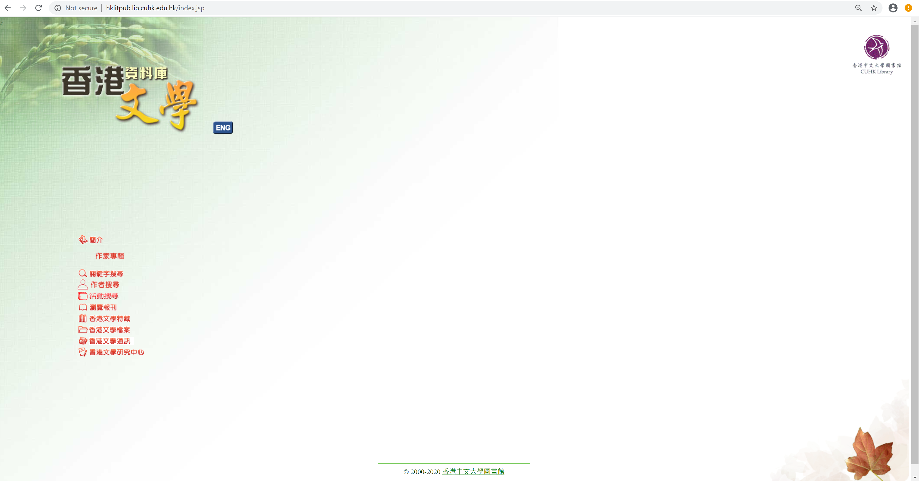
Hong Kong Literature Database (香港文學資料庫)
Summary
Number of records migrated | 587,919
Number of sources | ca. 3,716
Fulltext character counts (without space) | ca. 228,092,726
Time period covered | from 1921 to 2020
15 Jun 2000
HKLIT database official launched
8 Jan 2019
The first meeting of HKLIT Database Migration workgroup
9 Sept 2019
The first meeting of HKLIT “3Ds” (Discovery, Data & Digital Scholarship) Implementation Team
2 Nov. 2020
New HKLIT 3Ds beta database/portal launched

Slide 3
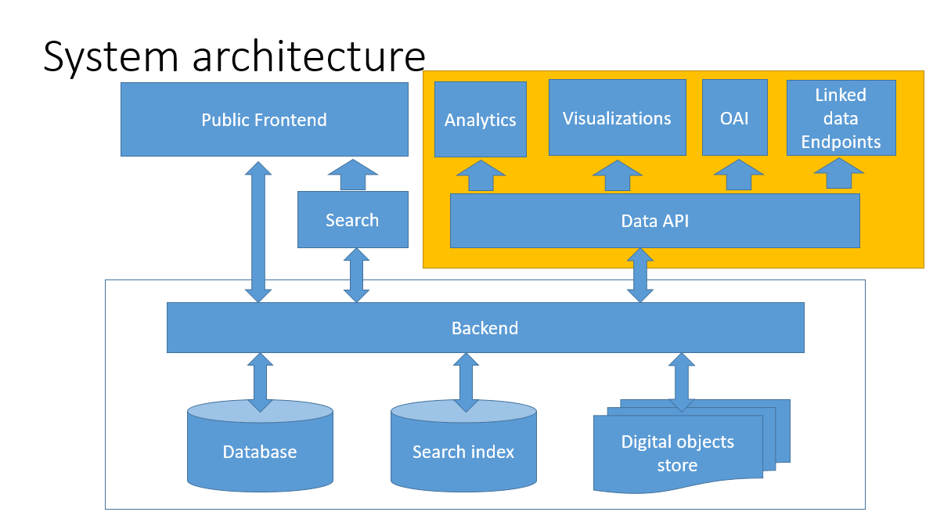
Goal: Develop a new platform for open DS infrastructure and redesign the data structure.
New system architecture supporting “3Ds” approach:
  Cutting edge Search engine (Discovery)
  Enhanced Author Data (Data)
  Linked data/visualizations/ Analytics (Digital Scholarship tools/infrastructure)

Slide 4
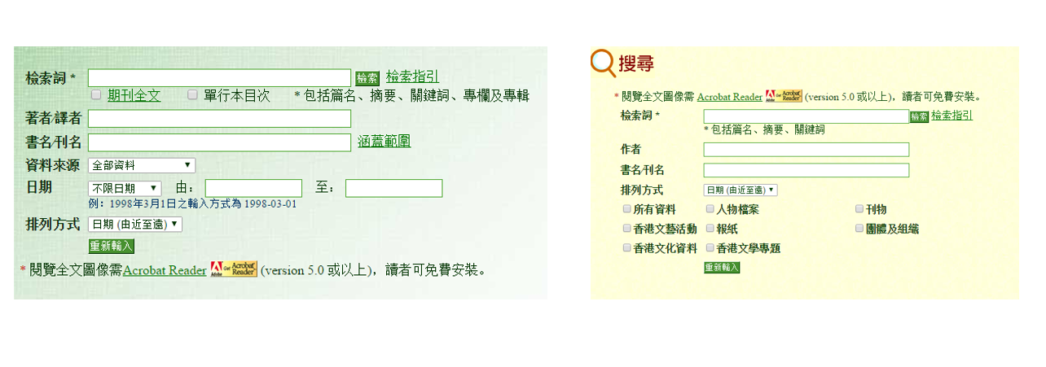
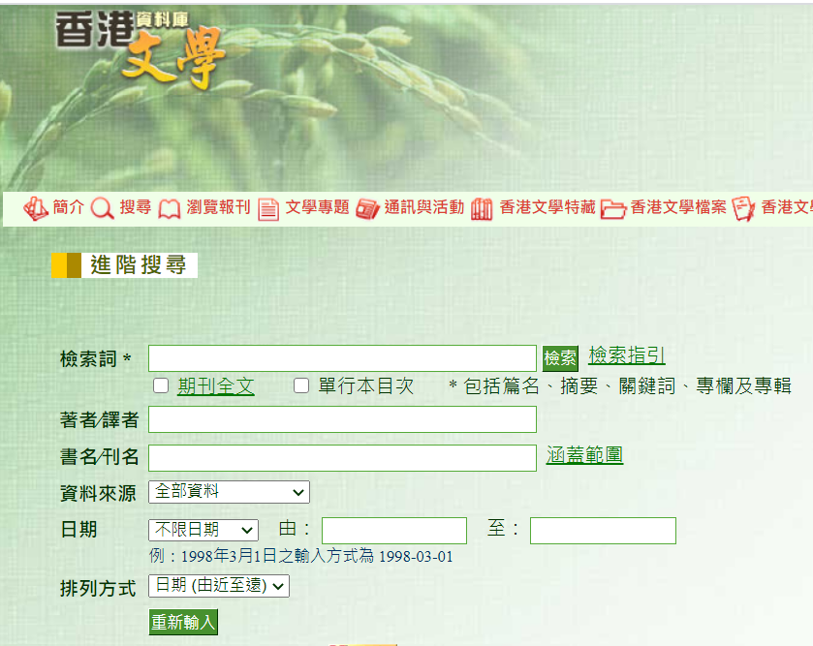
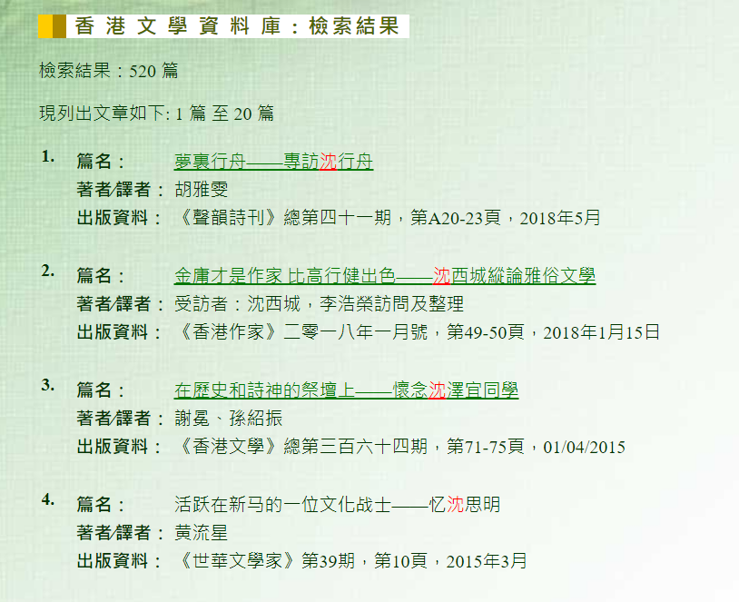
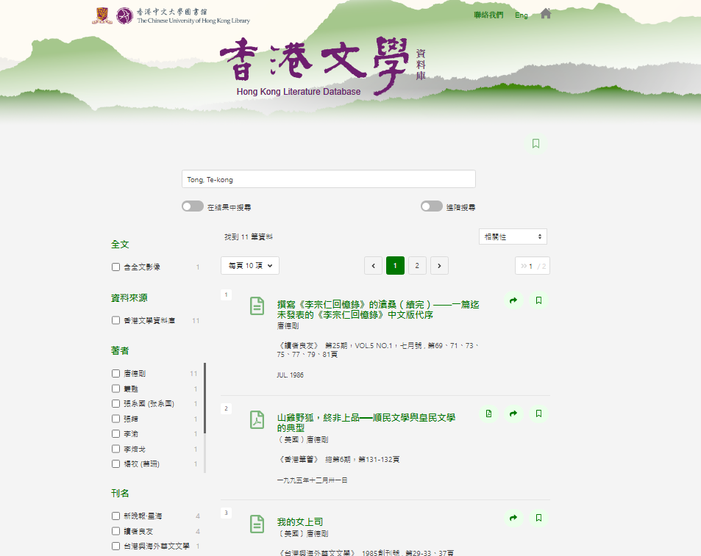
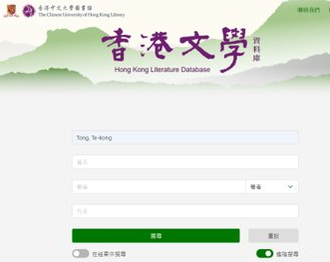
HKLIT 3Ds - Discovery
Portal: https://hklit-beta.lib.cuhk.edu.hk
Combines two data sets (香港文資料庫 & 香港文學檔案) into a single search index

Slide 5
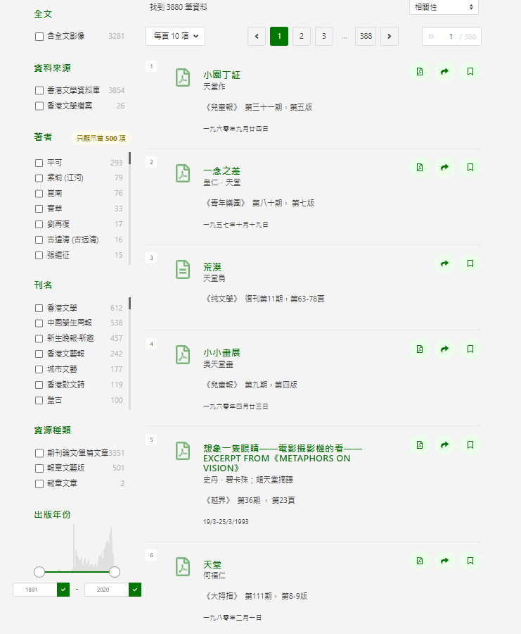
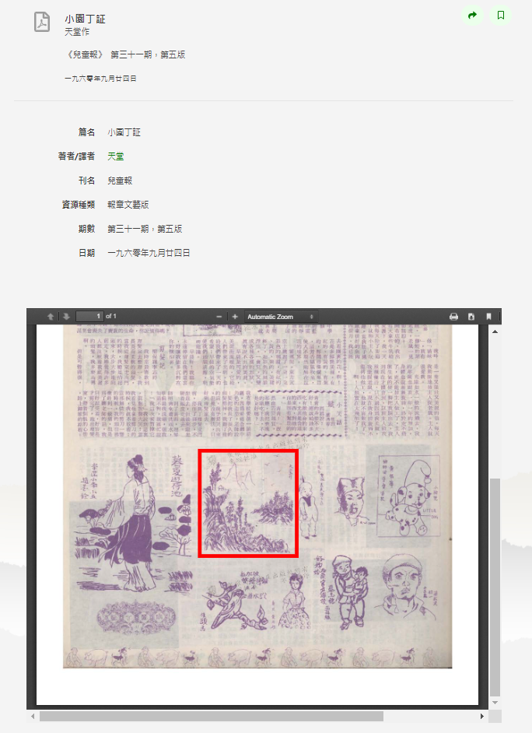

HKLIT 3Ds -Discovery:
  New search interface/facets - metadata revitalization by new technology
  Facets
  Result display/share
  Secondary search
  Smart Autofill
  PDF viewer

Slide 6
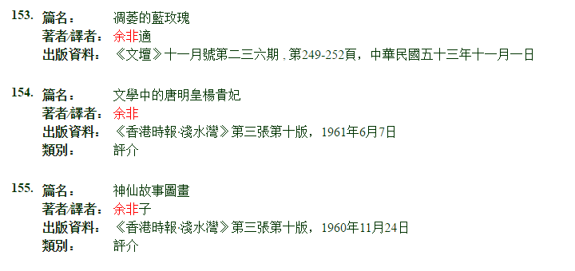
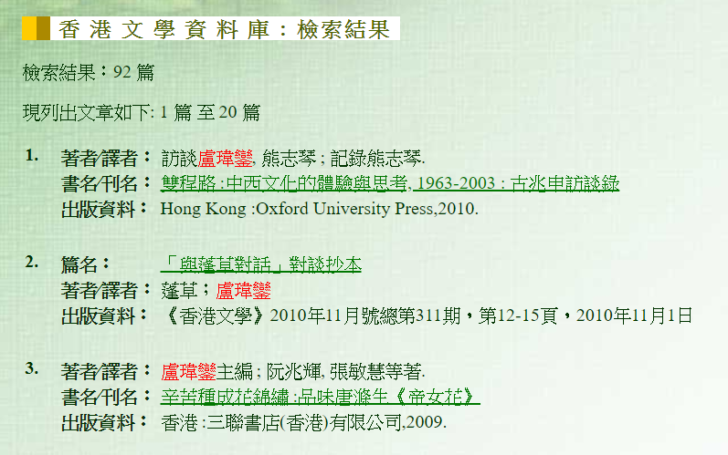
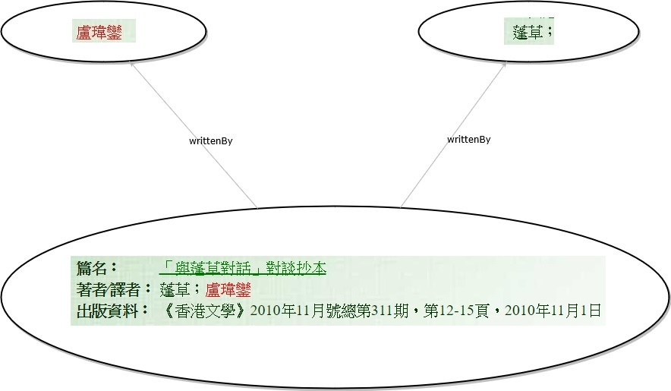
HKLIT 3Ds - Discovery
Person Names in Old HKLIT database before enhancement

Slide 7
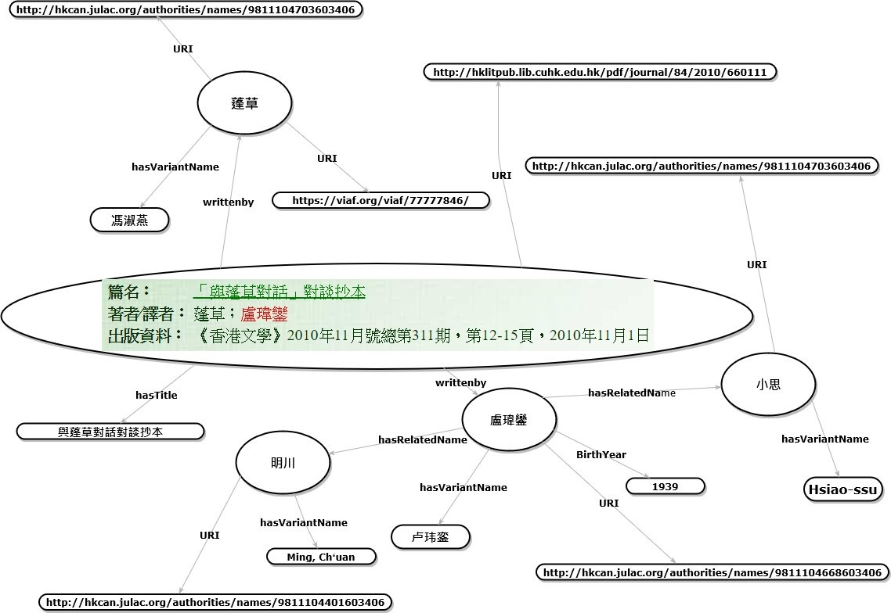
Enhanced Person Names in HKLIT

Slide 8
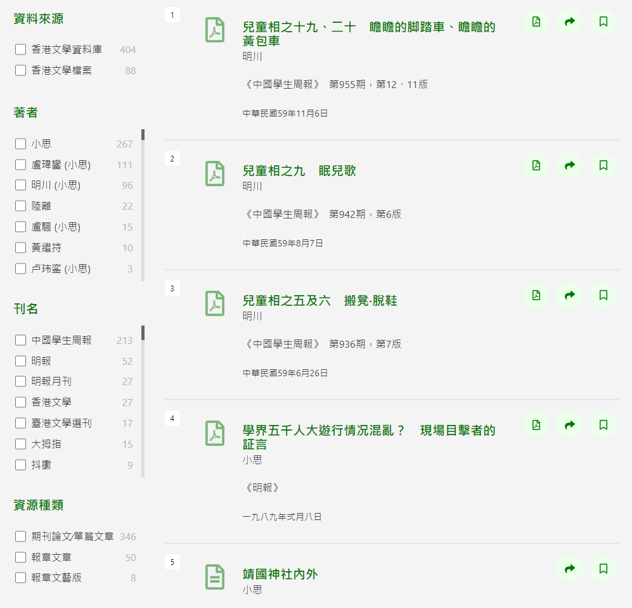
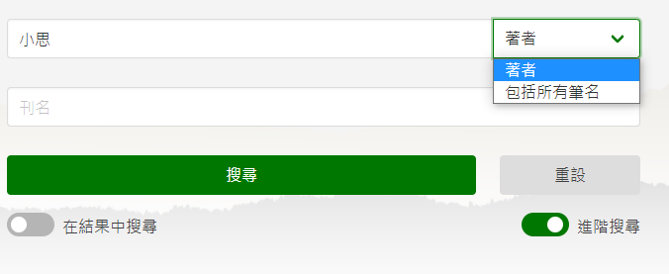
HKLIT 3Ds -
Discovery: Pen Name search
  Pen Name search (100,803 unique authors extracted) by Enhanced person names

Slide 9
HKLIT 3Ds – Data (Author name data) About the Created Name Dataset
Scope
Number of unique authors/contributors | ca. 100,803
Total number of original name or pseudonyms | ca. 163,652

Slide 10
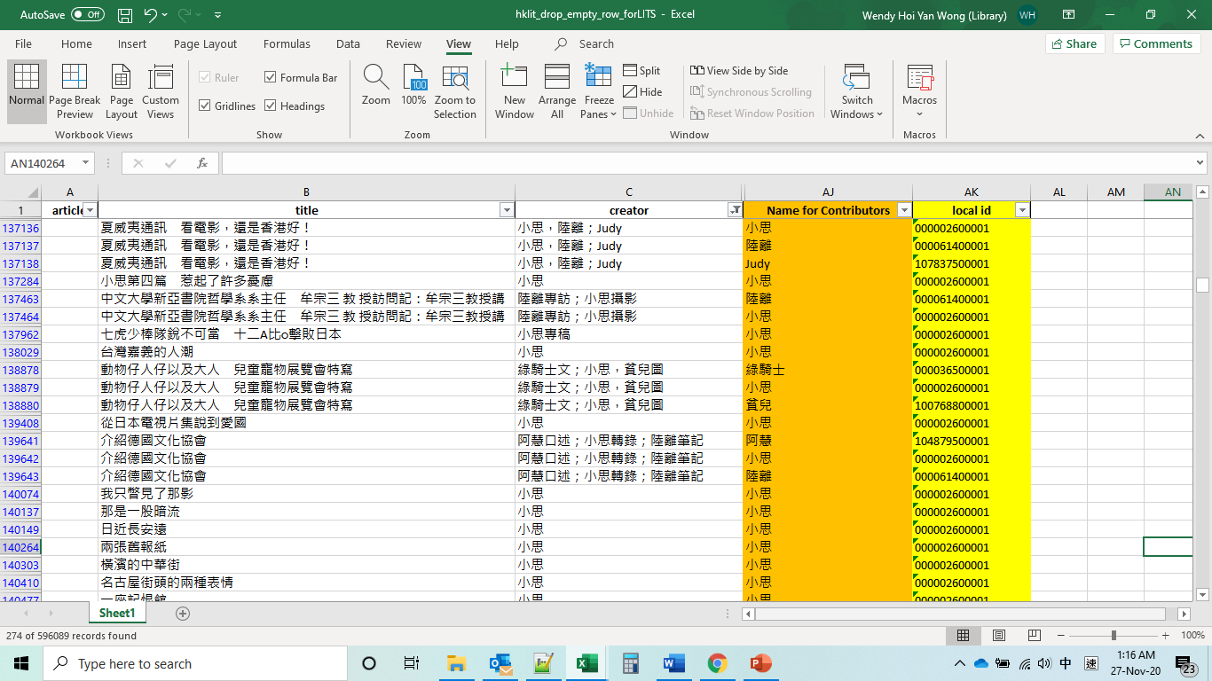
HKLIT 3Ds – Data (Author name data) Name Extractions from Metadata

Slide 11
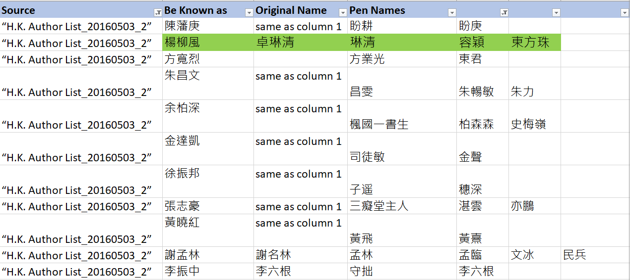
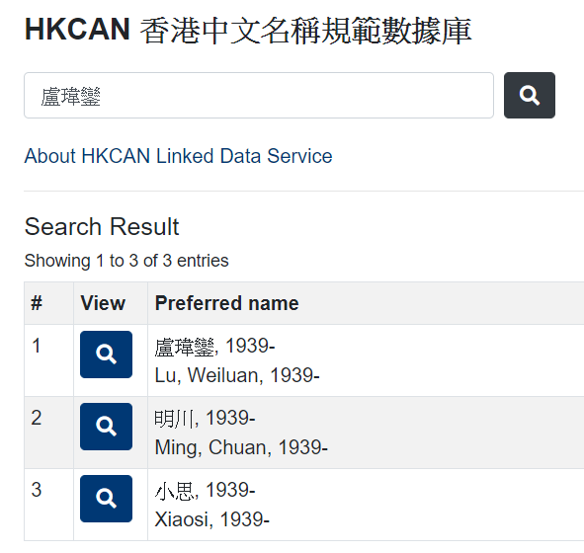
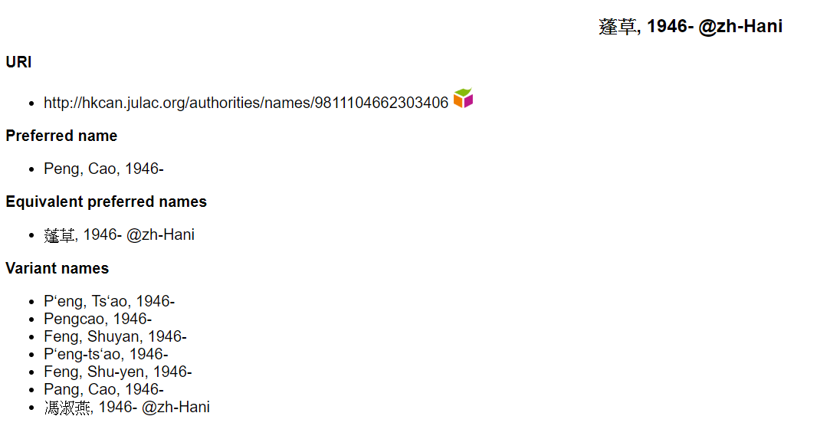
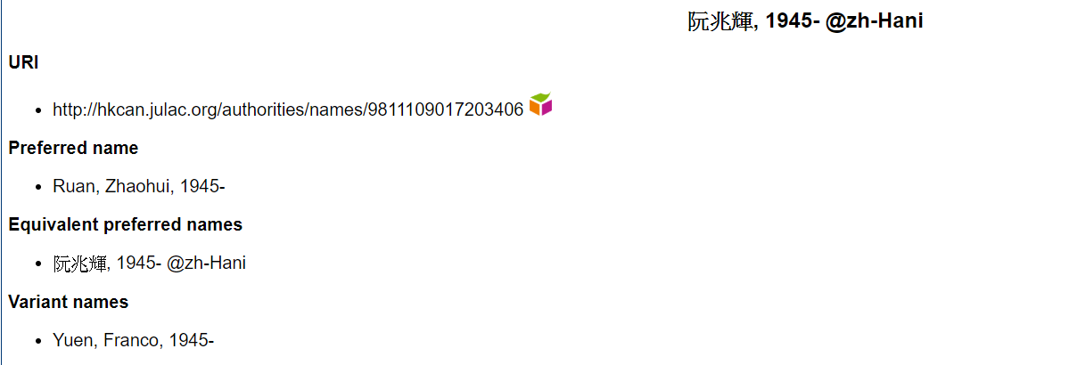
HKLIT 3Ds – Data (Author name data /Entity resolution)
Enhance Authors data index-作者筆名, 本名 linking consolidation by CU HKLIT author penname data, HKCAN & other name data sources

Slide 12
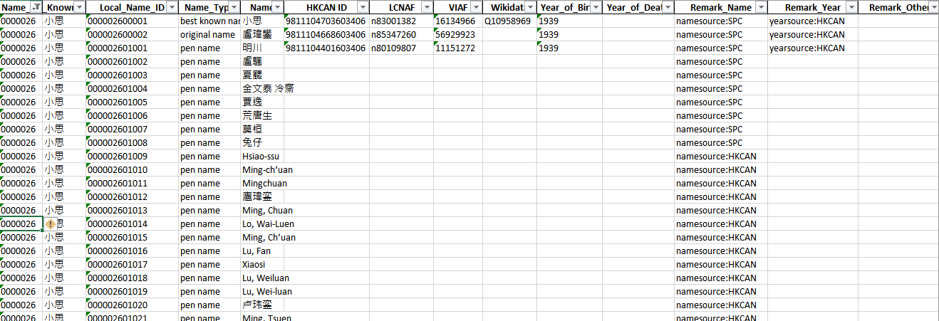
HKLIT 3Ds – Data (Author name data) Creating a Unique Names Dataset with IDs

Slide 13
HKLIT 3Ds – Data (bibliographical data & Full text)
Bibliographical data from HKLIT database or HK literature archive
Full text data for Text mining/Named entry recognition
Data in the HKLT Database
Number of records migrated | 587,919
Number of sources | ca. 3,716
Fulltext character counts (without space) | ca. 228,092,726
Time period covered | from 1921 to 2020

Slide 14
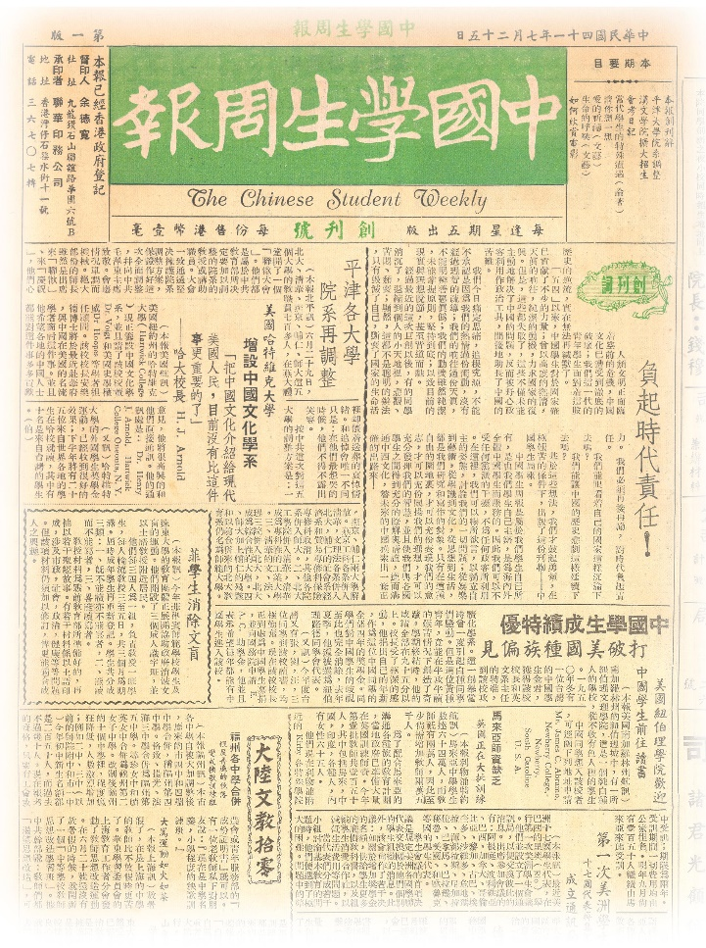
HKLIT 3Ds – Data (bibliographical data & Full text)
Example - The Chinese Student Weekly《中國學生周報》
Scope
Publication Date | 25.07.1952–20.07.1974
Publication Place | Hong Kong
Number of Issues* | 1,128
Number of Articles | 79,482
Fulltext Character Count | 58,784,831
*Note: some 1967 issues missing

Slide 15
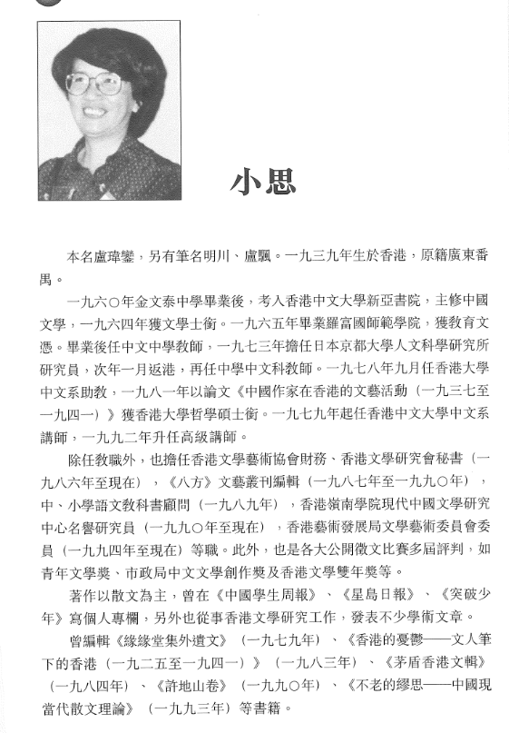
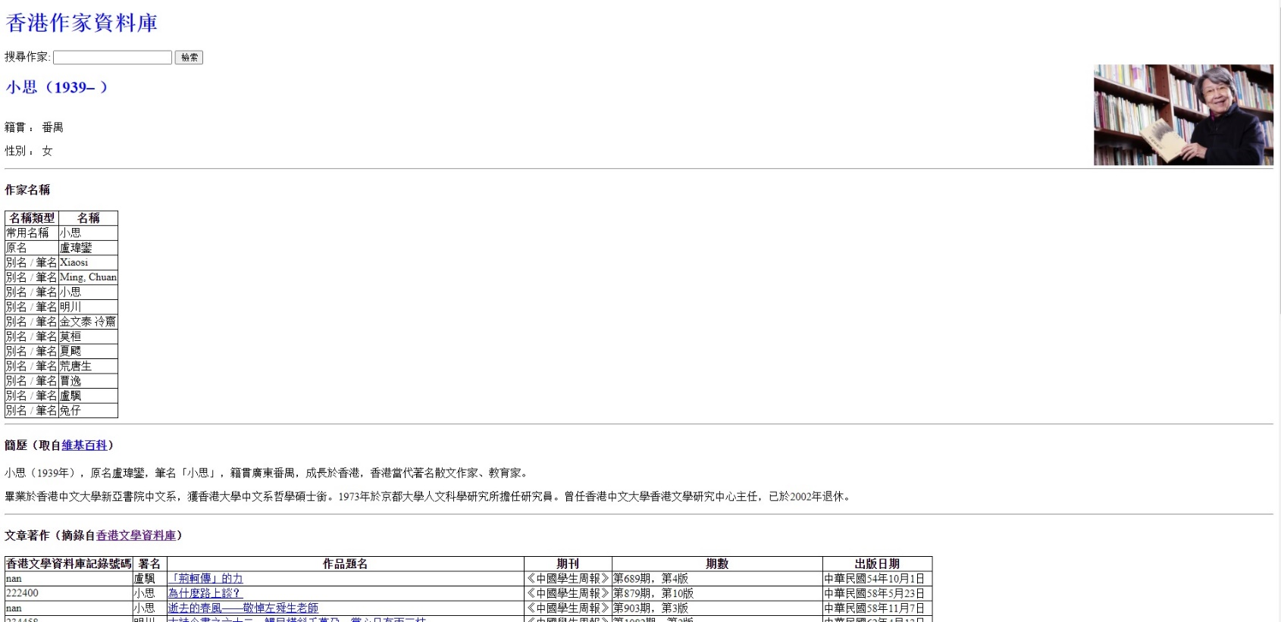
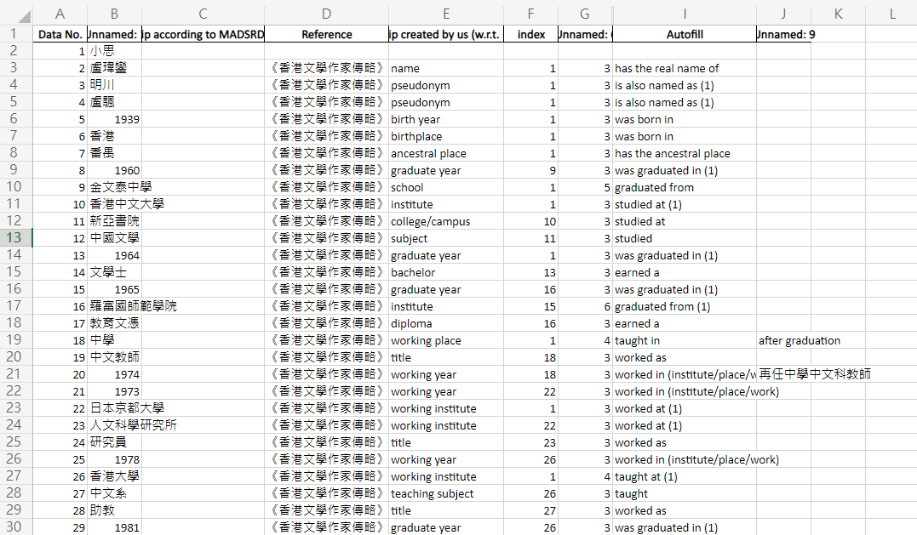
HKLIT 3Ds – Data (biographical data)
560 Hong Kong Writers from《香港作家傳略》 →Hong Kong Writers Profile (香港作家資料庫) for social network analysis

Slide 16
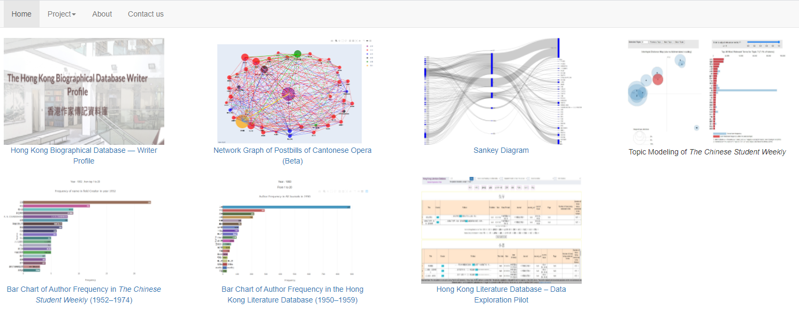
HKLIT 3Ds – Digital Scholarship tools

Slide 17
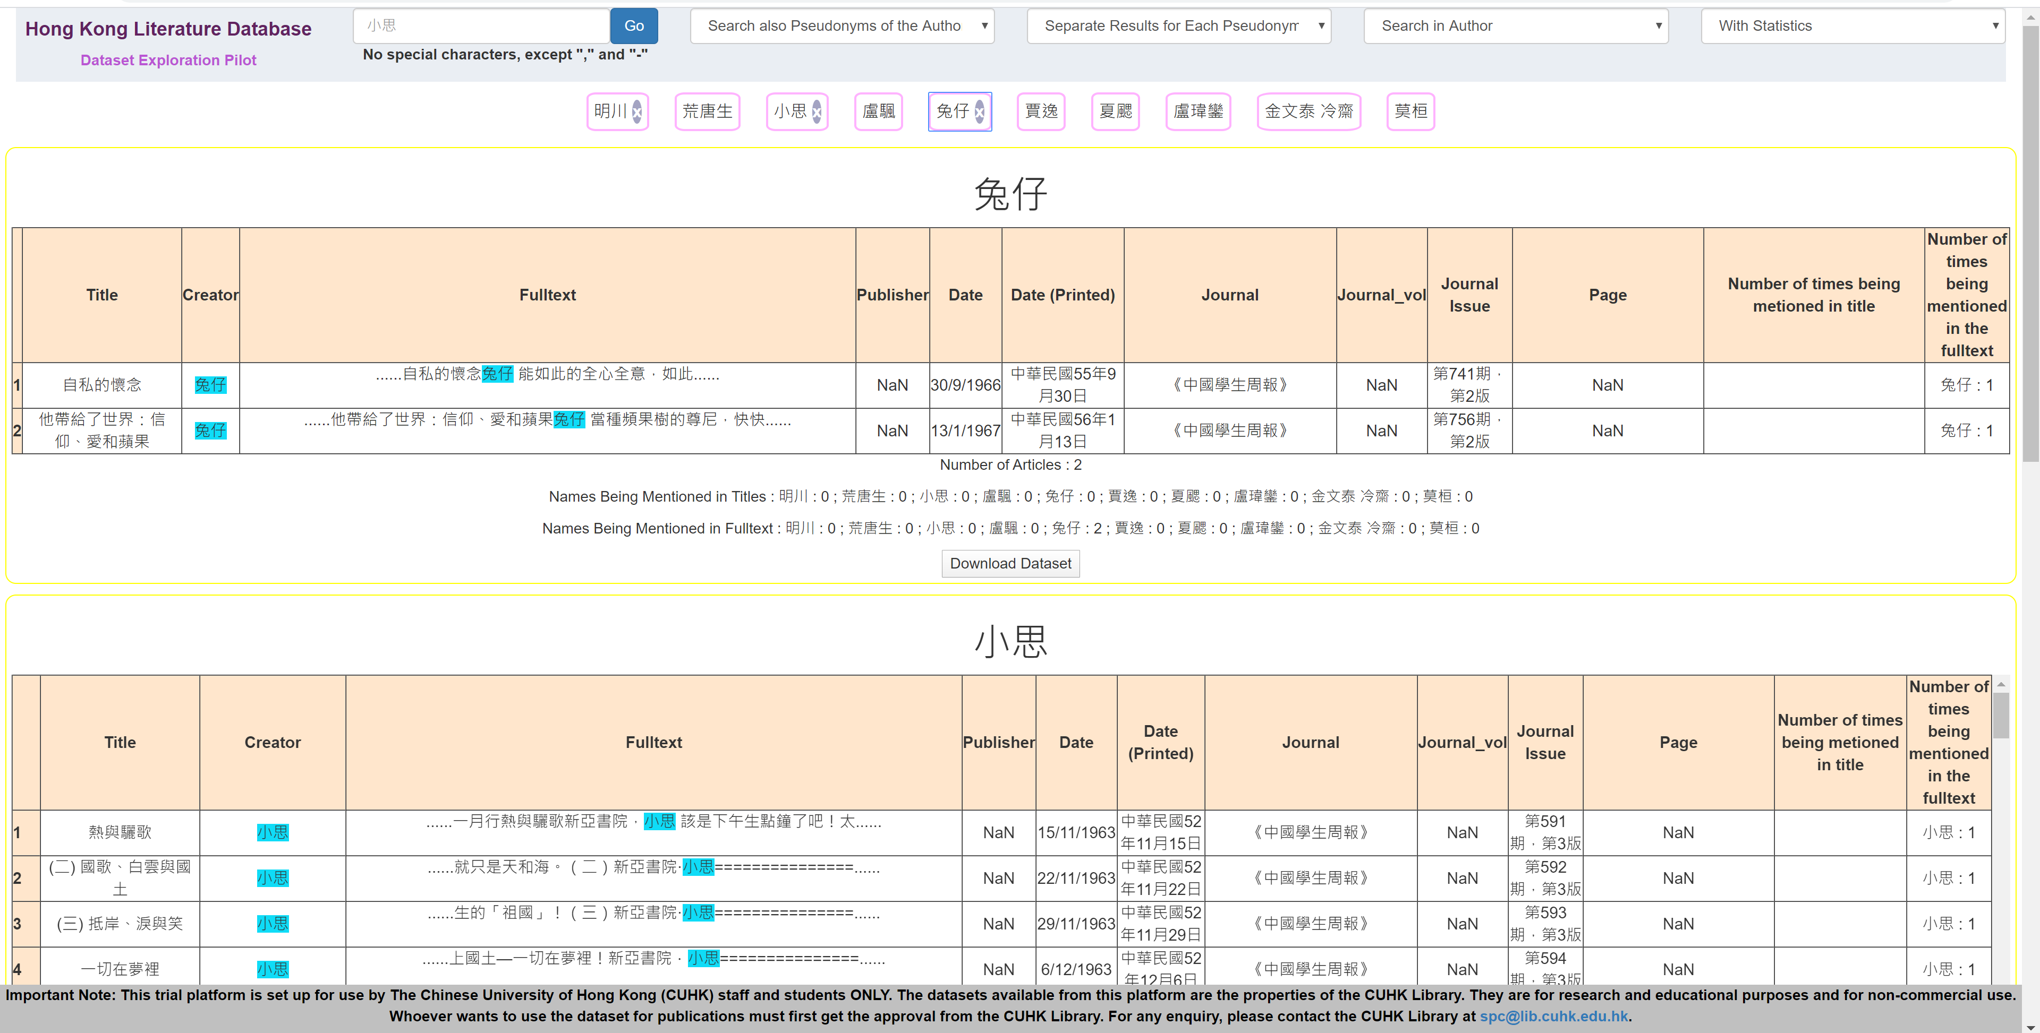
HKLIT 3Ds – Digital Scholarship tools
Data Exploration and Sharing

Slide 18
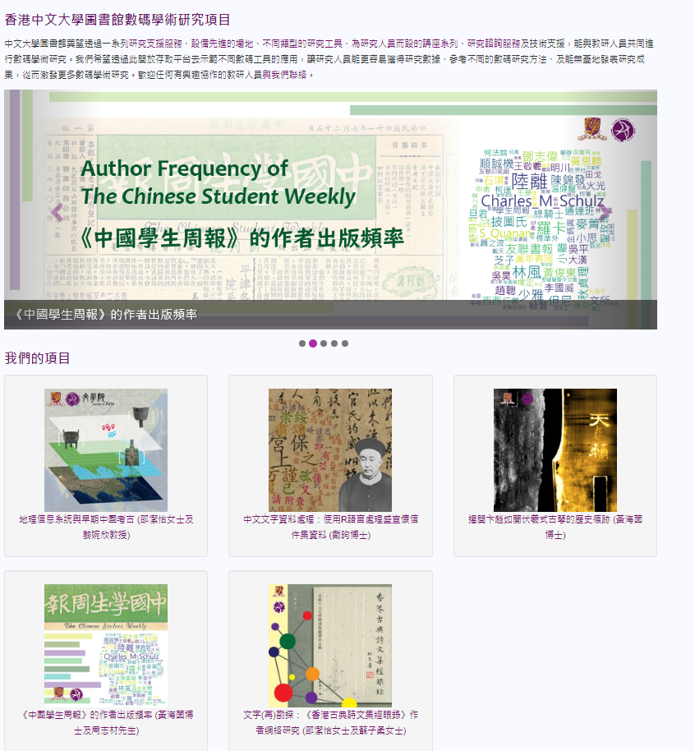
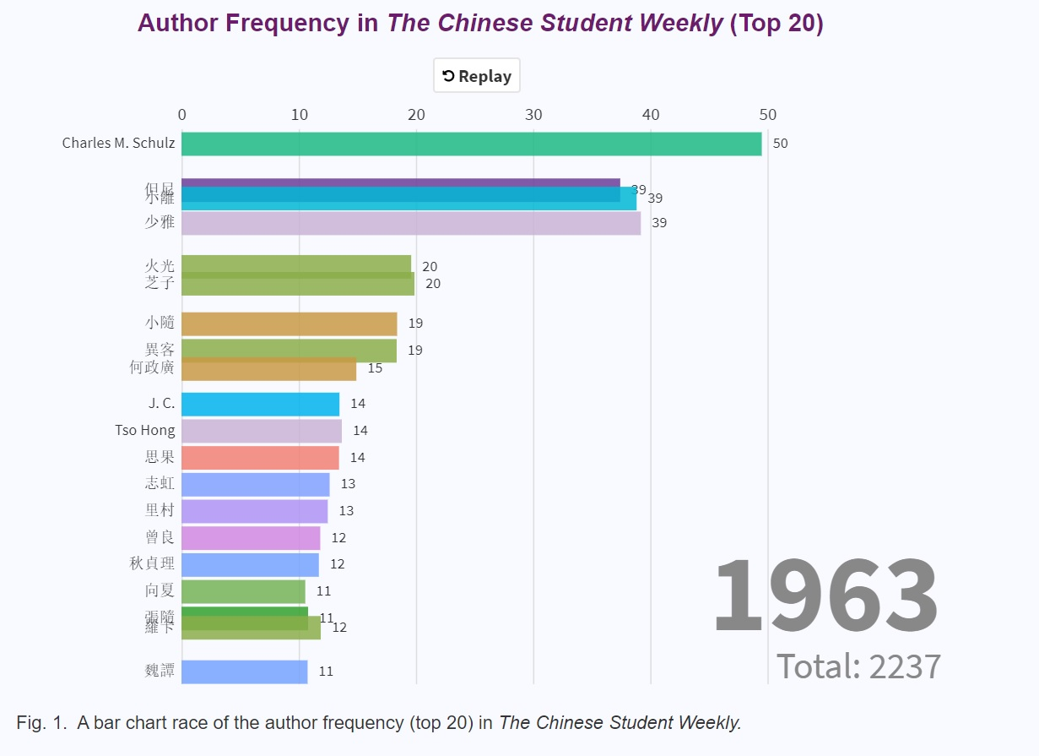
HKLIT 3Ds – Digital Scholarship tools
Bar Chart Race: Author Frequency of The Chinese Student Weekly
http://dsprojects.lib.cuhk.edu.hk/zh-hant/
projects/weekly-author-frequency

Slide 19
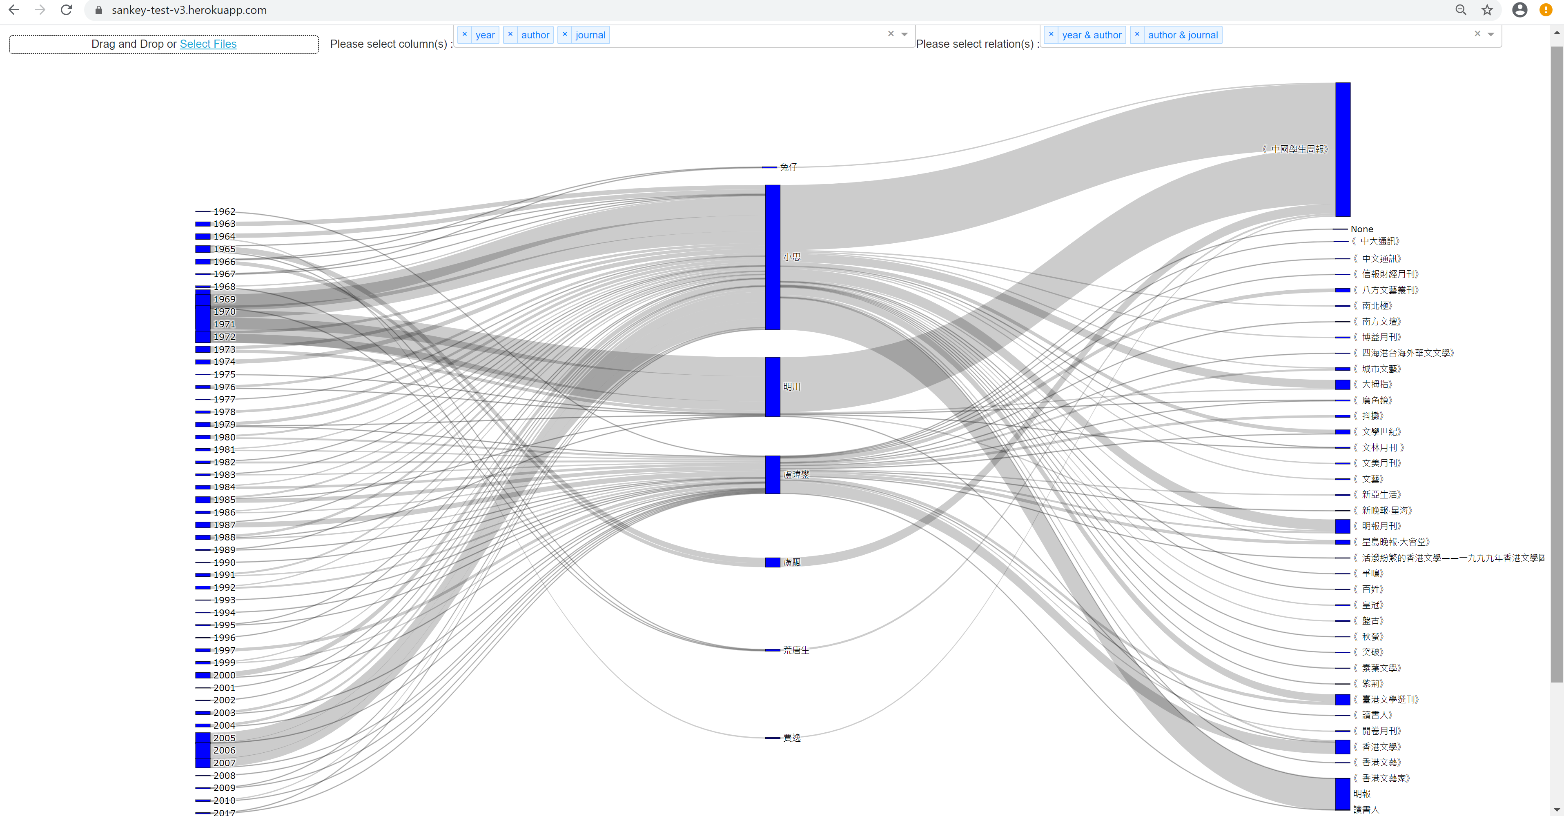
HKLIT 3Ds – Digital Scholarship tools
Sankey Graph: The Use of Pseudonyms by Xiaosi (小思)

Slide 20

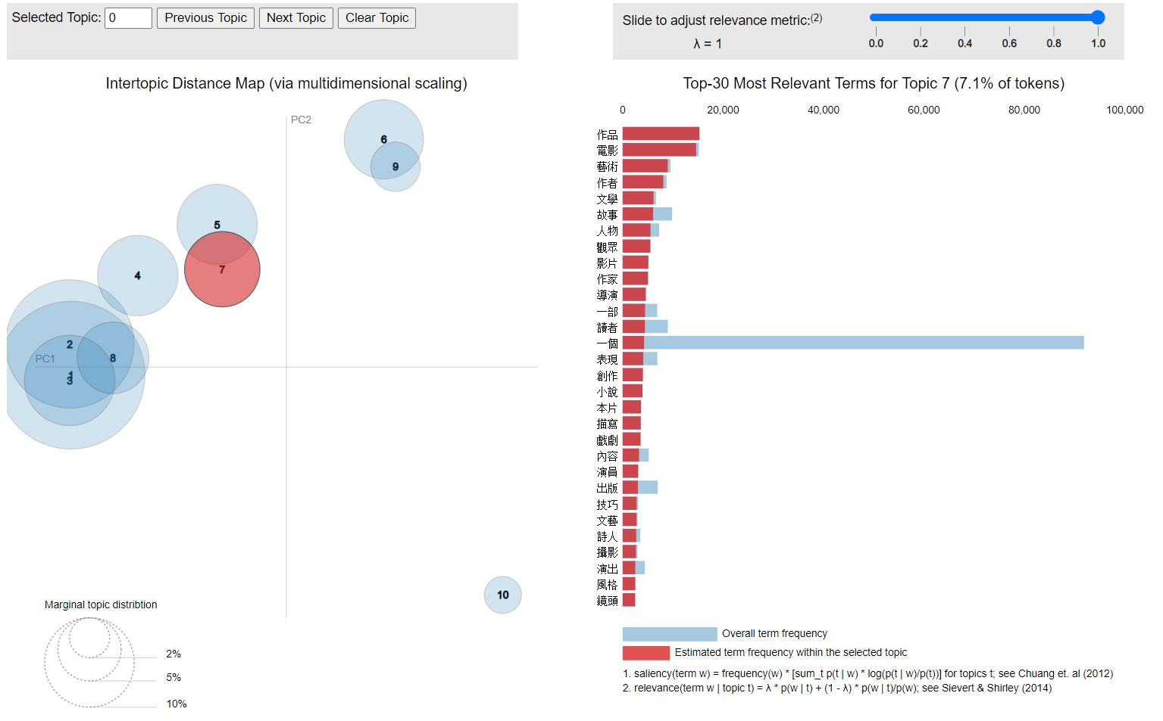

HKLIT 3Ds – Digital Scholarship tools
Wordclouds: Author Frequency /Topic Modeling of The Chinese Student Weekly
http://dsprojects.lib.cuhk.edu.hk/zh-hant/projects/weekly-author-frequency/

Slide 21
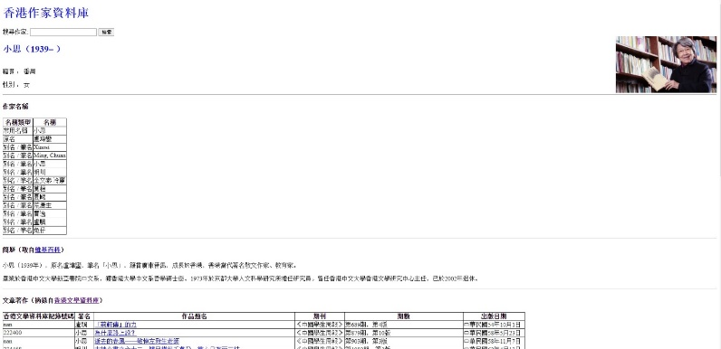
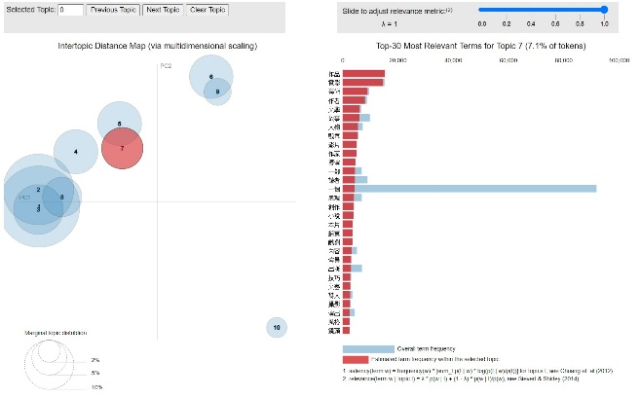
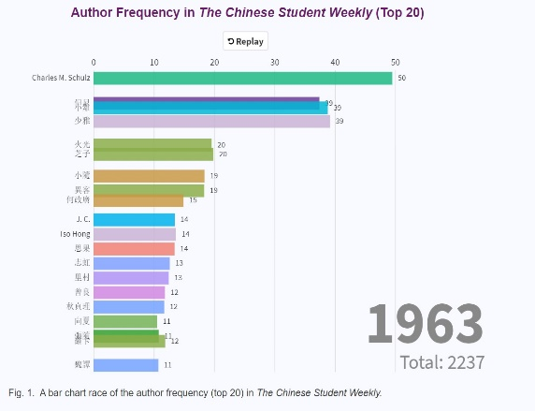
HKLIT 3Ds – Digital Scholarship Infrastructure
Data Sets: Author data, HKLIT data &HK Writer Profile
DS Tools: Visualization, data portal & text analysis
Open DS infrastructure – Unlock access to Knowledge across silos

Slide 22
HKLIT 3Ds – Digital Scholarship Infrastructure – Why Knowledge Graph?
Unlock access to Knowledge
Reveals the relationship in data
Logical reasoning and inference capabilities
Graphs supports continuous integration of data from multiple sources, allows end-users to query the graph effectively, and draws inferences across silos.
Graphs being closer to our mental models, make it easy to describe a data as real-world objects.
Graph databases are suited to irregular, complex structures; variation in the relationships storing at the individual-record level.
Unified different data sources for further analysis. is easier to change the data model in a graph database than it is in an RDBMS.
Improve library data discovery and support Machine Learning models.
Query and view the Graph data from any imaginable point of interest, supporting many different use cases.

Slide 23
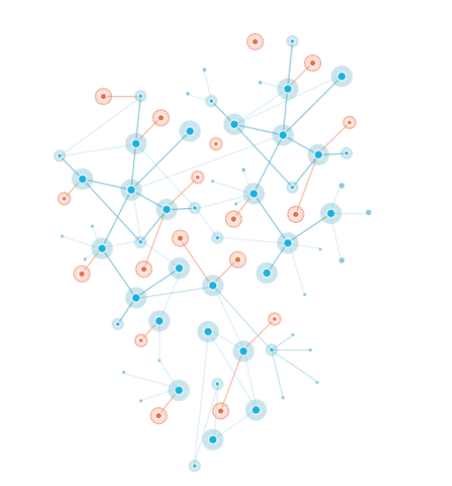
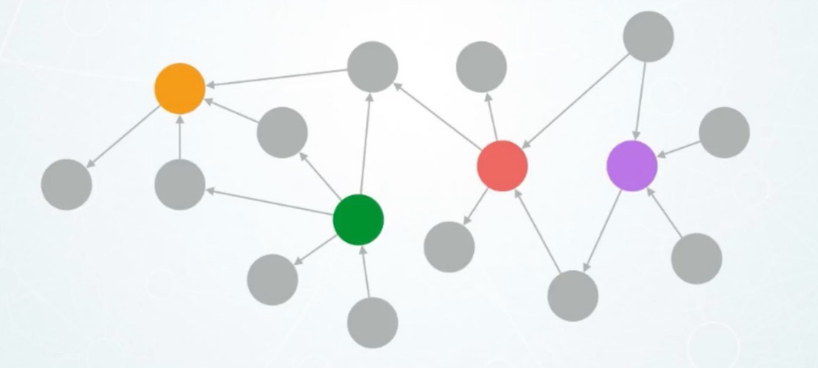
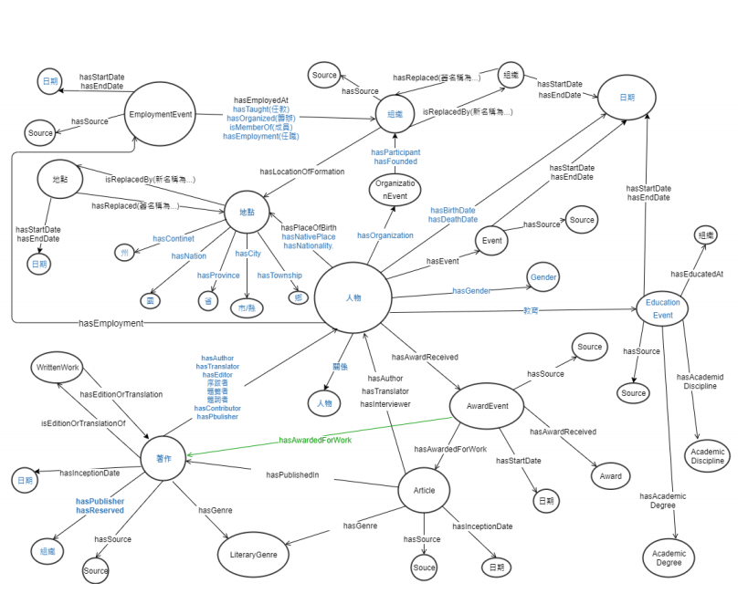
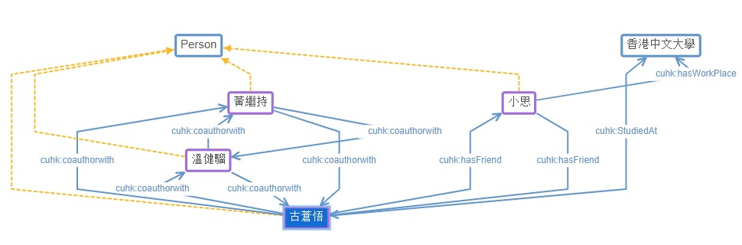
HKLIT 3Ds – Digital Scholarship Infrastructure
Knowledge Graph (KG) stores a domain’s data as entities and relationships using a graph model, which abides by an ontology.
A domain’s ontology defines its members (entities, relationships) and their properties in a way that resembles the real world.
Modelling HKlit data sets (Person/Organization/event/) in Ontology, including 《香港作家傳略》, 《香港古典詩文集經眼錄》, CU's pennames data set & HKLIT's data set.

Slide 24
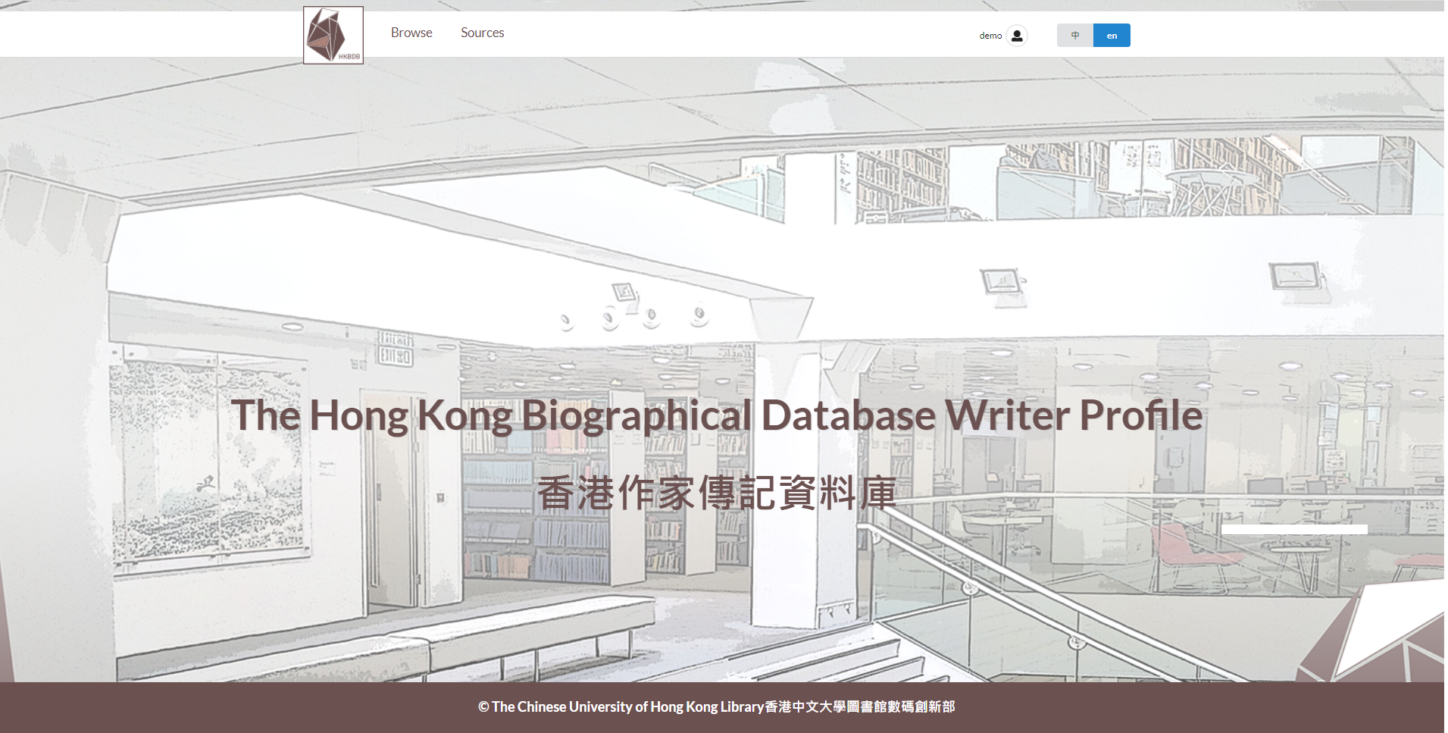
HKLIT 3Ds – Digital Scholarship Infrastructure
HKBDD – Writer Profile is made of a graph data store coupled with an Ontology as a subset of Hong Kong biographical database (HKBDB).
Visual layer - Open DS applications for HKLIT text Analysis and visualization tools (Basis biographical/ SNA/Timeline)
Query layer – Query language (i.e. SPARQL) to query data stored in KG (Complex queries to provide research insight)

Slide 25
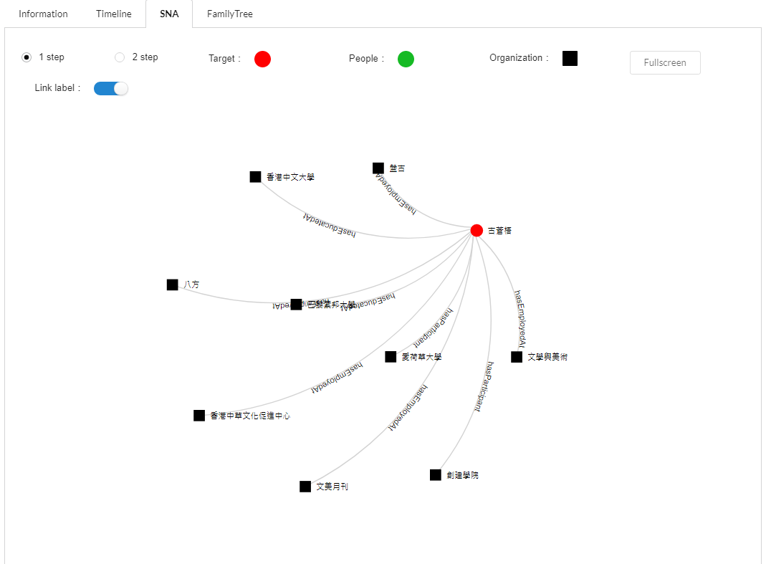
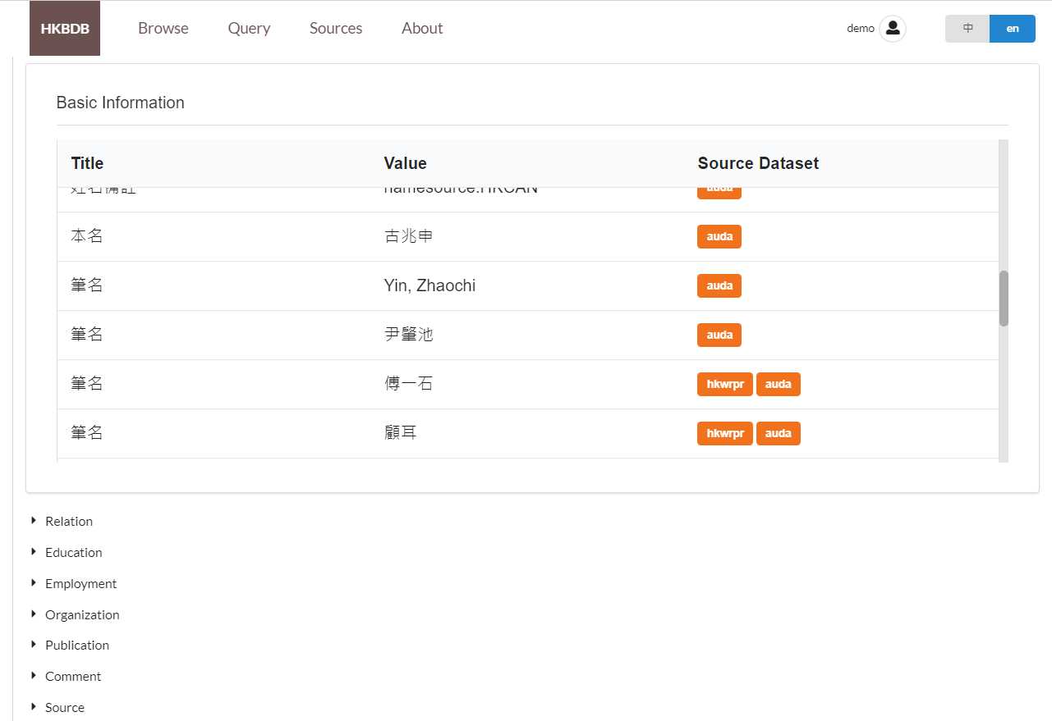
HKLIT 3Ds – Digital Scholarship Infrastructure

Slide 26
HKLIT 3Ds – Digital Scholarship Infrastructure
Potential for future development:
  HKBDB’s Knowledge Graph (Public data) open to HKLIT researcher to integrate with their research data (private data).
  Continuous integration of HK related data sets from multiple sources and of different formats, from structured (i.e. excel) E.g. Hong Kong Visual art Yearbooks and unstructured (i.e. text) e.g. Who's who in HK.
  Transfers to connected data (Linked Open Data) linking to GLAM's resources.
  Provides a host of advanced features such as semantic search (Linked data endpoint) and support Machine Learning (ML).
Hk Studies/Cultural studies
Linking to GLAM's resources
HK biographical database
Semantic search/ML

Slide 27
Special Thanks:
HKLIT “3Ds” implementation team members : ​
1. Ryun Lee, chairperson​
2. Leo Ma, liaison with faculty of Dept. Of Chinese Literature, provide feedback on system/UAT.​
3. Alex Chan, system development and support, Data/Digital object migration.​
4. Vincent Lum, system development and support, Data/Digital object migration.​
5. Wendy Wong, project leader of two HKLIT sub-projects (HKLIT Creators mapping & HK writers Profiles).​
6. Joe Chow, development support for two HKLIT sub-projects (HKLIT Creators mapping & HK writers Profiles).​
7. PL Chan, provides feedback on HKLIT data ingestion workflow and UAT; HK writers data cleansing, Liaison with SC.​
8. Maria Lau, liaison with other stakeholders and provides feedback on system/UAT.​
9. LF Li, liaison with other stakeholders and provides feedback on system/UAT.

Slide 28
Thank you
Comments and Questions
Email: ryunlee@cuhk.edu.hk

