Slide 1



PolyU OER Portal:
Collective Wisdom for Sustainable & Scalable Pedagogical Innovations
Open Educational
Resources OER
Resource List
2021 JULAC Libraries Forum

Slide 2
01
02
OER, Open Science, & OA
OER from IL perspective
03
04
PolyU RESOURCE LIST
POLYU OER PORTAL

Slide 3
01.
OER, Open Science,
& OA
Mystery

Slide 4
OER (noun)
“… Teaching, learning, and research materials in any medium, digital or otherwise, that reside in the public domain or have been released under an open license that permits no-cost access, redistribution, use, & adaptation by others with no or limited restrictions."
UNESCO's 2002 Forum on Open Courseware

Slide 5
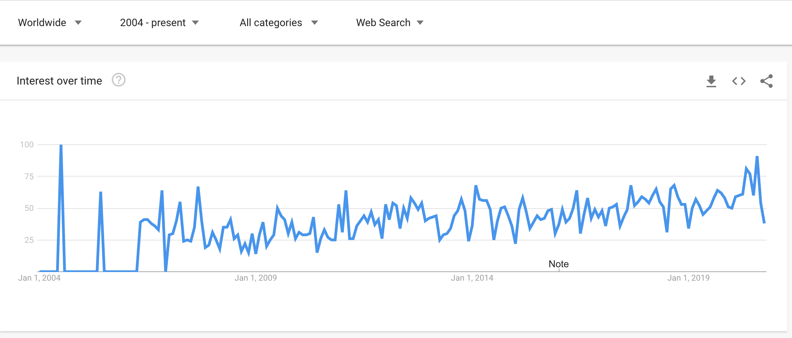
“Open Educational Resources”
The term “Open Educational Resources (OER)” was coined by 2002 UNESCO Forum
Cape Town Open Education Declaration 2007
2012 Paris OER Declaration
UNESCO OER Dynamic Coalition Consultations

Slide 6
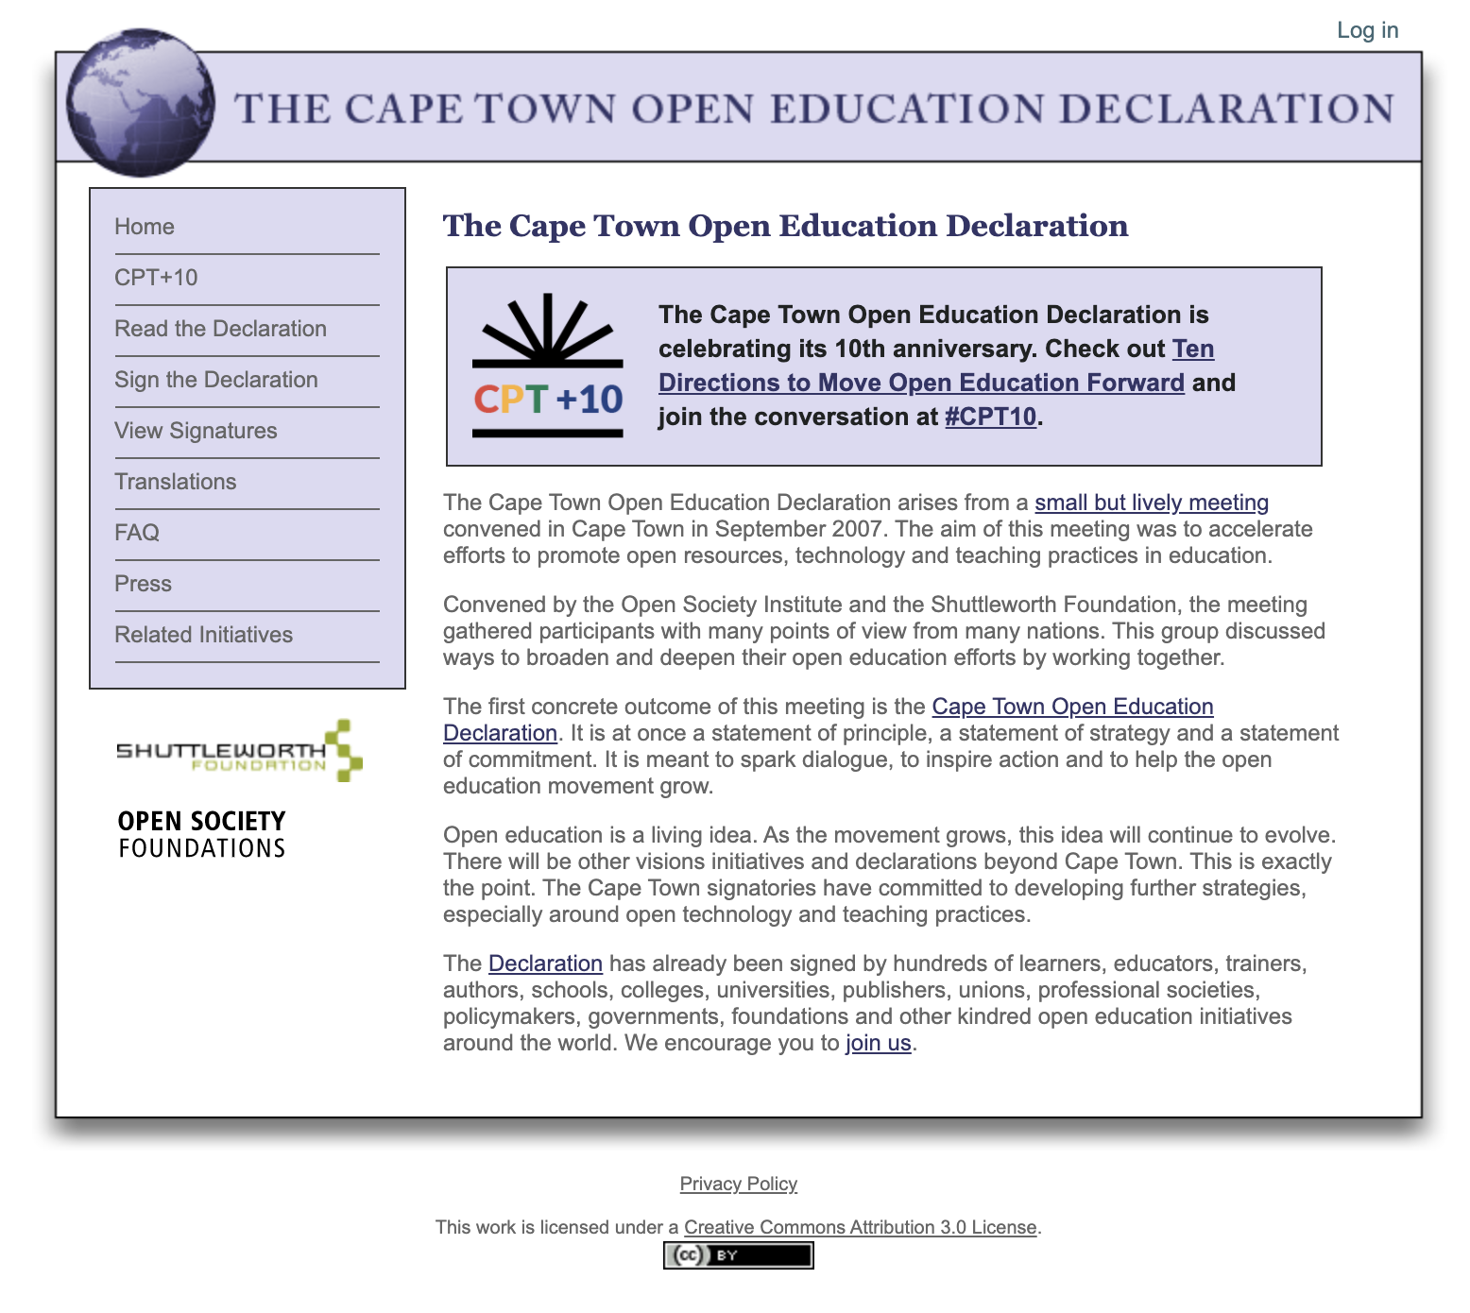
2007
Open education is not limited to just open educational resources. It also draws upon open technologies that facilitate collaborative, flexible learning and the open sharing of teaching practices that empower educators to benefit from the best ideas of their colleagues. It may also grow to include new approaches to assessment, accreditation and collaborative learning. Understanding and embracing innovations like these is critical to the long term vision of this movement.

Slide 7
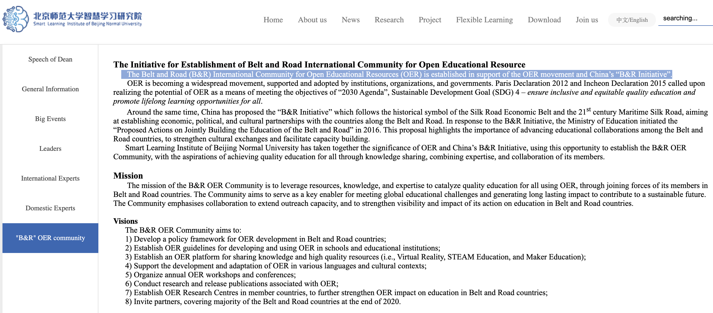
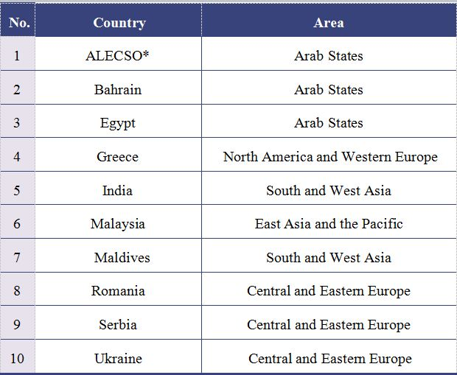
“Belt & Road Initiative” OER Community

Slide 8
Open Science
Open science encompasses unhindered access to scientific articles, access to data from public research, and collaborative research enabled by ICT tools and incentives.
Broadening access to scientific publications and data is at the heart of open science, so that research outputs are in the hands of as many as possible, and potential benefits are spread as widely as possible.
https://www.oecd.org/science/inno/open-science.htm

Slide 9
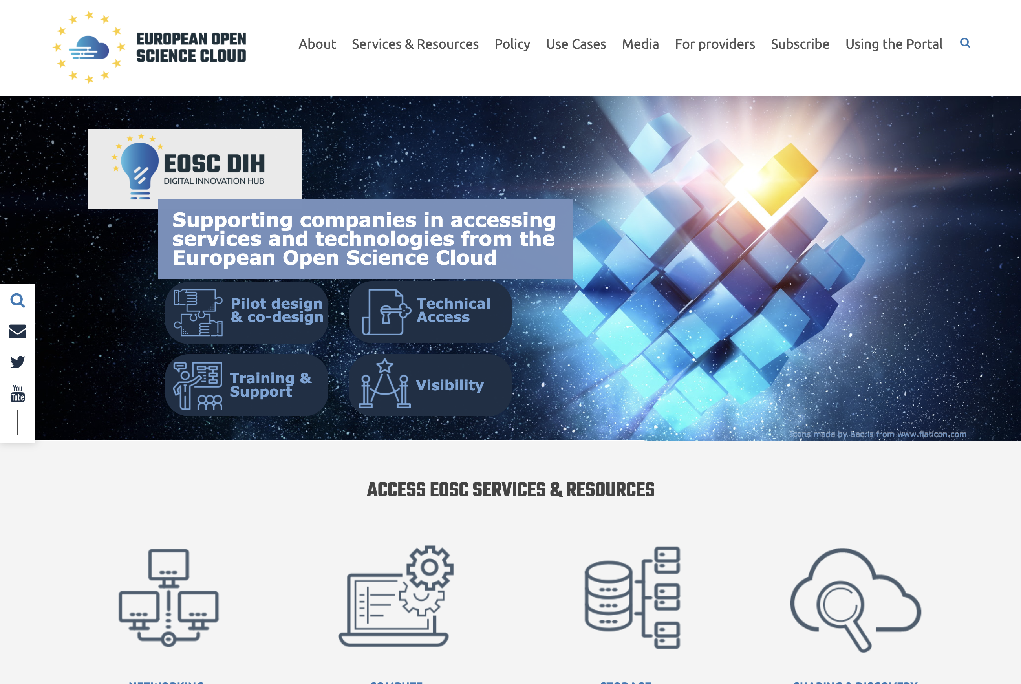
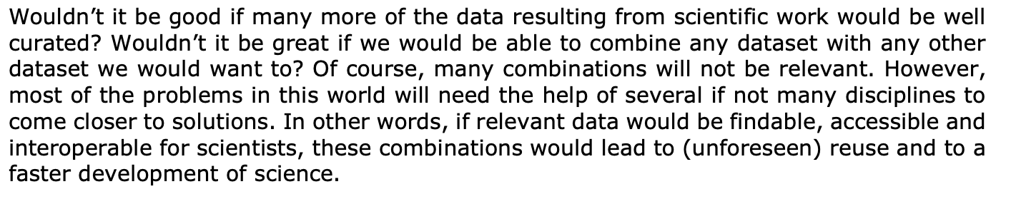
European Open Science Cloud (EOSC) launched 2016
A virtual commons where science producers and science consumers come together for more insights, new ideas and more innovation.
https://www.eosc-portal.eu/

Slide 10
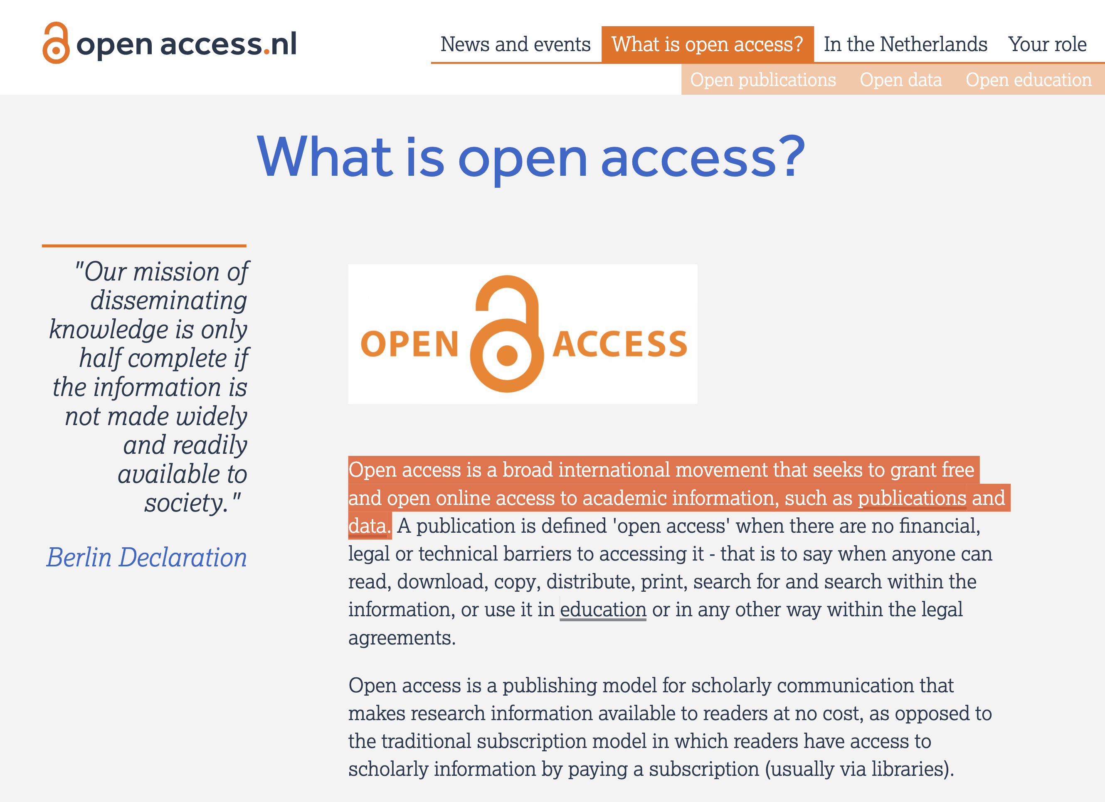

Slide 11
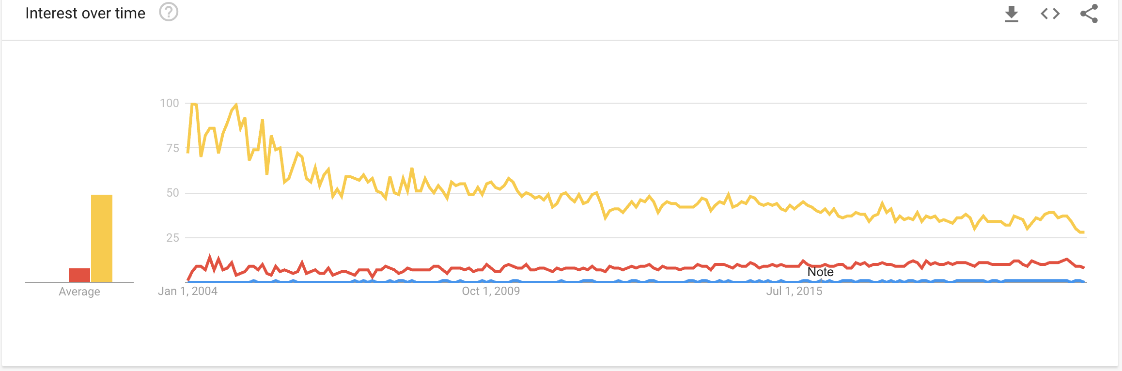
“OER” vs. “Open Science” vs. “Open Access”
From Google Word Trend

Slide 12
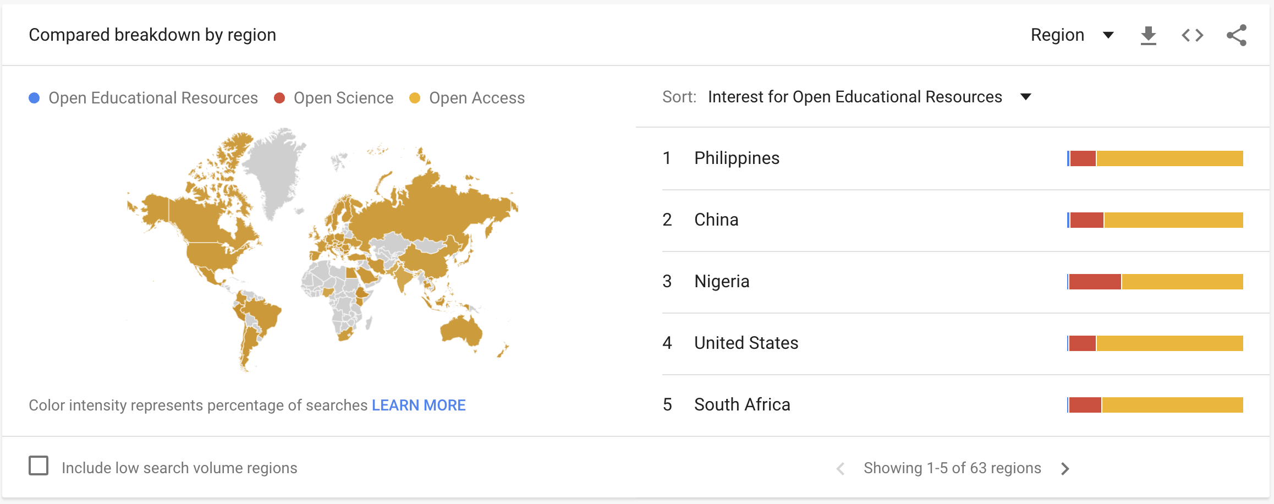
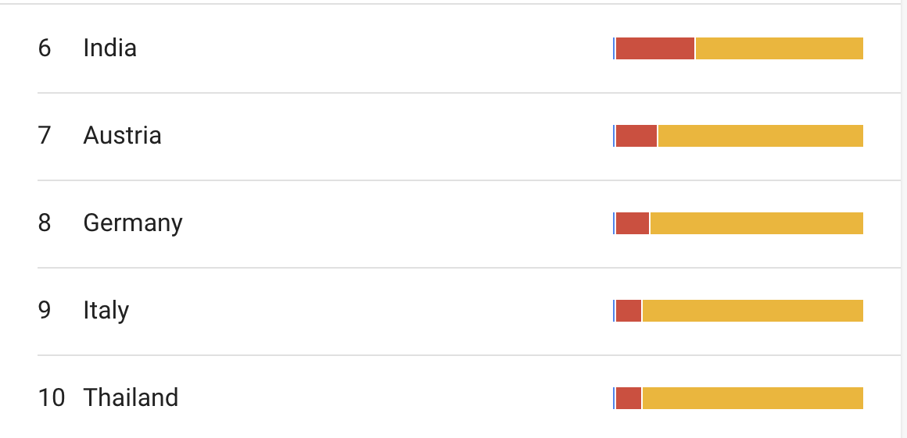

Slide 13
02.
OER = Adding more resources into T&L?
Mystery

Slide 14
2007
Open education is not limited to just open educational resources. It also draws upon open technologies that facilitate collaborative, flexible learning and the open sharing of teaching practices that empower educators to benefit from the best ideas of their colleagues. It may also grow to include new approaches to assessment, accreditation and collaborative learning. Understanding and embracing innovations like these is critical to the long term vision of this movement.

Slide 15
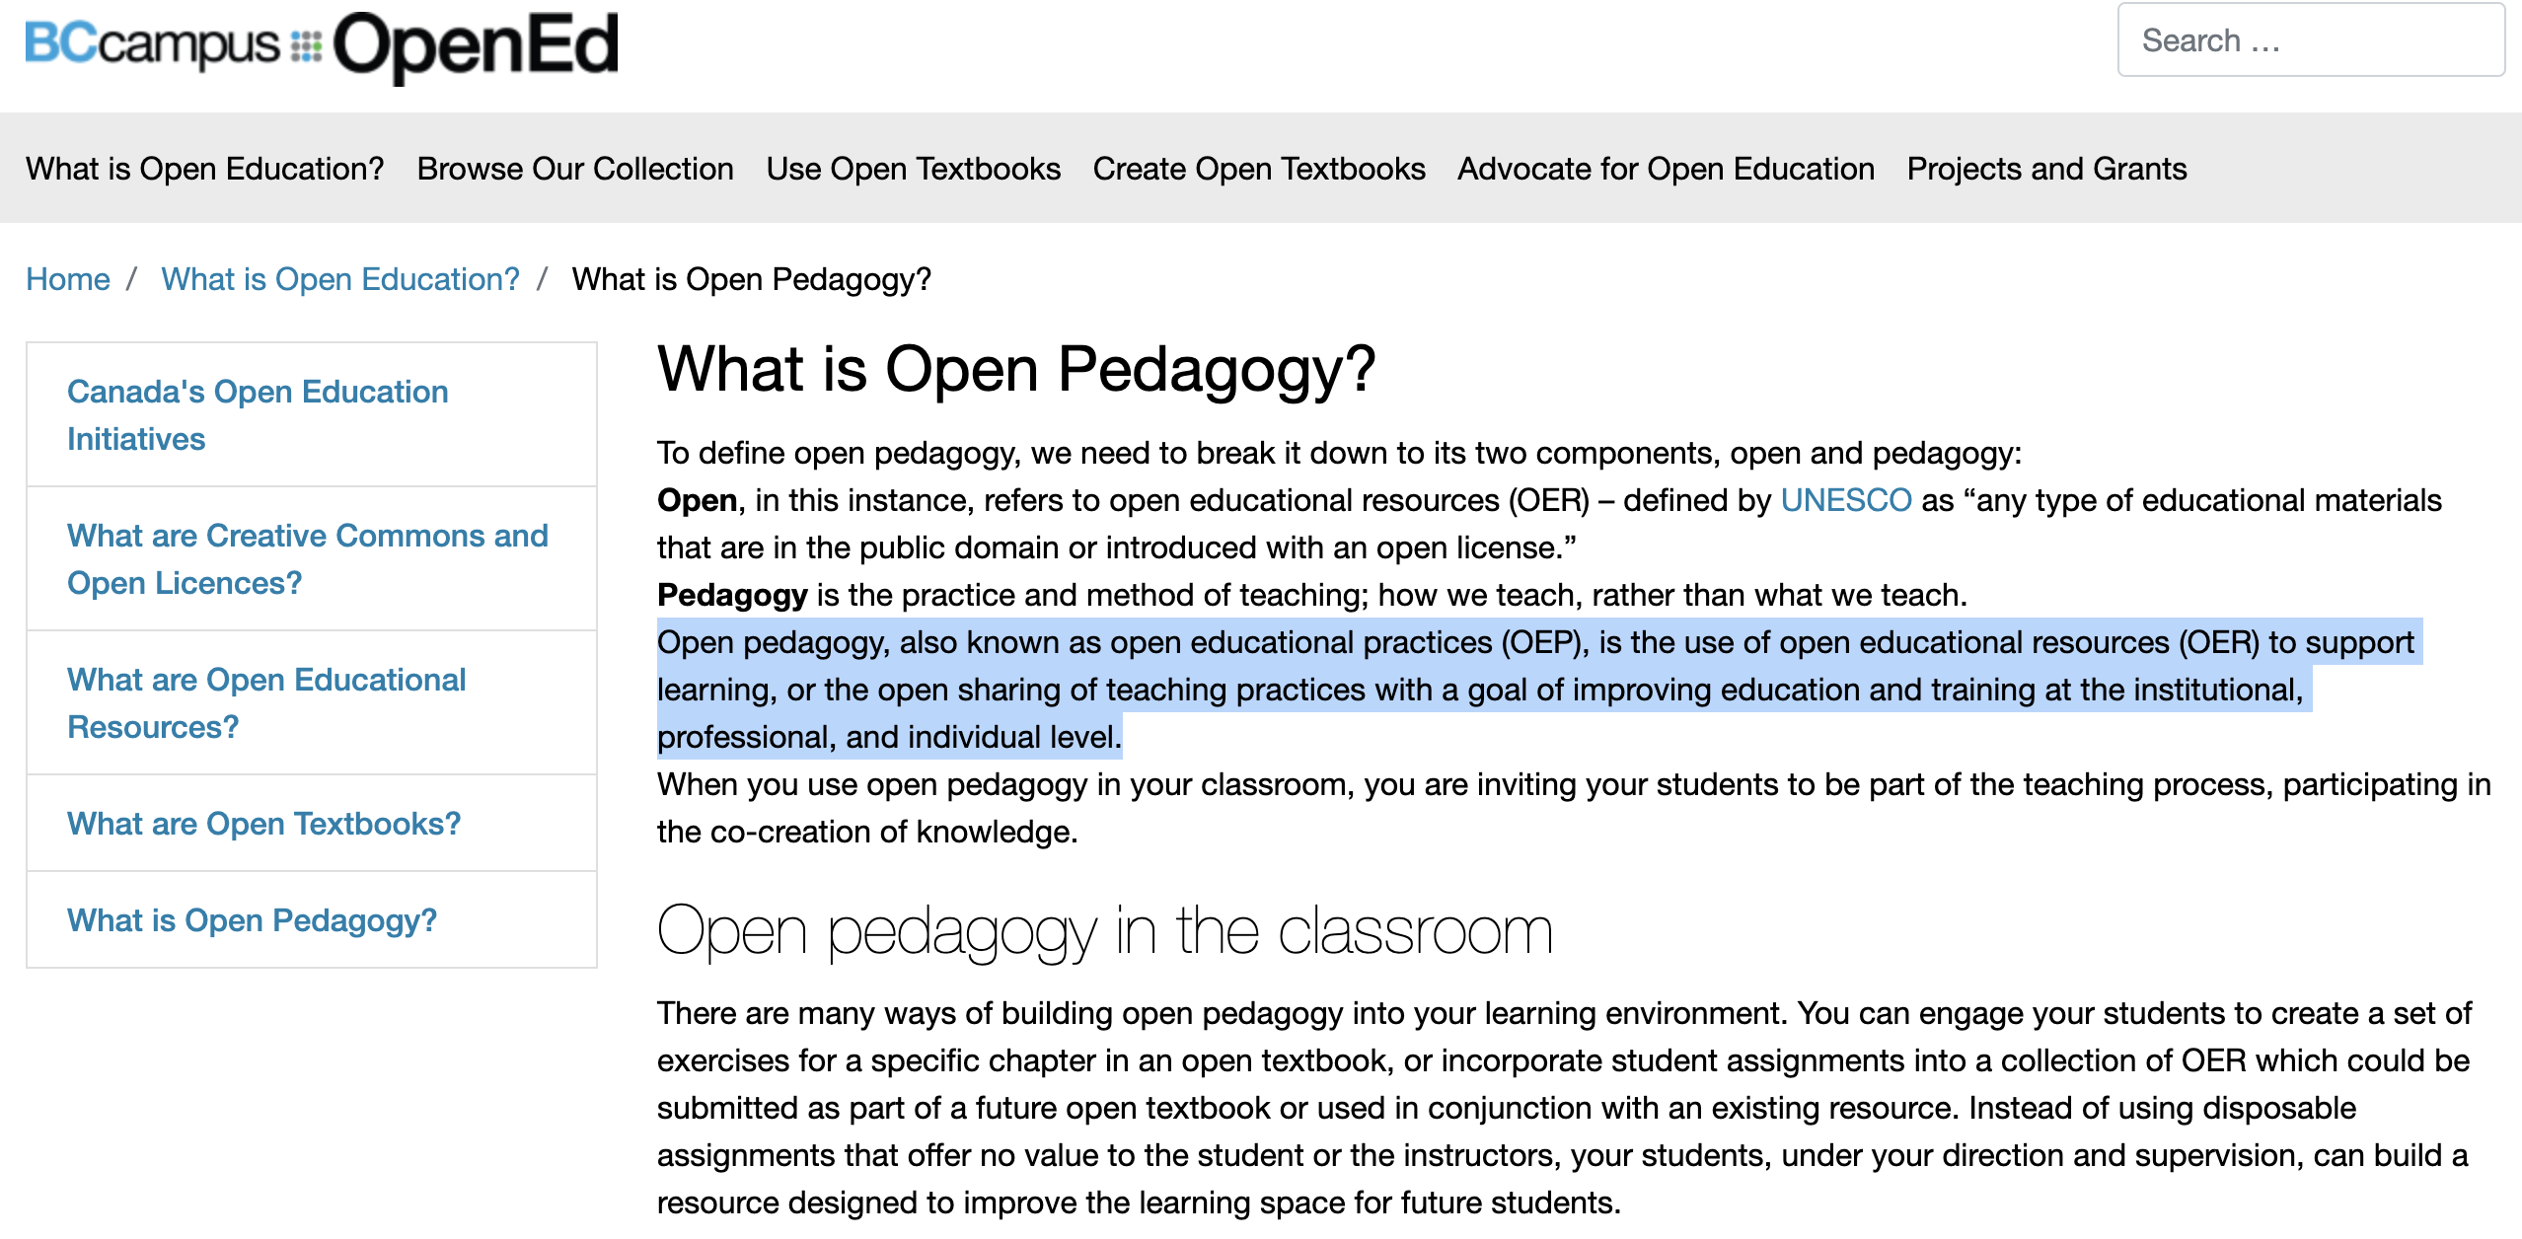
Open Pedagogy
Open pedagogy, also known as open educational practices (OEP), is the use of open educational resources (OER) to support learning, or the open sharing of teaching practices with a goal of improving education and training at the institutional, professional, and individual level.

Slide 16
What we used to do…

Slide 17
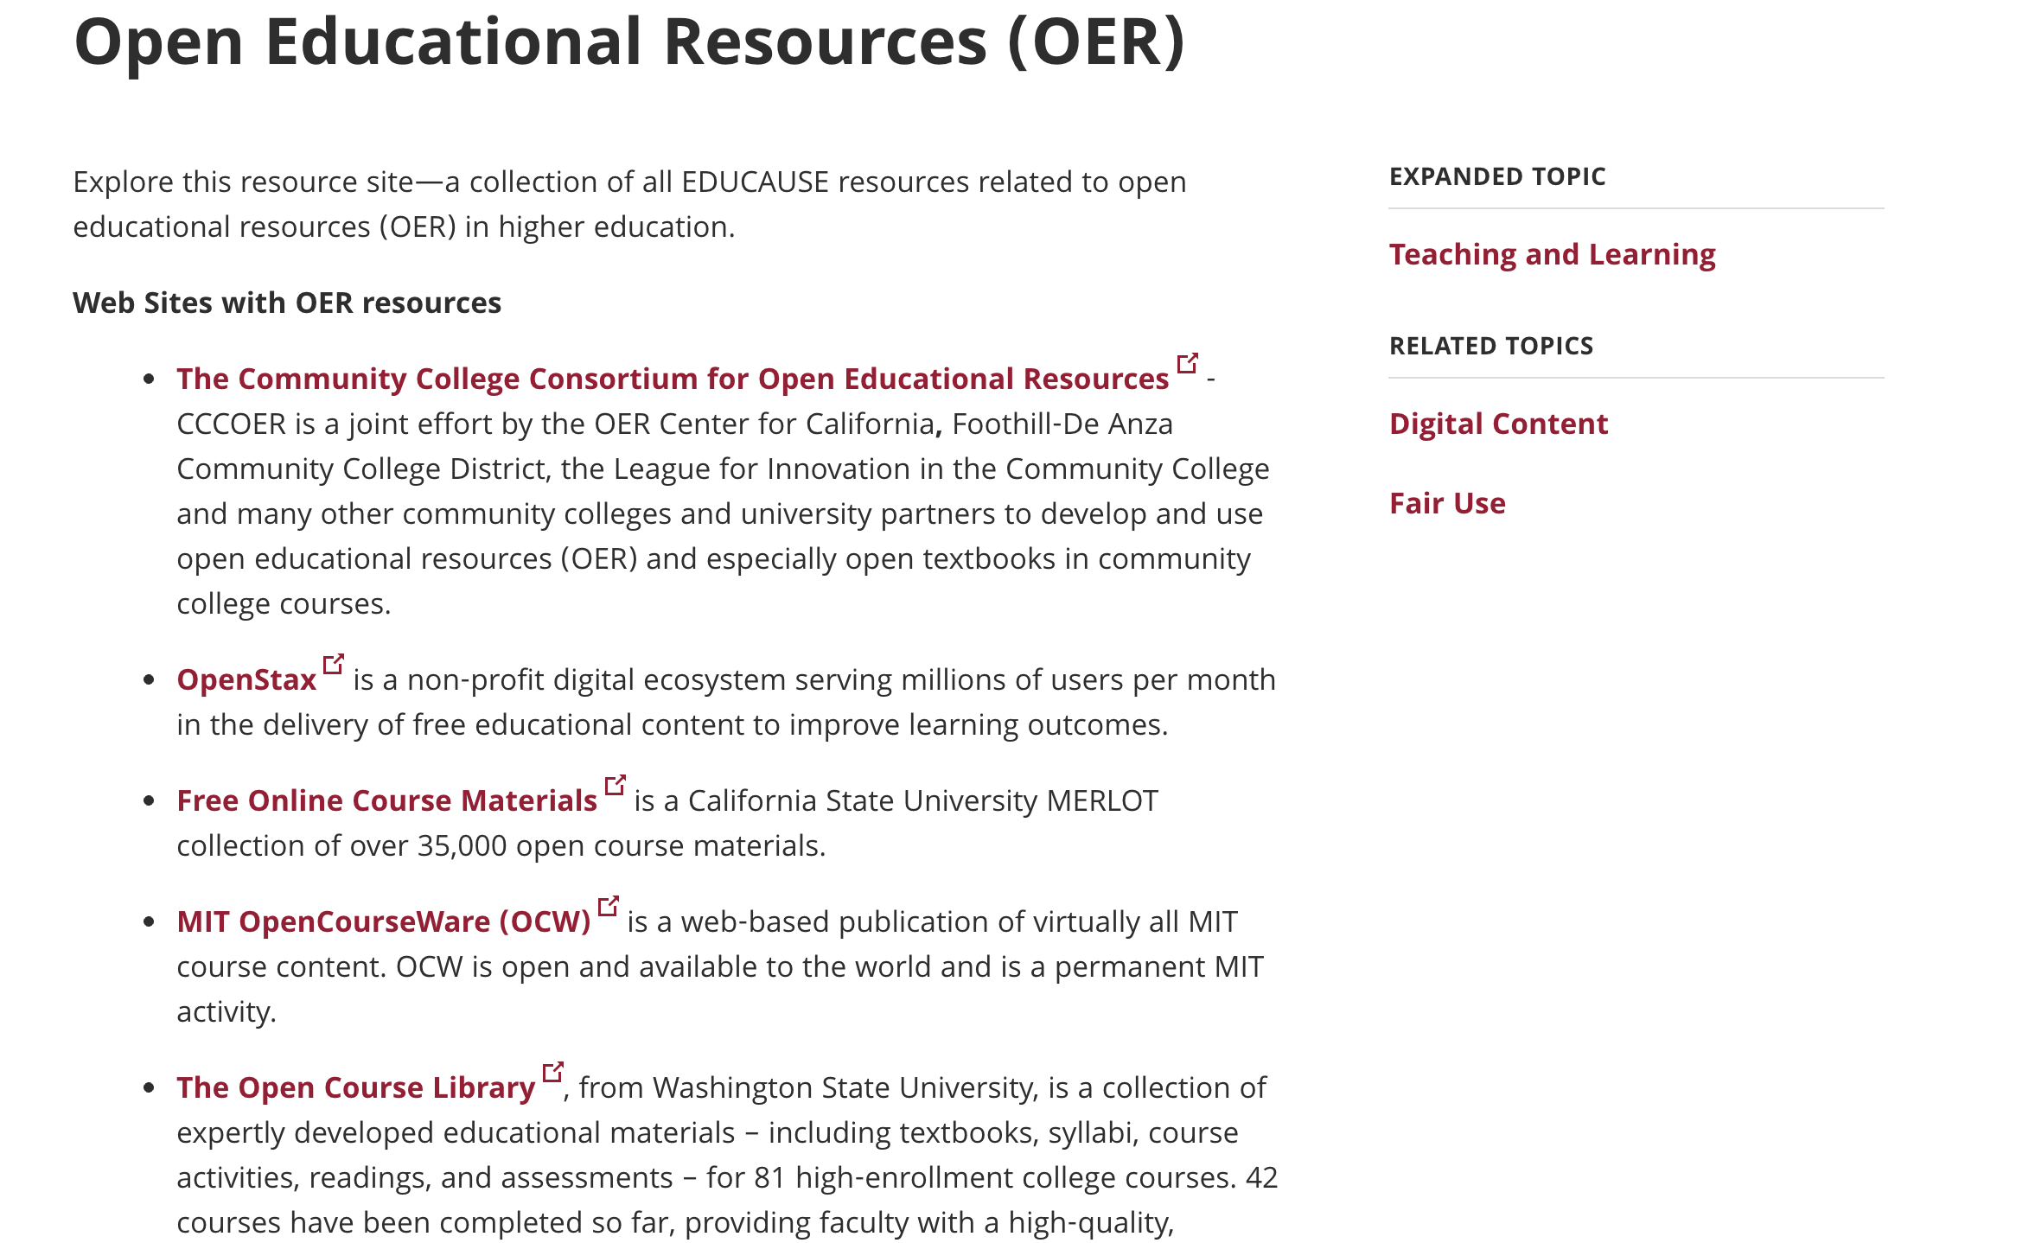

OER Links Page
From: https://library.educause.edu/topics/teaching-and-learning/open-educational-resources-oer

Slide 18
The vision 2019/20-2024/25
The Library curates open educational resources, for and by students and staff, the latest and best e-learning resources to support blended teaching and learning @PolyU.

Slide 19

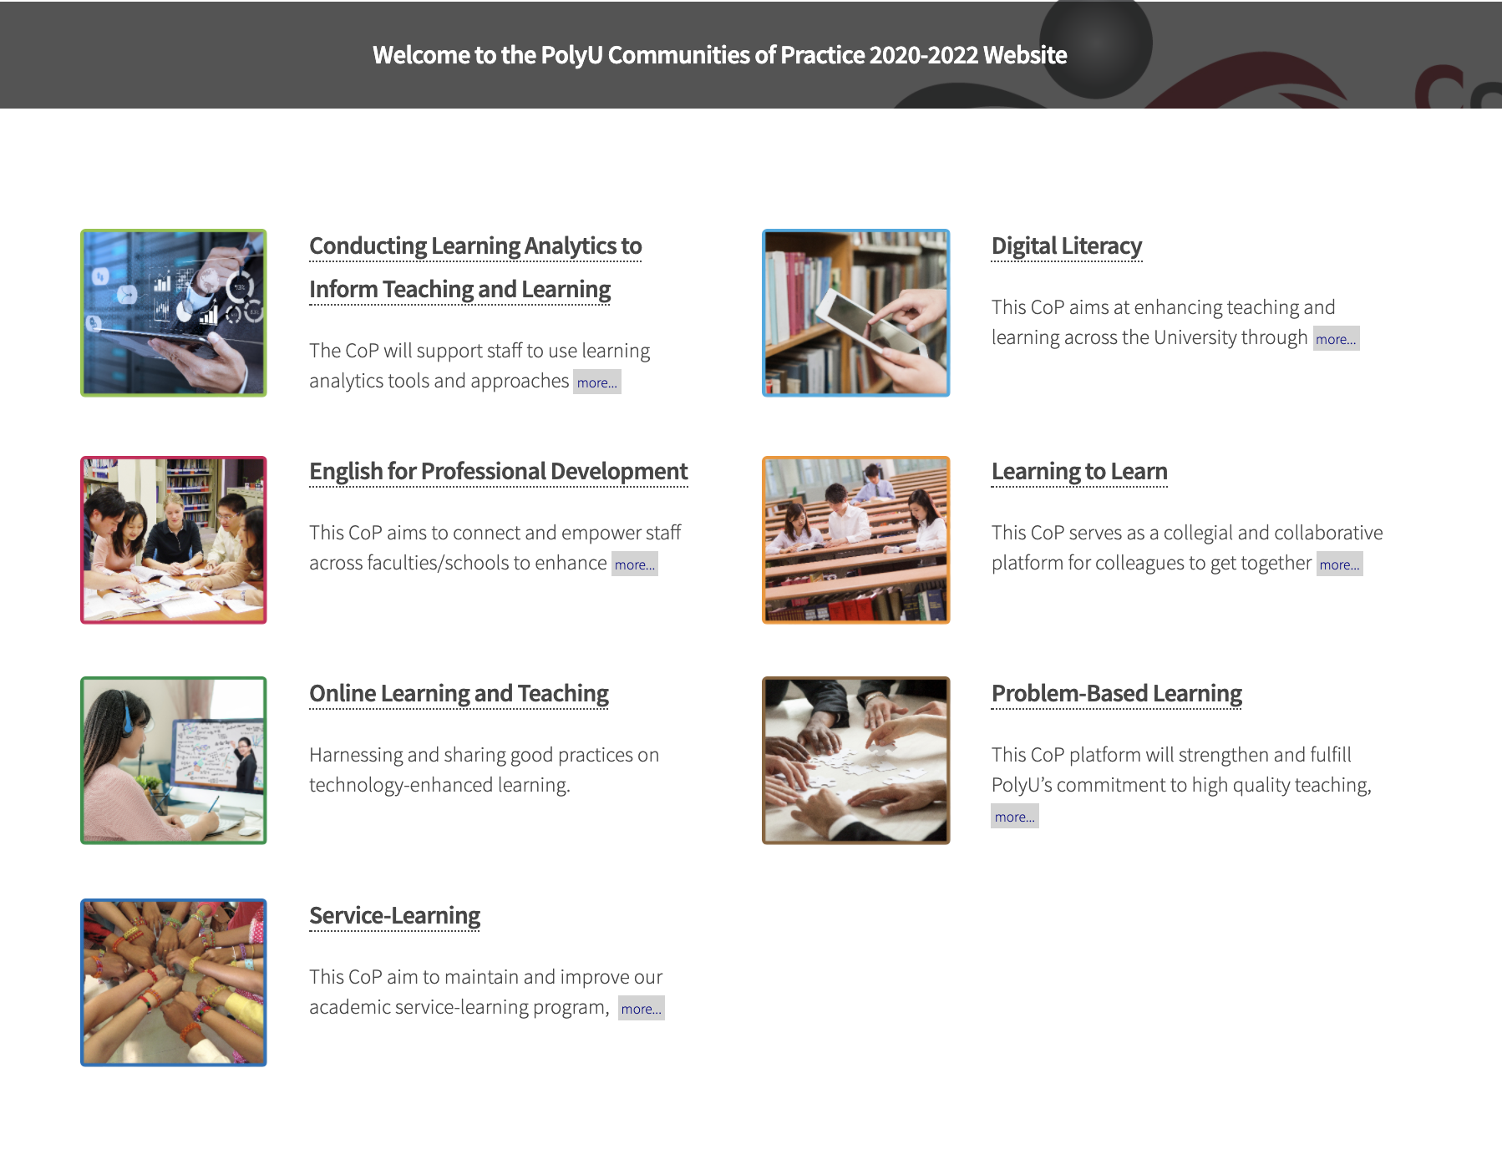
OER Sub-Community of Practice @PolyU
2020-22
Sub-communities include MOOCs/SPOCs, Flipped Classrooms, Hybrid Classrooms, eAssessments, and Open Educational Resources (OERs).

Slide 20
Adapting educational innovation to other contexts, while retaining its principles and effectiveness, is a significant barrier.
(C.K.K.Chan, 2011; N.Law, 2015; Dede & Honan, 2005)

Slide 21
We are not education development/advancement unit…
We are The Library

Slide 22
Open Educational Resources

Slide 23
Information Literacy of
Open Educational Resources

Slide 24
Bruce, Christine. Informed learning. Association of College & Research Library, 2008.
Personal Relevance Frame
Content Frame
Personal Relevance Frame
Finding personal relevance of OER in study
6 Frames of Informed Learning
Content Knowledge
Social Impact Frame
Learn to Learn Frame
PolyU community knowledge: learning outputs and pedagogy
Info. process & learning strategies
Relational Frame
Relational Frame
Competency Frame
Discover & curate relationship between OER
Skills related to content
Notes:
adfasdfasdf

Slide 25
#1. PolyU students* have a wide spectrum of views towards Open Educational Resources “OER”
Teaching & learning material released under an open license
#A
51%
Educational resources openly available on search engines
#B
15%
All things that help me to learn online
27%
#C
7%
Copyright-free materials
#D
*174 students responded
Single-choice MC item
Notes:
#MLM 1

Slide 26
#2. Learning materials used by PolyU students* 3 times or more per week
YouTube Videos
Images
e-Books,
Text Materials
87%
75%
68%
Presentation Slides
Online Interactive Demos, Simulations, Tutorials, Etc.
75%
71%
*174 respondents

Slide 27




#3. PolyU students’ preference on sharing “OER from the web”
With friends?
With the whole class?
Students said they will share OER they found online with close friends
Students said they will share OER they found online with the whole class
90% Yes
32% Yes
Ripping me off?
Fruitful partnerships
Sharing OER helps other students rip me off
Sharing OER helps building fruitful partnerships with classmates
51% Agree
91% Agree
*174 respondents
Notes:
Q15
Q16

Slide 28


#4. PolyU students’ preference on sharing “self-created learning resources”
With friends?
With the whole class?
Students said they will share their creations with close friends
Students said they will share their creations with the whole class
82% Yes
36% Yes
Ripping me off?
Fruitful partnerships
Sharing my creations is letting other students rip me off
Sharing my creations helps building fruitful partnerships with classmates
55% Agree
89% Agree
*174 respondents
Notes:
Q15
Q16

Slide 29
Facilitating adoption of OER should not only aim at providing “more T&L resources” thru’ PolyU Library web.
“a change of perception & habit” in both teaching & learning is needed.

Slide 30
Streamline & Inform
Collective Wisdom
Open Educational
Resources OER

Slide 31
Library’s Resource List

Slide 32
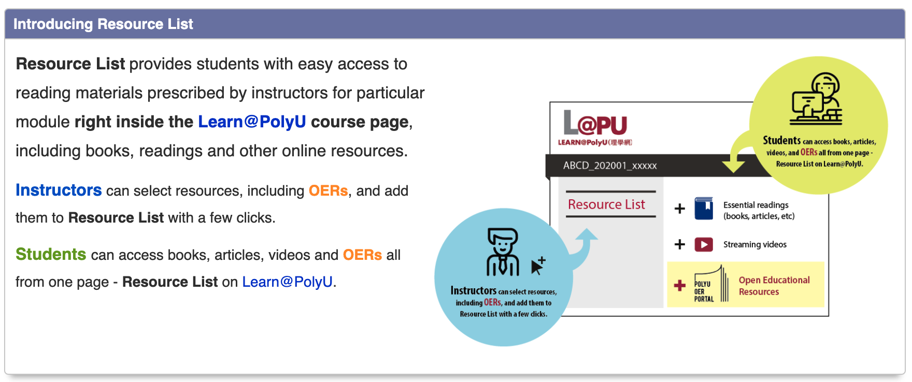

Slide 33
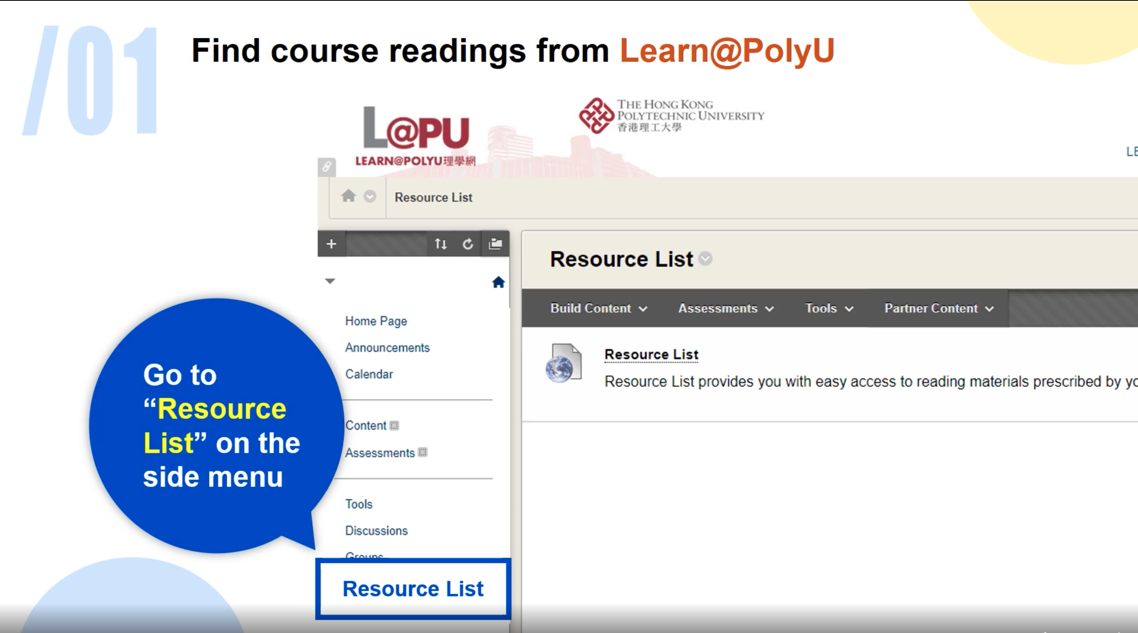
Subject’s space on Blackboard

Slide 34
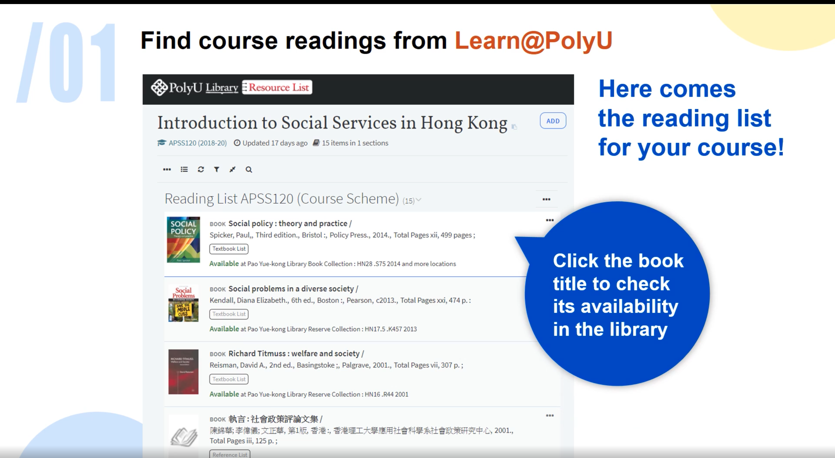

Slide 35
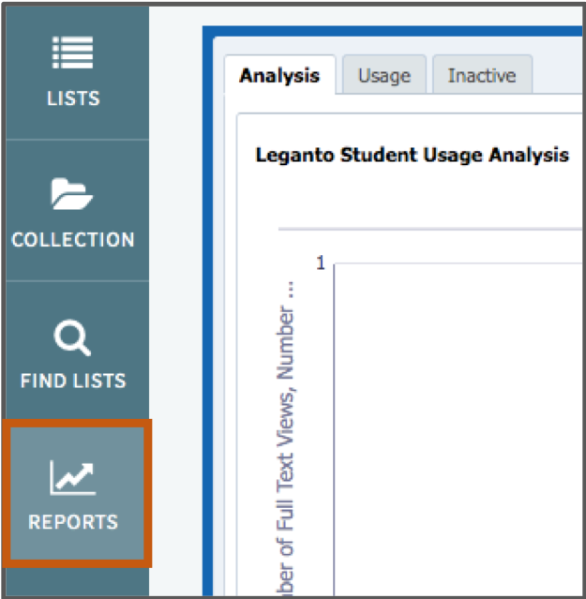
Real-time analytic reports
help instructors
enhance T&L designs.

Slide 36
over 40,000 lists
in 3,700 PolyU subjects
as of Sept 2020

Slide 37
Open Educational Resources Portal

Slide 38
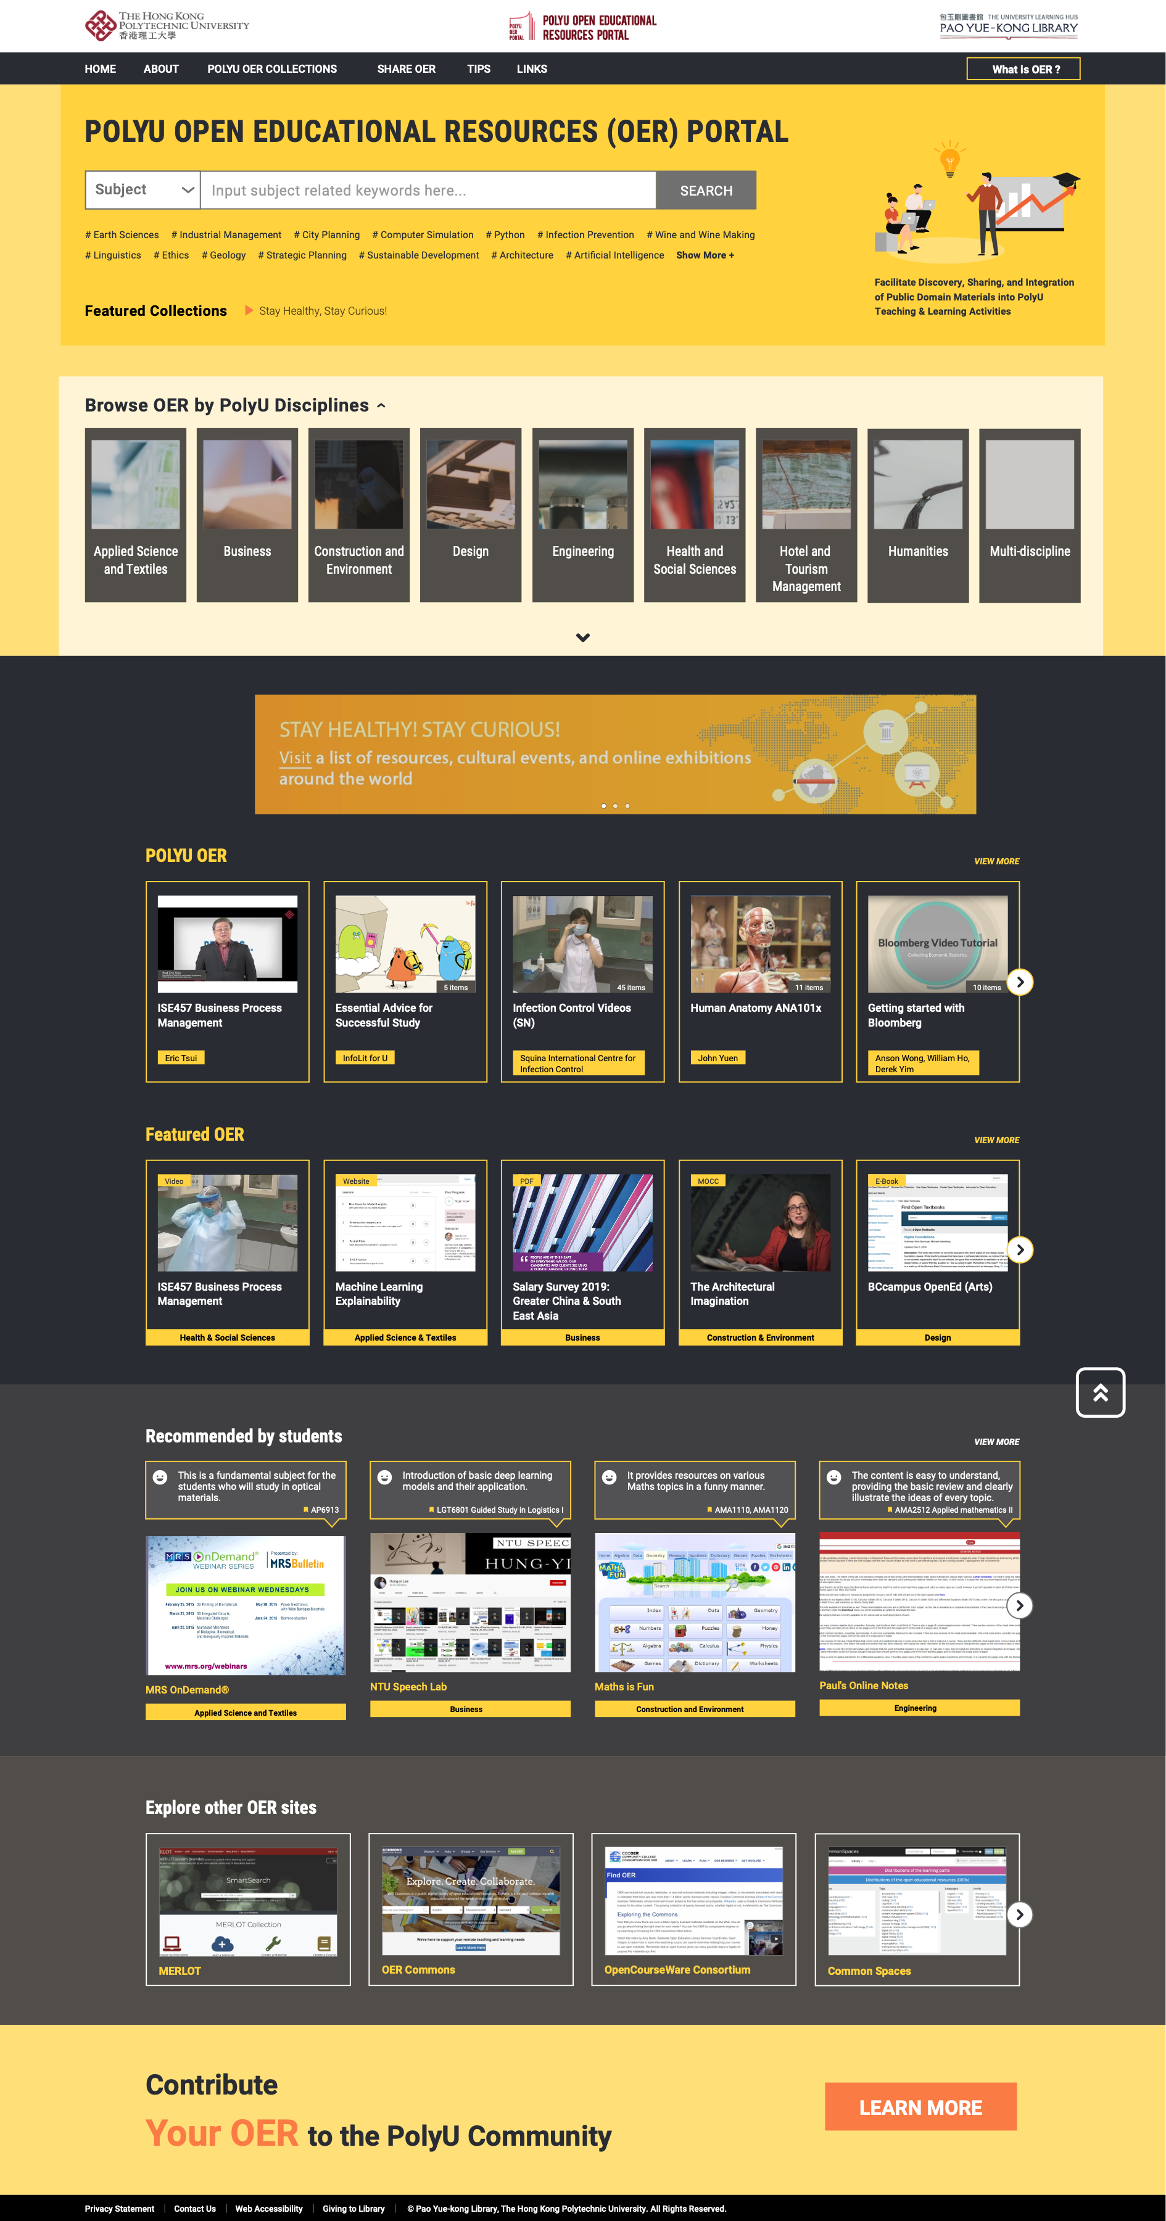

PolyU
OER Portal
The collective wisdom of:
  Students
  Faculties
  Librarians
http://oer.lib.polyu.edu.hk

Slide 39

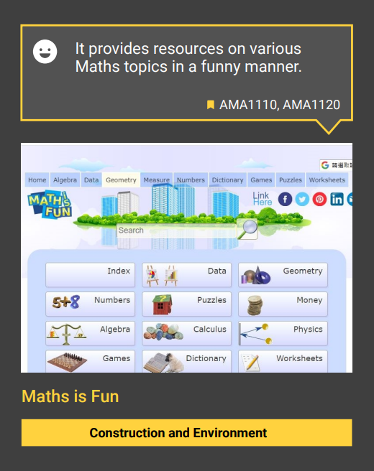
Students recommendations w/personal sharing
“Since PolyU has terminated the forensic accounting free elective class, so I took this class to expand my knowledge as I have passion to be forensic accountant.”
“It teaches you the steps to conduct the analytical steps by using an example.”
#From OER Survey 2019
#From OER Student Survey 2019

Slide 40
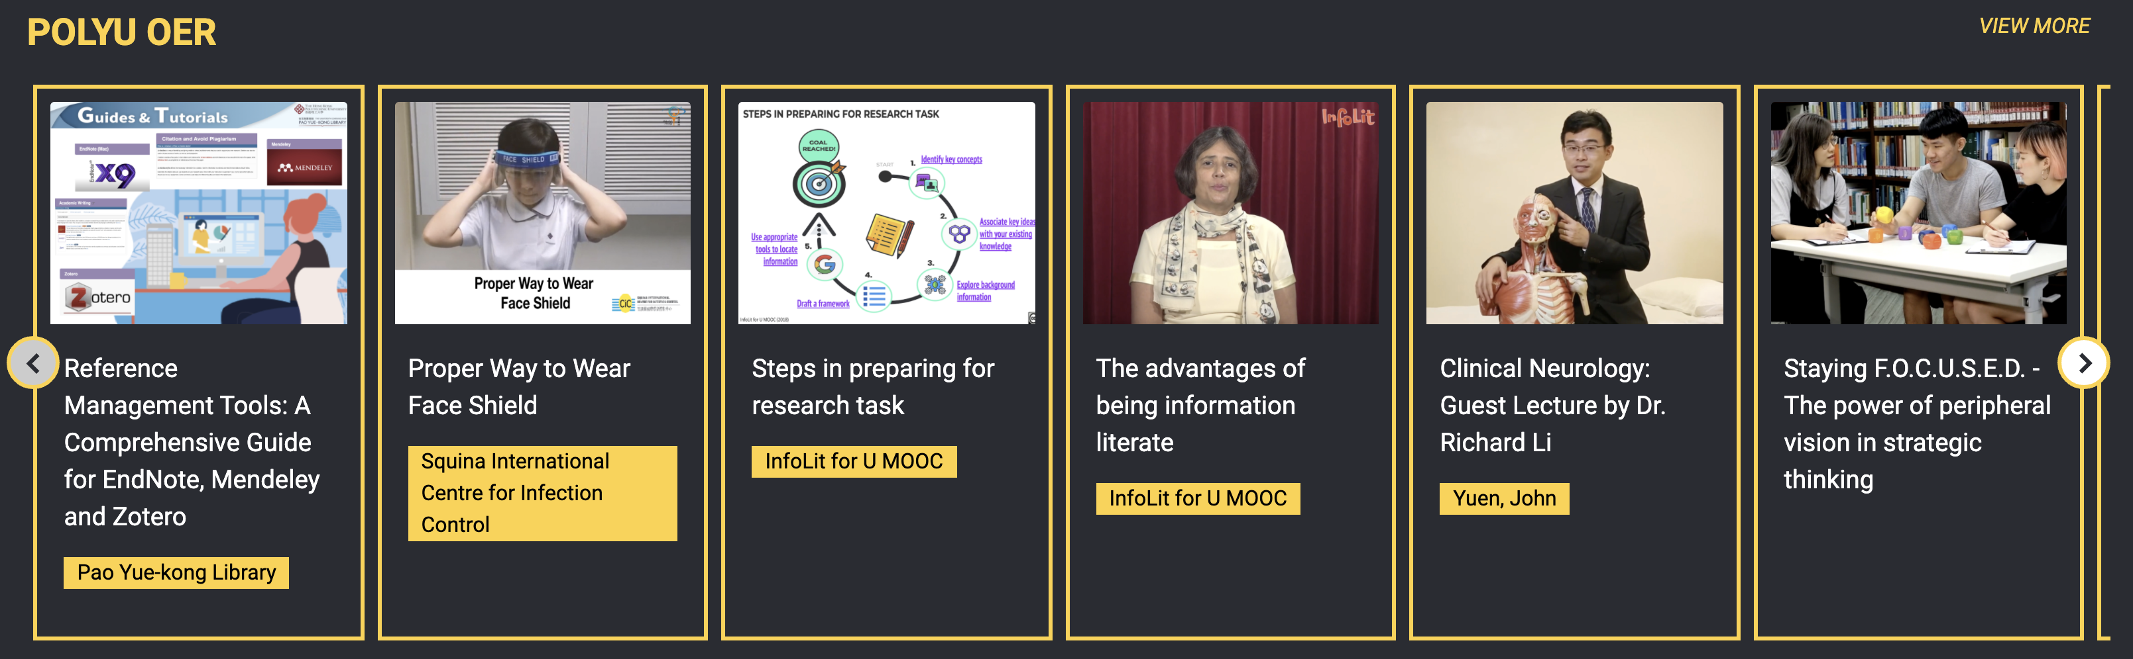


PolyU OER Collections
A growing collection of PolyU produced OER
#PolyU staff are welcome to contribute OER to this portal.

Slide 41
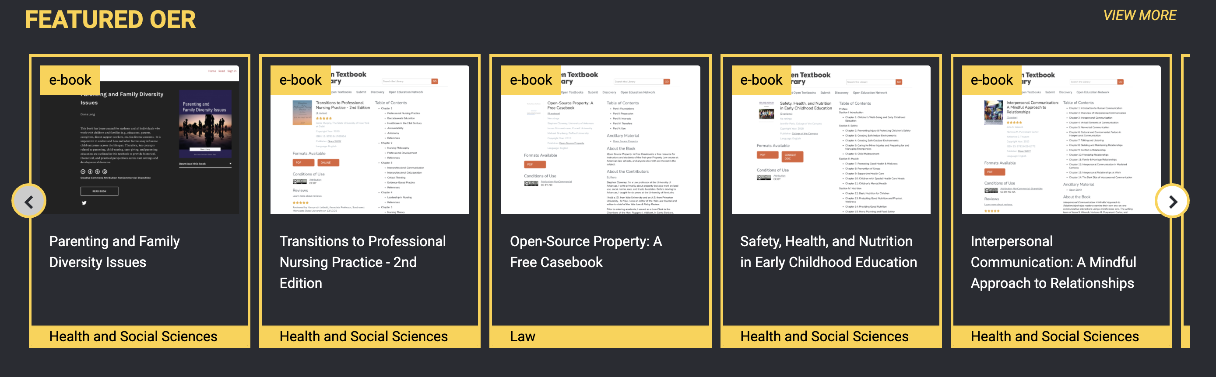
OUR TEAM
Featured OER hand-picked by librarians
Covers all 8 PolyU schools/faculties
w/ metadata tags assigned to connect
T&L activities, e.g. “Related PolyU course”
Added regularly

Slide 42
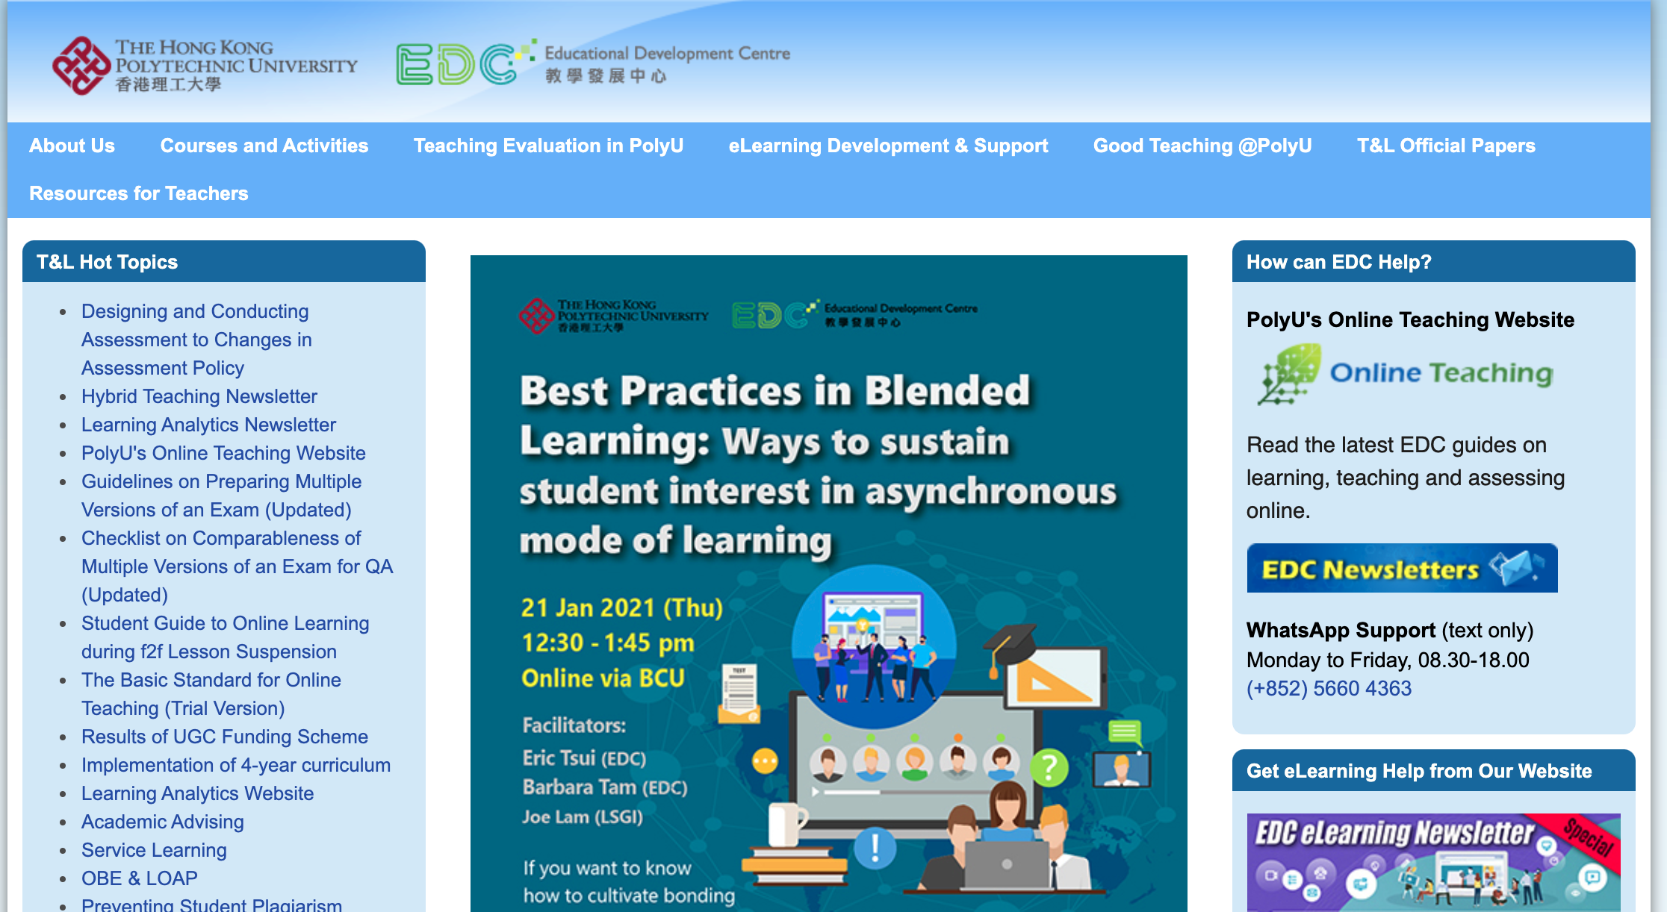
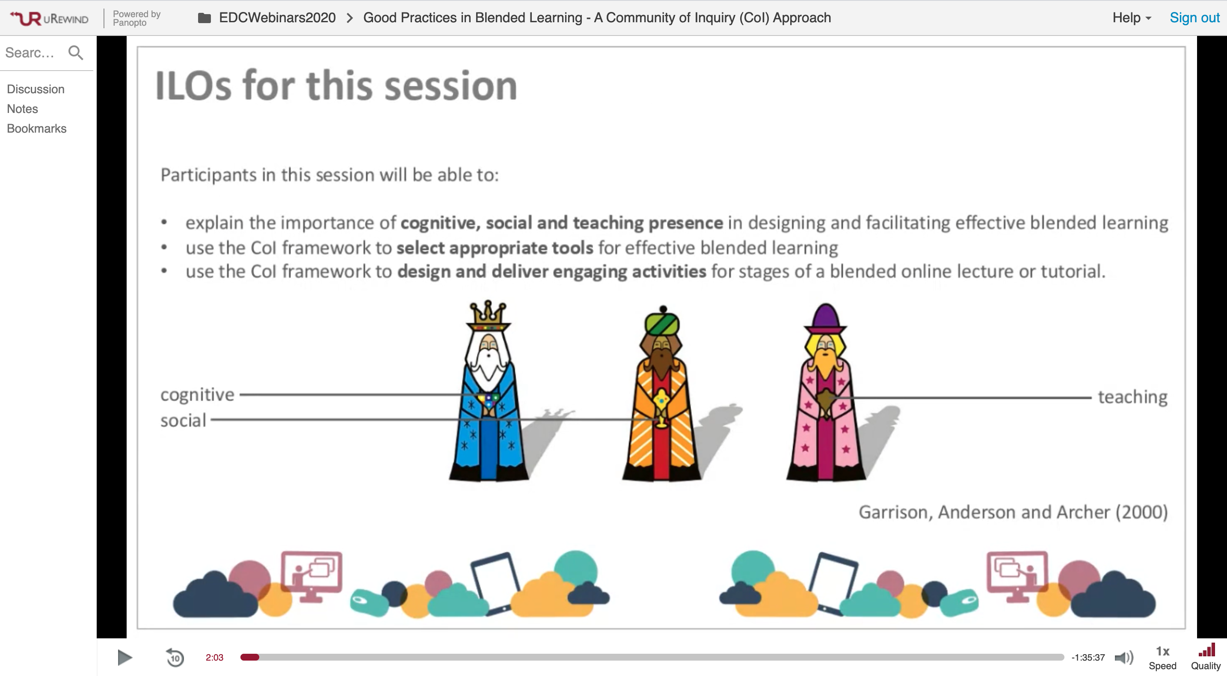
Curate PolyU Pedagogical Expertise from online training events onto the OER Portal

Slide 43
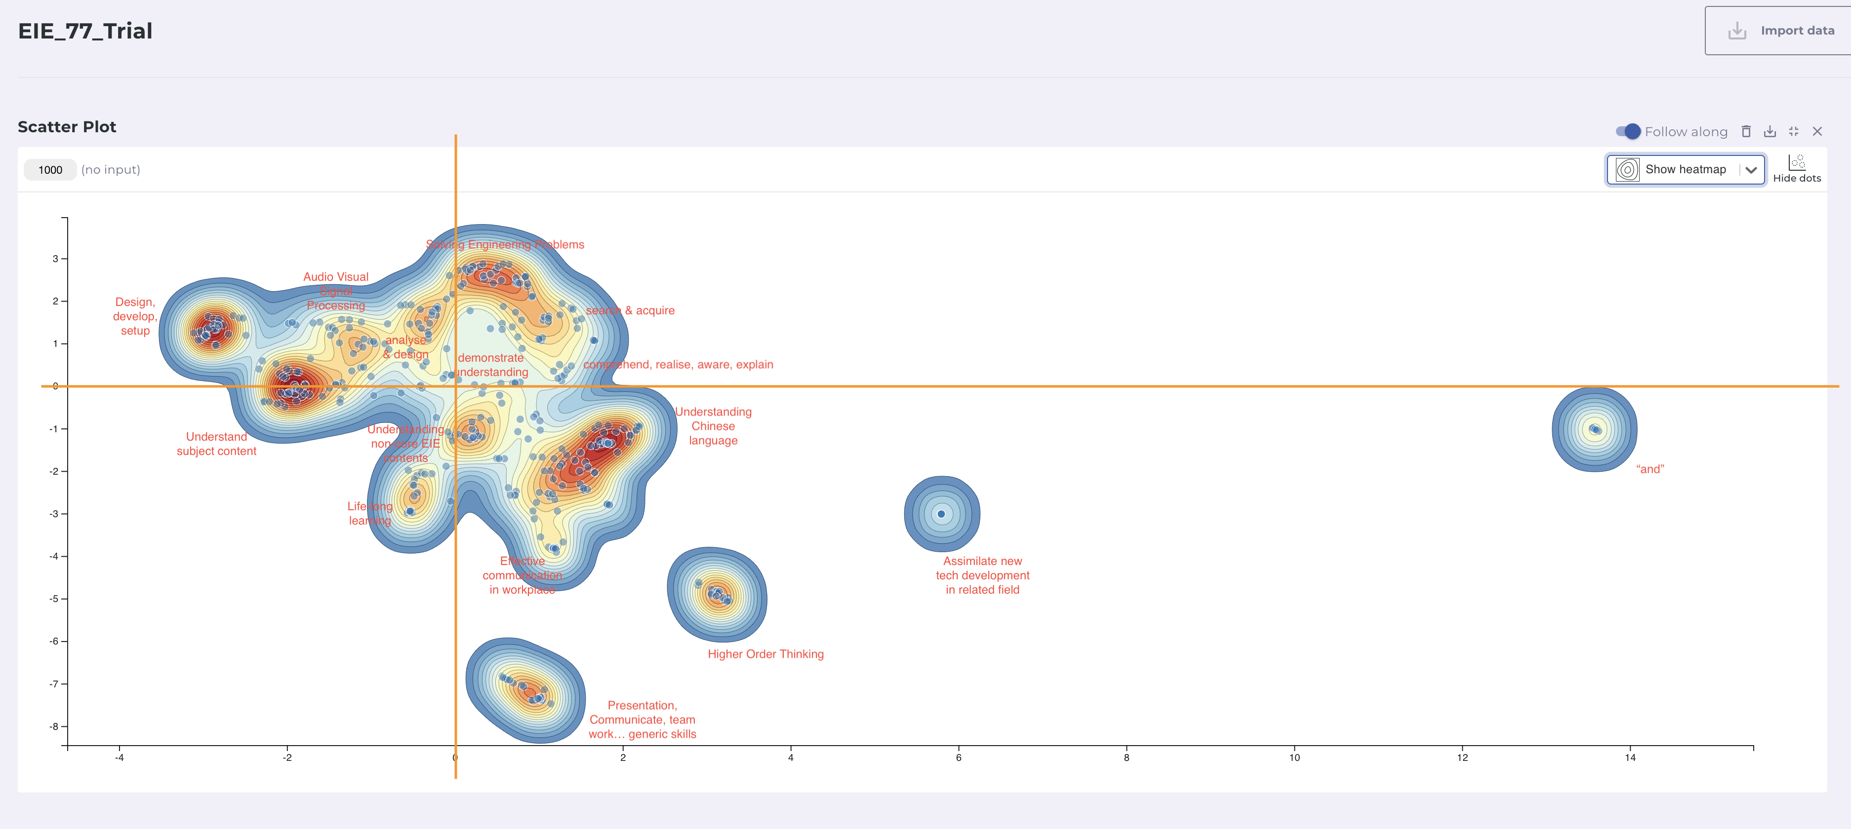
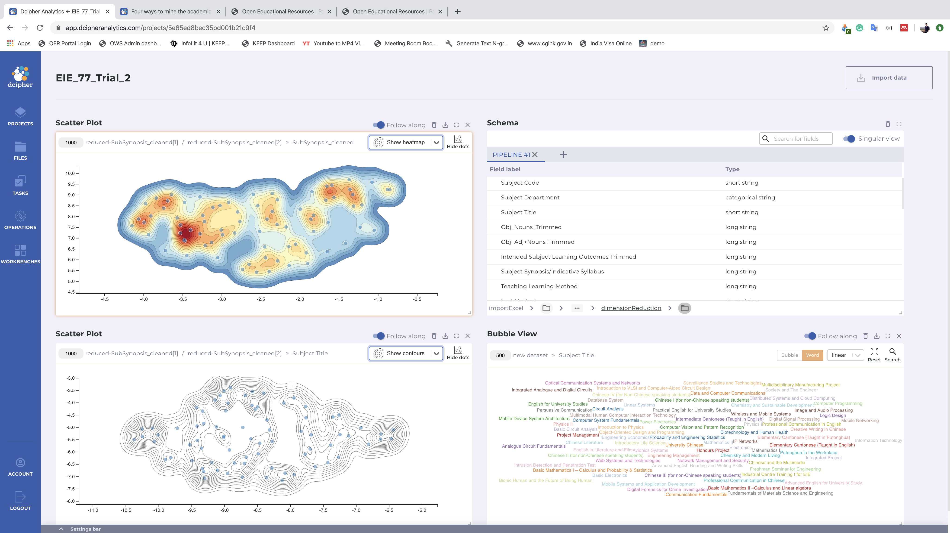
Dig deep into OER: Analytics & AI

Slide 44
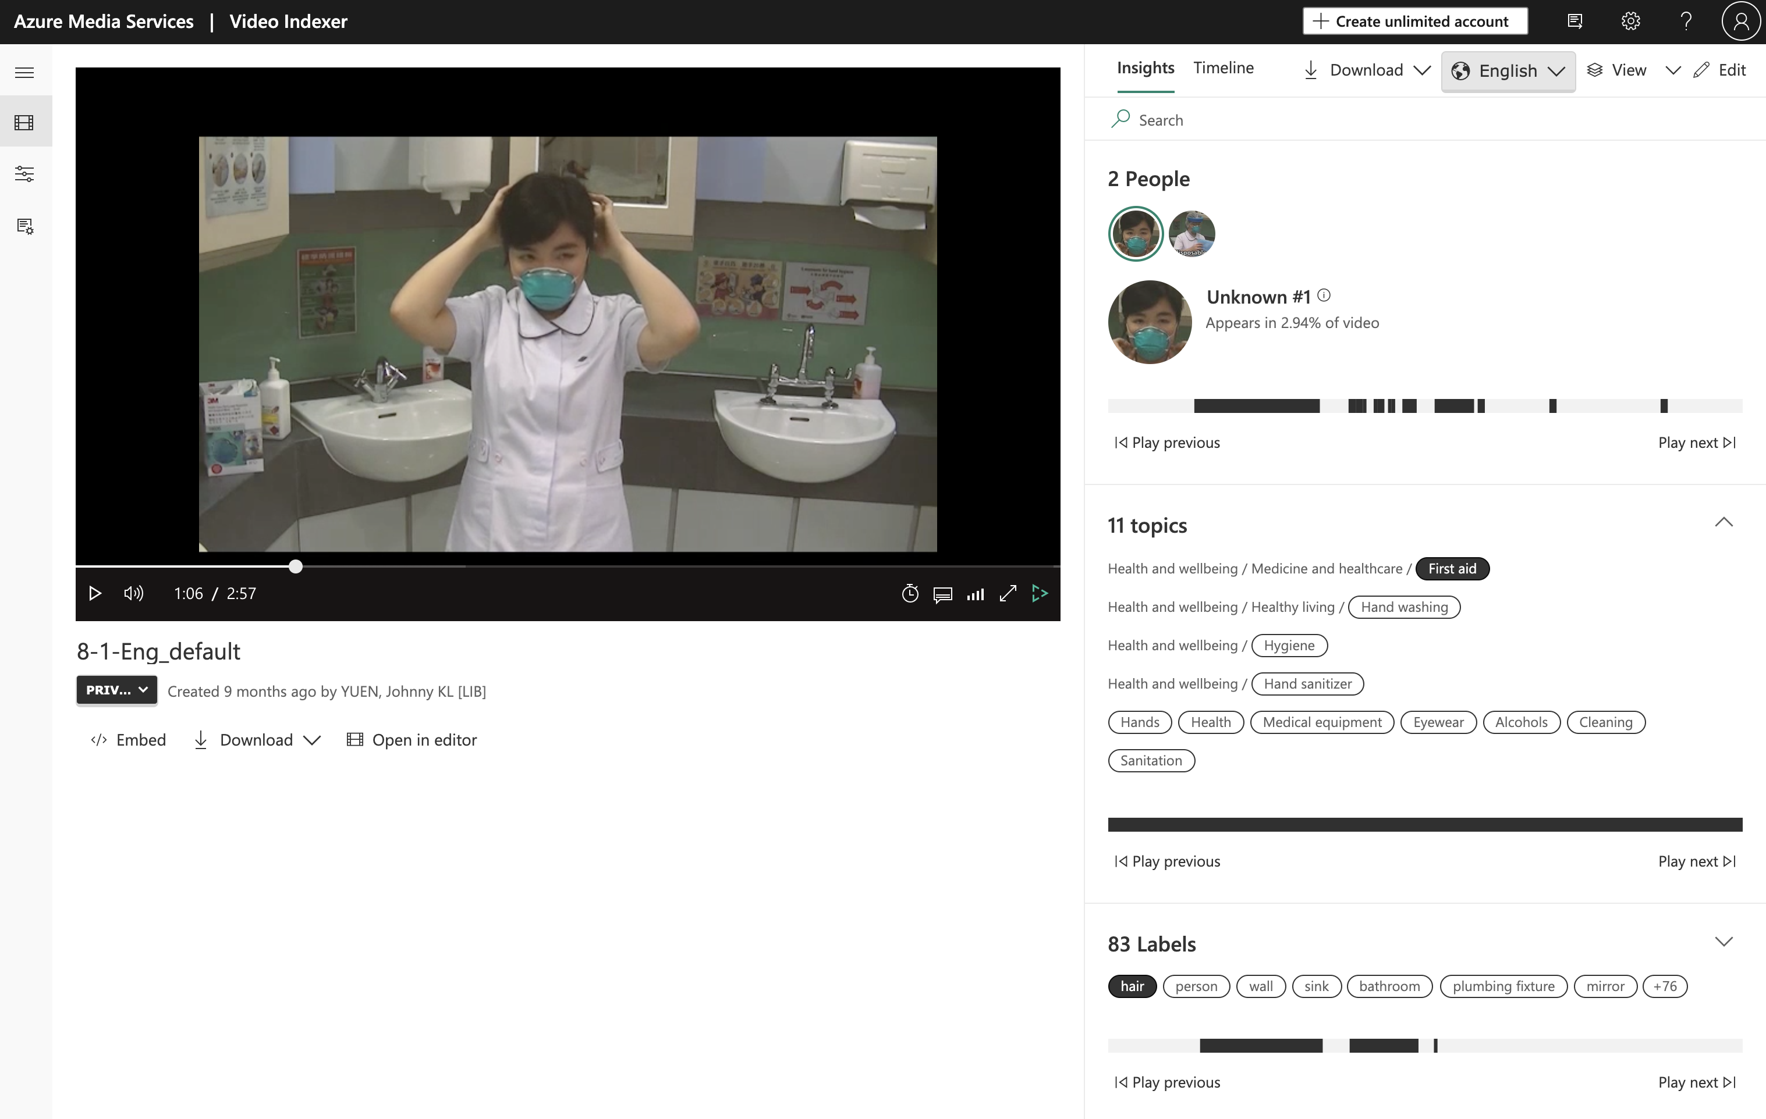
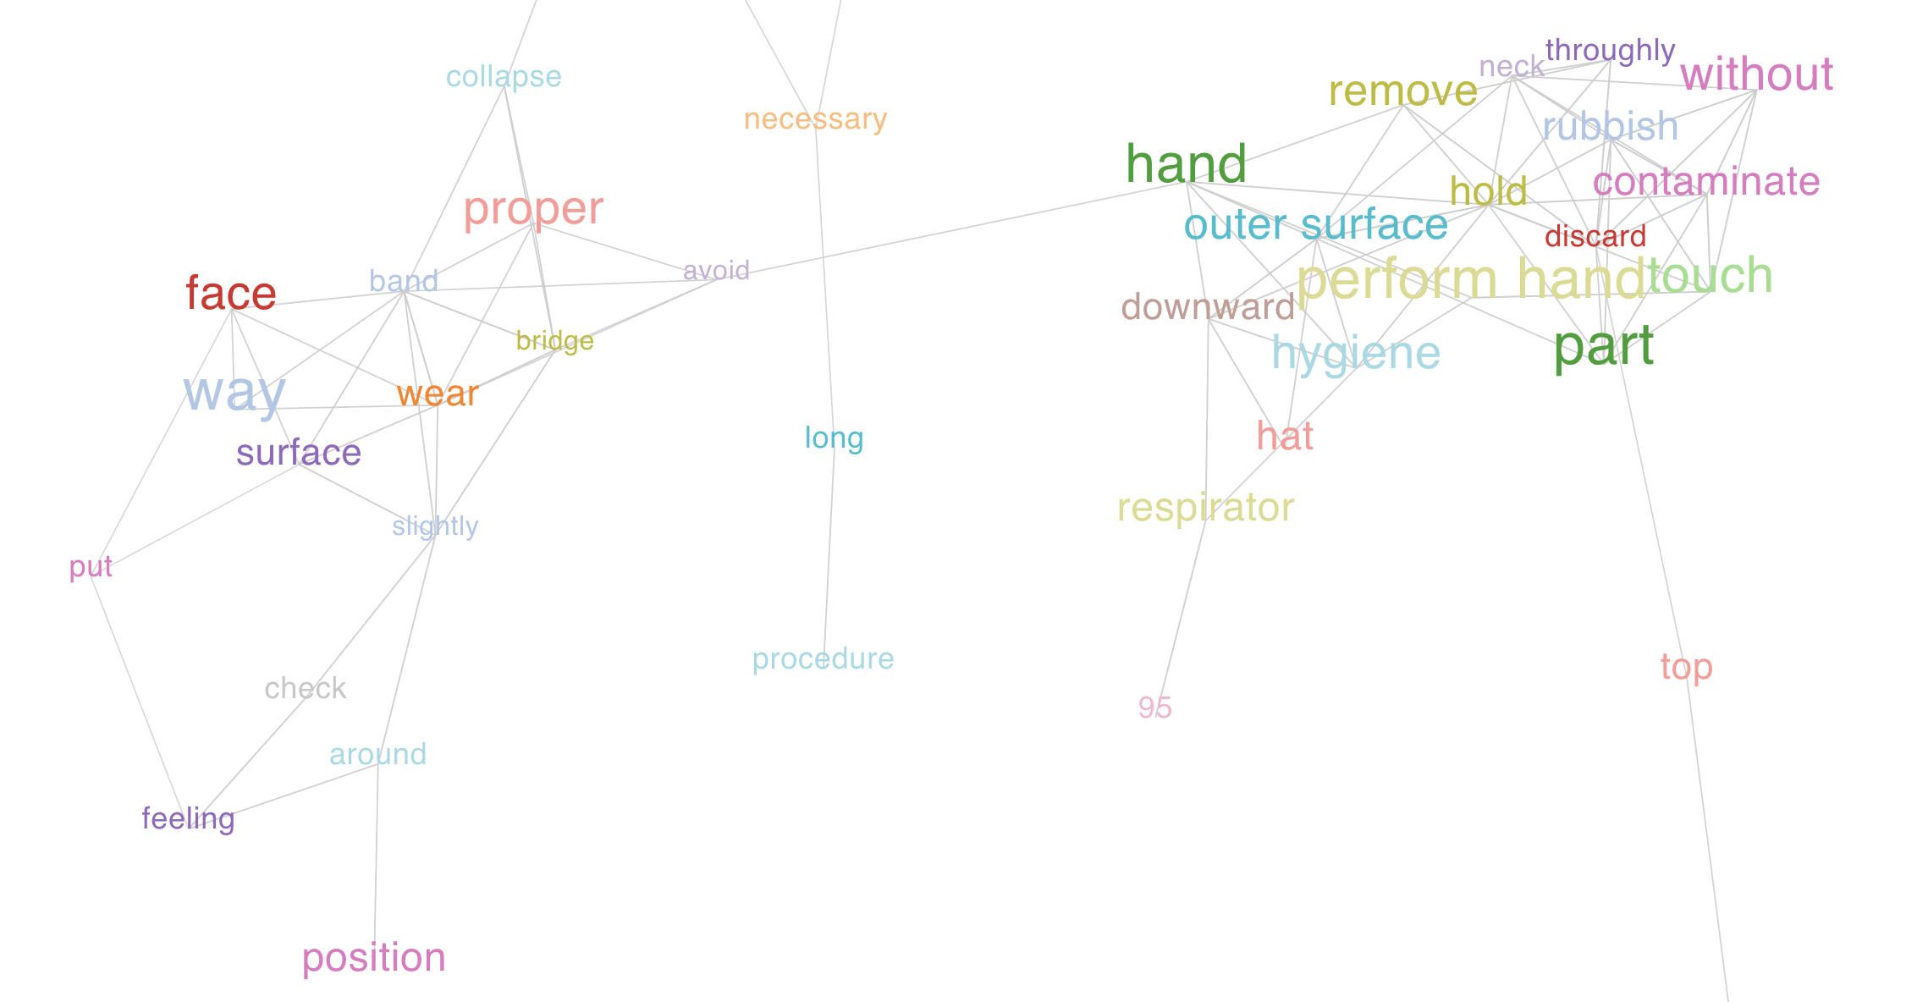
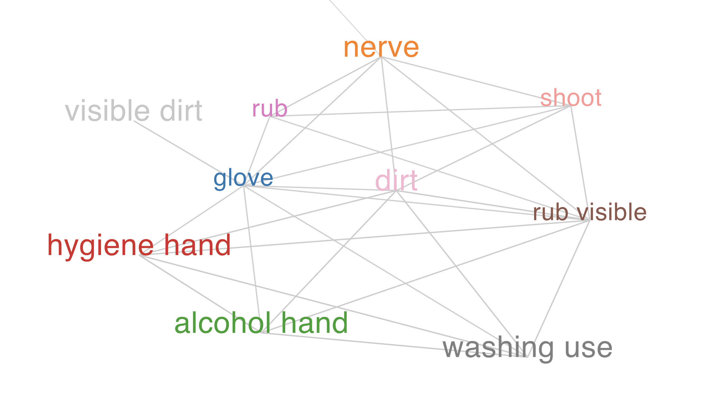
Dig deep into OER: Analytics & AI

Slide 45
In 2021…
OER Lib Workshops
OER Recommendation & Reflection Survey
OER Student Curators
PolyU staff-only OER content
…and more…

Slide 46
THANKS!
Does anyone have any questions?
https://oer.lib.polyu.edu.hk/

Slide 47
Bruce, Christine. Informed learning. Association of College & Research Library, 2008.
Personal Relevance Frame
Content Frame
Personal Relevance Frame
Finding relevance in areas of study
6 Frames of Informed Learning
Content Knowledge
Social Impact Frame
Learn to Learn Frame
Benefit society & wider community
Info. process & learning strategies
Relational Frame
Relational Frame
Competency Frame
Relationship between ideas
Skills related to content
Notes:
adfasdfasdf

