Slide 1
Building an analytics ecosystem platform:
benefits, solutions & collaborations

Slide 2
Open Access
Prelude

Slide 3



Digital Humanities
Research
Partnership
Digital Scholarship
Public Engagement
Global Presence
Web 3.0
Teaching & Learning
https://digitalrepository.lib.hku.hk/
Resource Discovery
Open Access
Knowledge Exchange
Resource Sharing
Collaboration
Digital Preservation

Slide 4
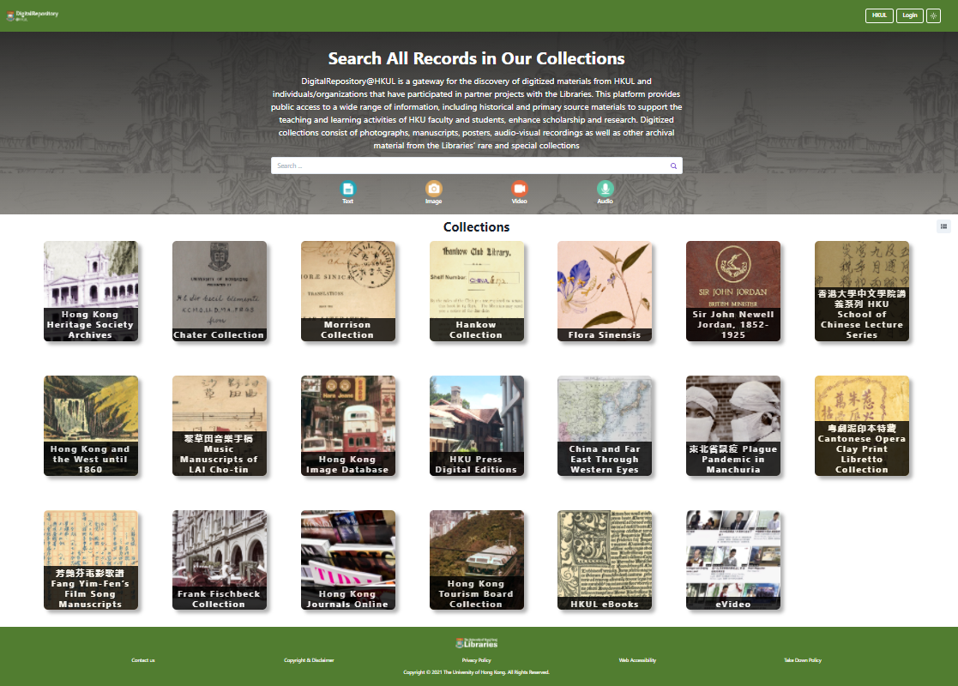
Enables responsive resource discovery
Open access ; OAI-PMH compliance for resource sharing
Broaden accessibility of HKUL’s digital collections
Increase HKU’s visibility and reputation globally

Slide 5

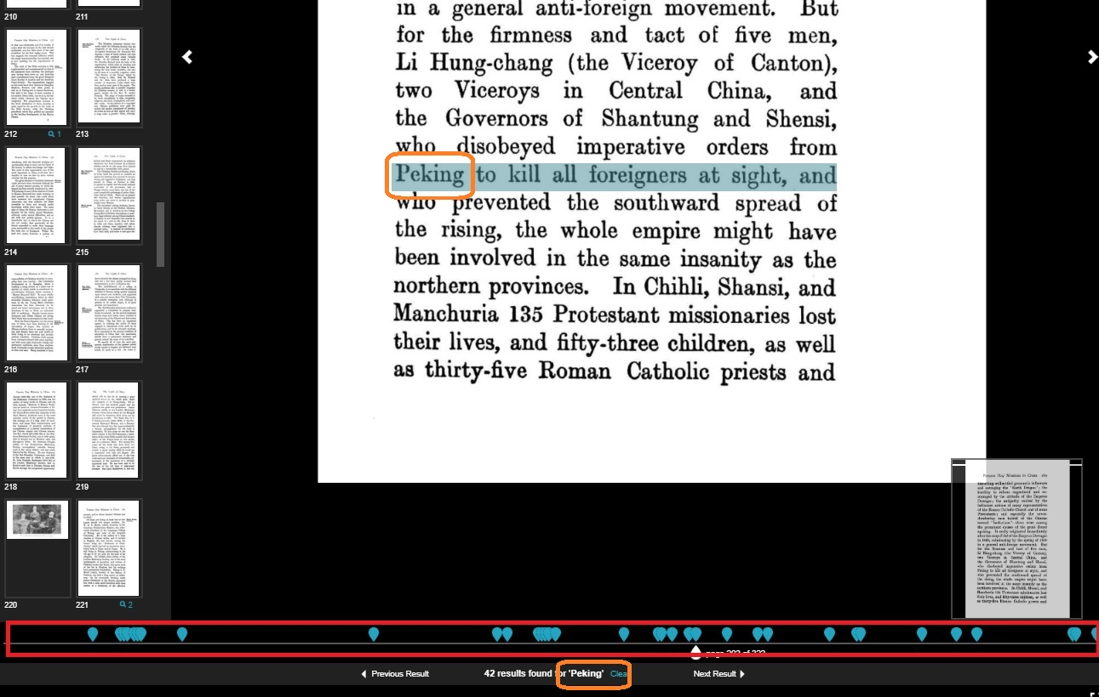
Enables full-text searching within a book or a document; highlight search results and indicate result locations

Slide 6
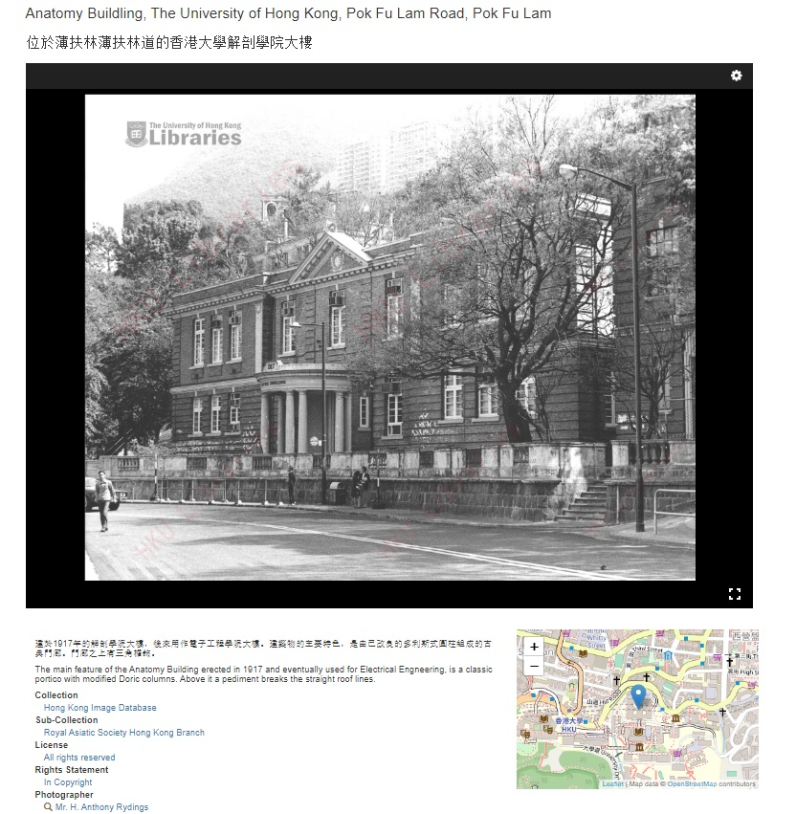
Google map embedded to show current place location

Slide 7
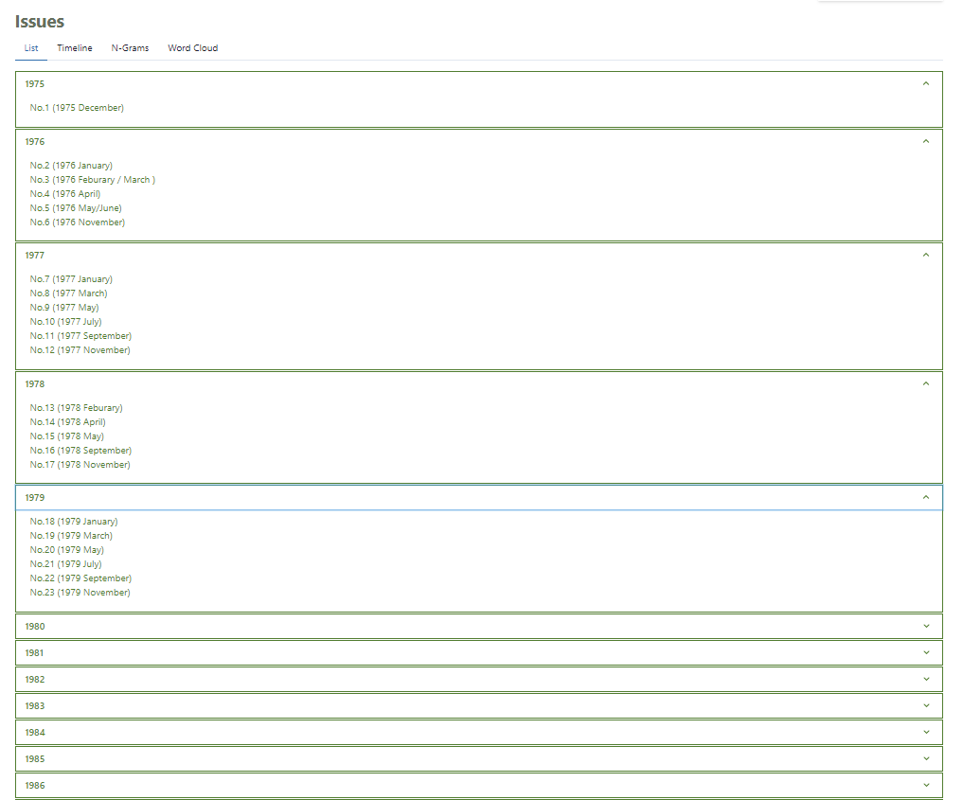
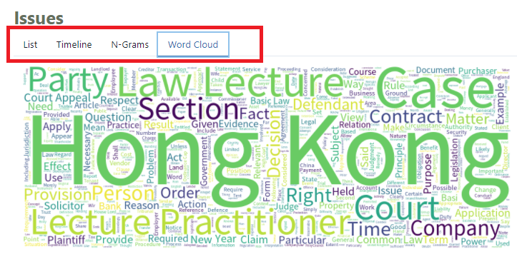
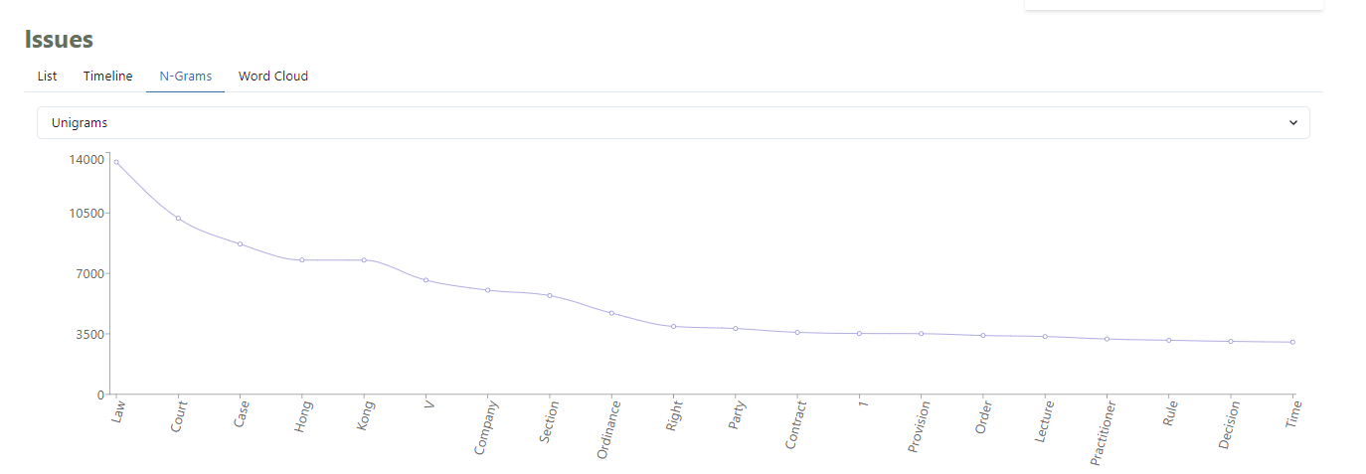
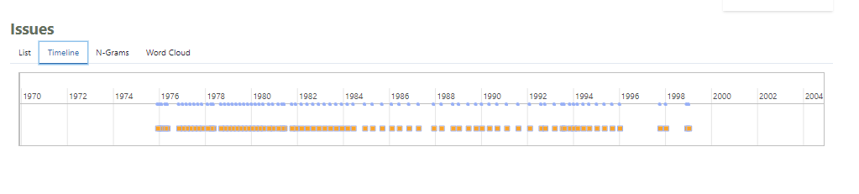
Data-visualization gadgets

Slide 8


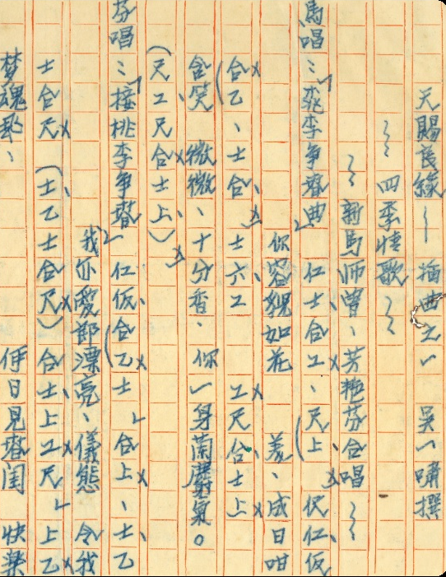



Newly Released Digital Collections
KE Project 2019/20

Slide 9
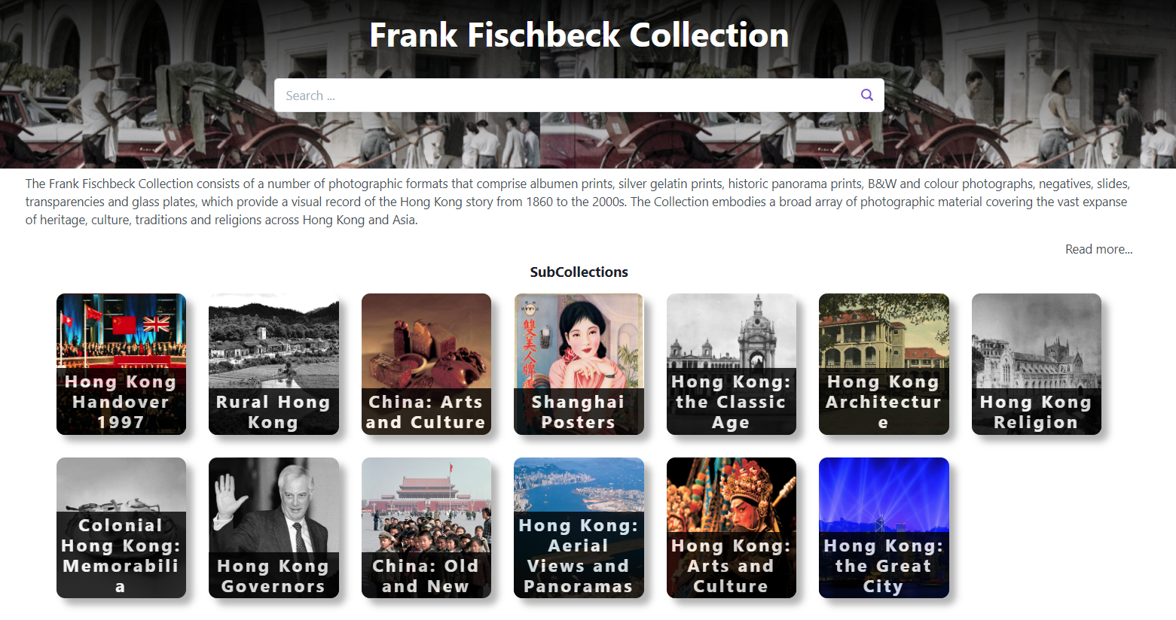

Slide 10


Upcoming New Digital Collections

Slide 11
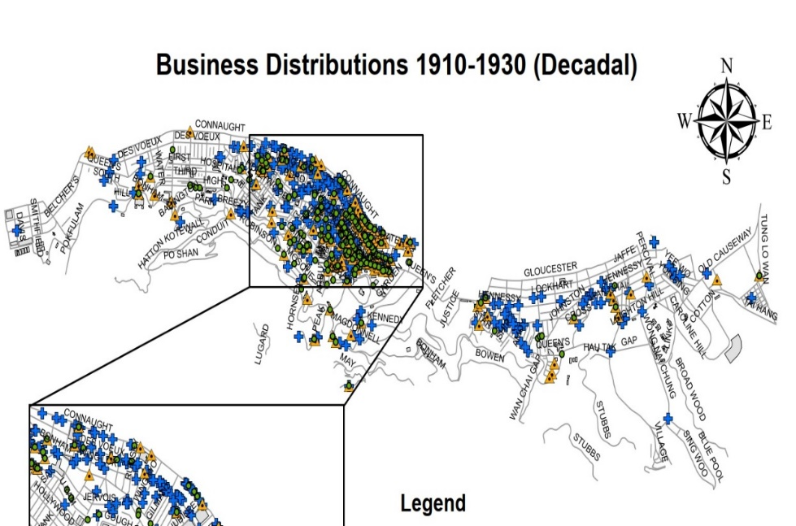
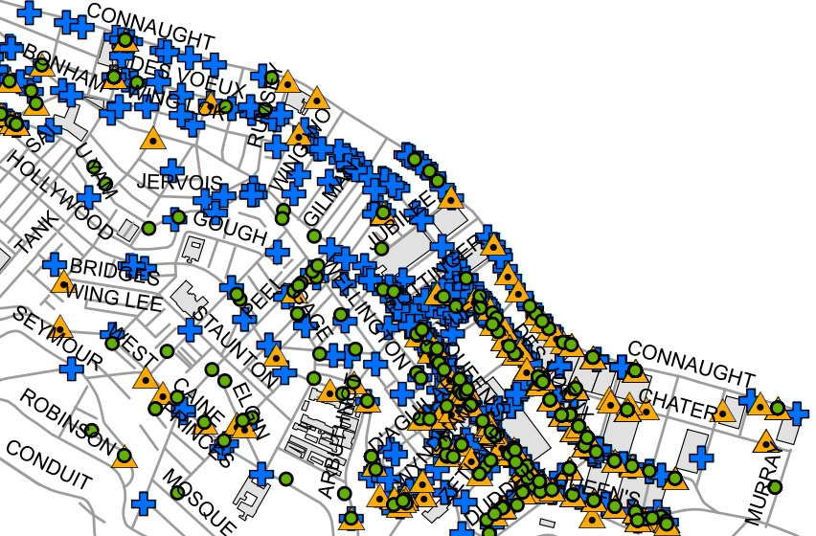
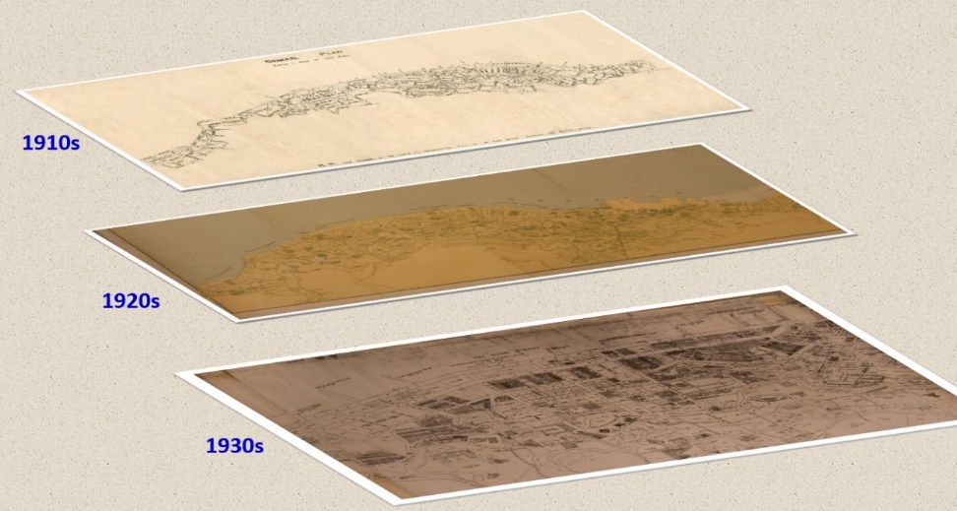
Digital Humanities – GIS Project
Collaborate with Dr. Michael Ng of Faculty of Law
Digitized library’s old maps and commercial directories of Hong Kong
Output: ArcGIS files + geocoding datasets
Will present the project with web-based GIS applications

Slide 12
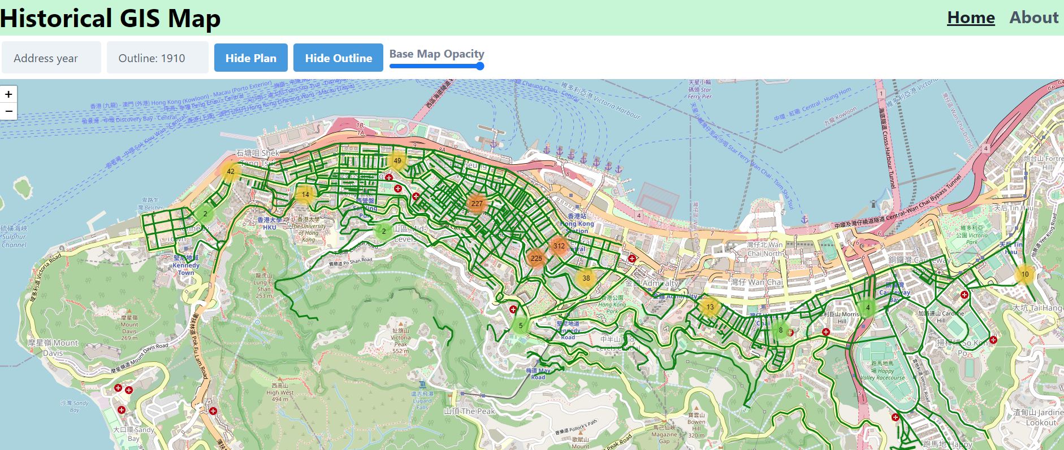
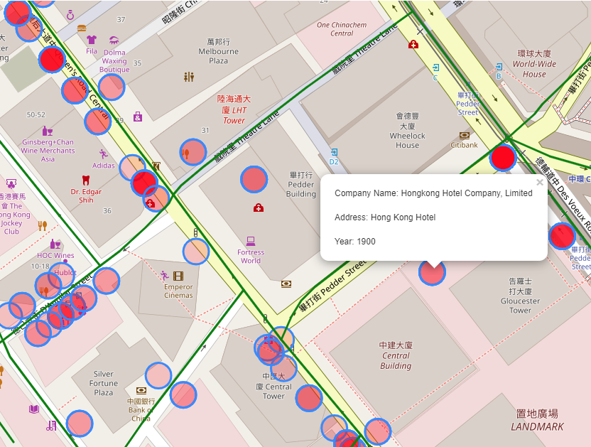

Slide 13

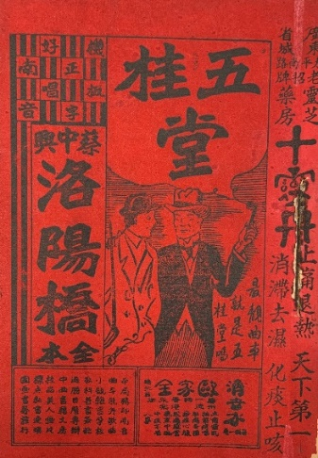

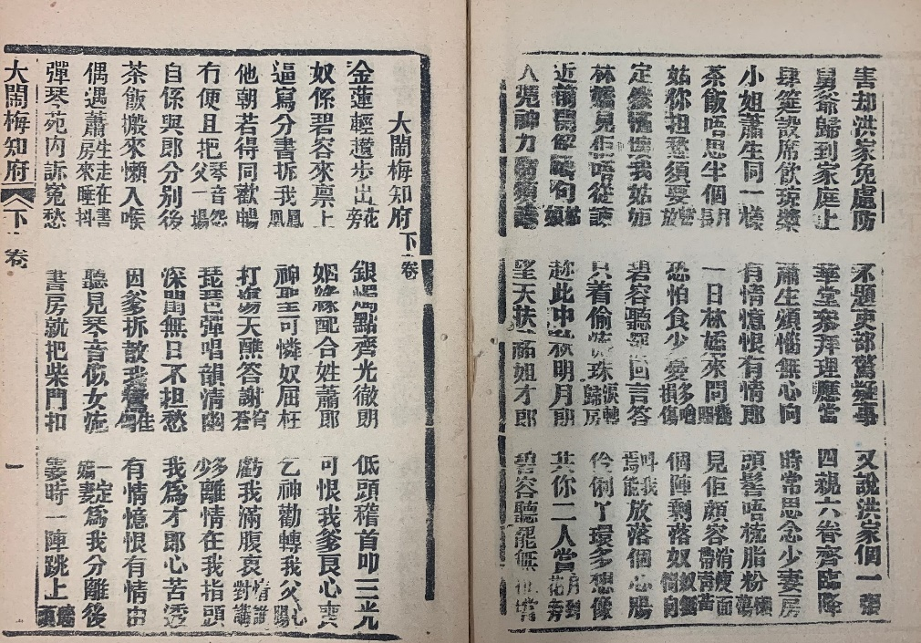



Cantonese Folk-Literature
Wooden-fish books 木魚書
Naamyam 南音
Lung-chow 龍舟
Yuet-au 粵謳

Slide 14
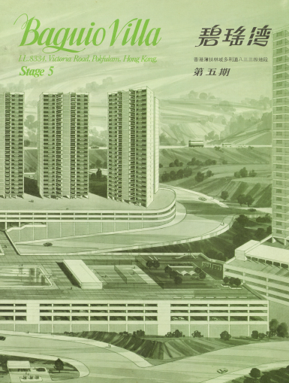



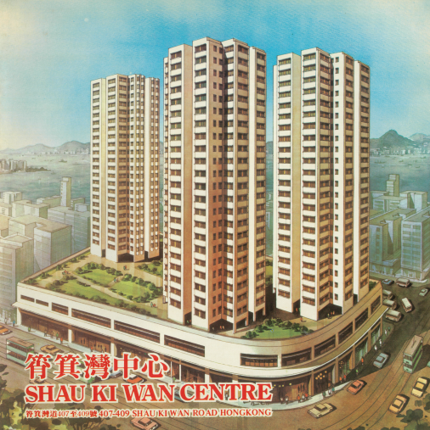

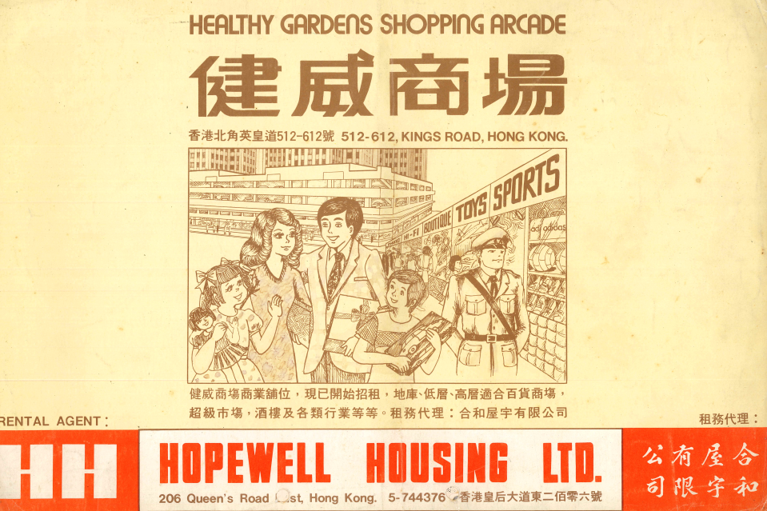

HK Property Sales Brochures 售樓書

Slide 15
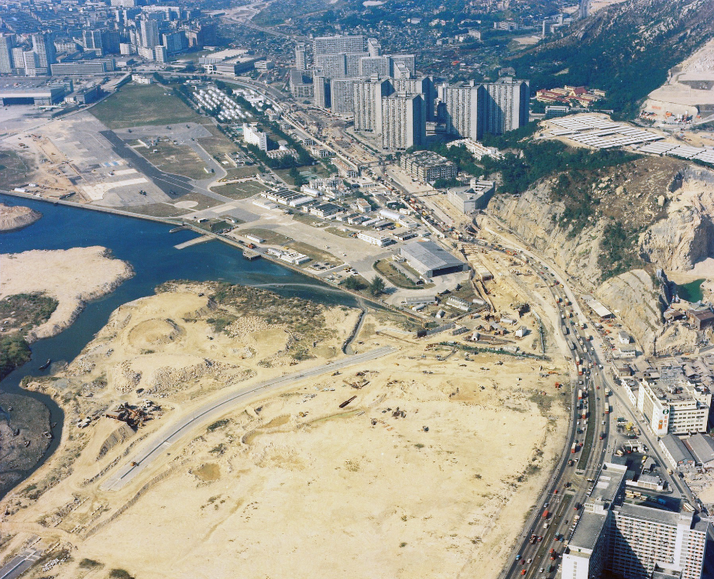

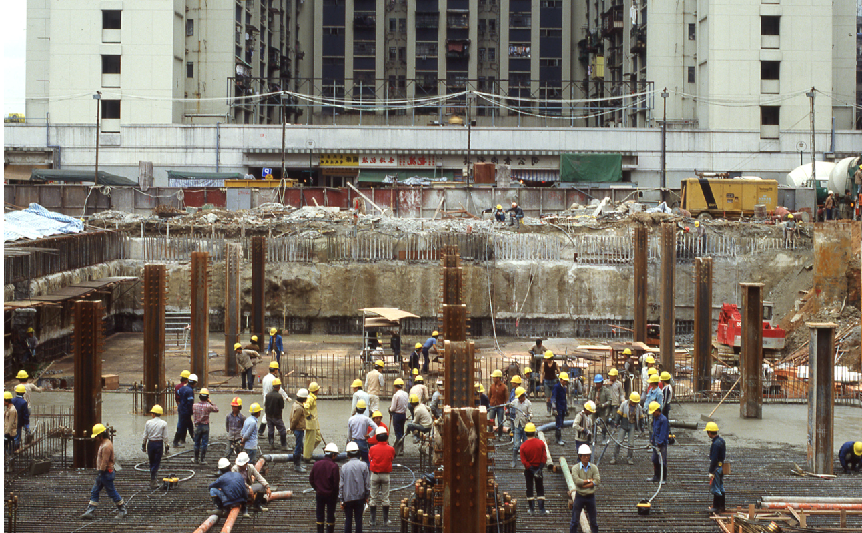
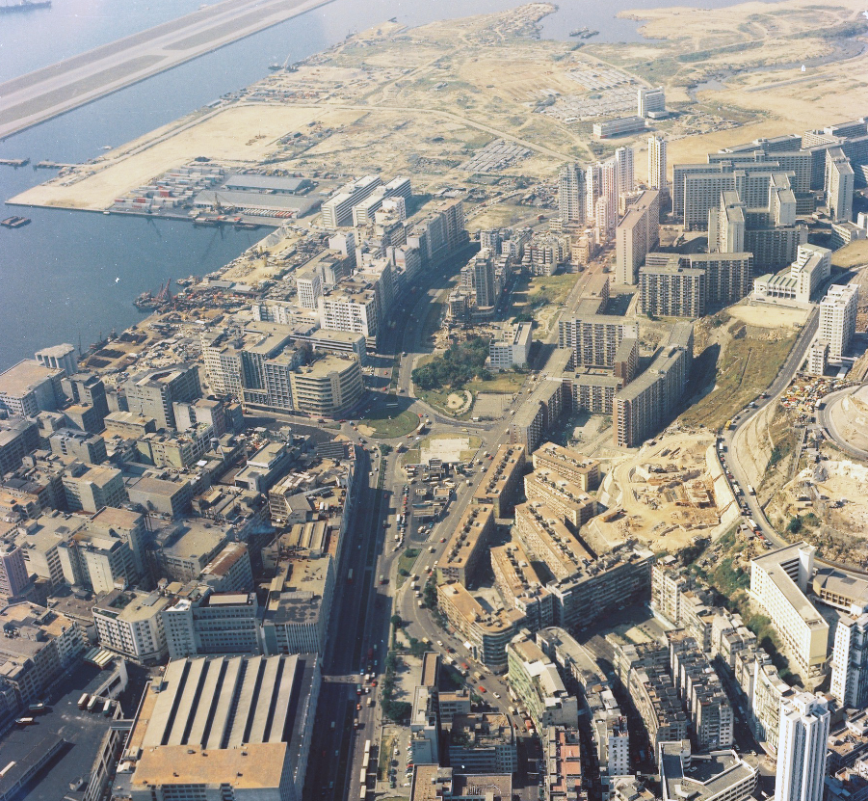
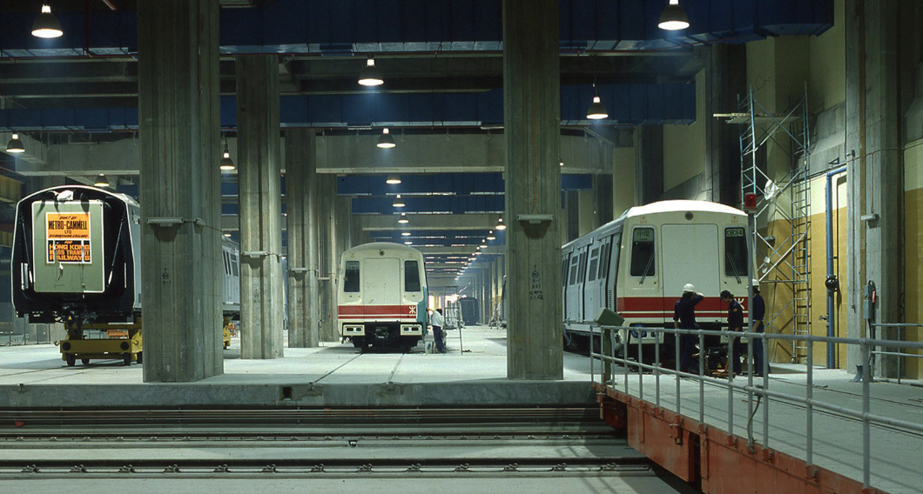


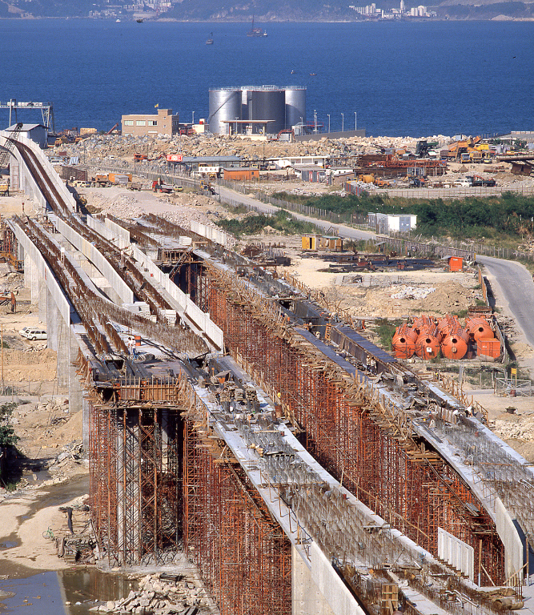
Heather Coulson Photo Collection

Slide 16
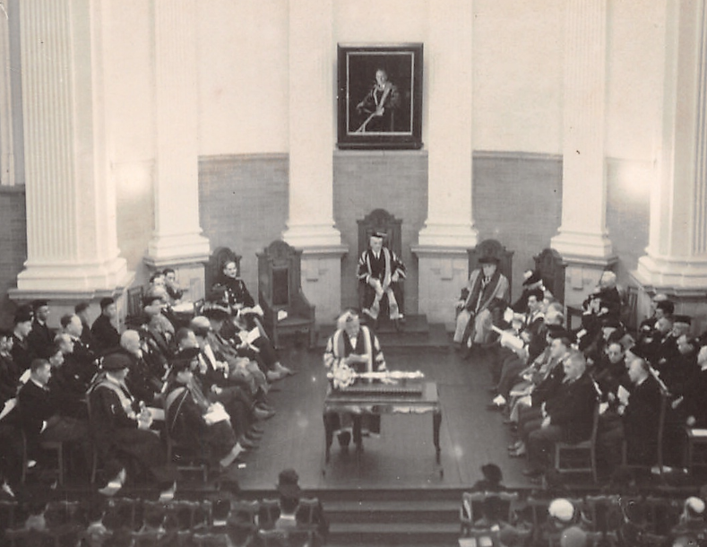
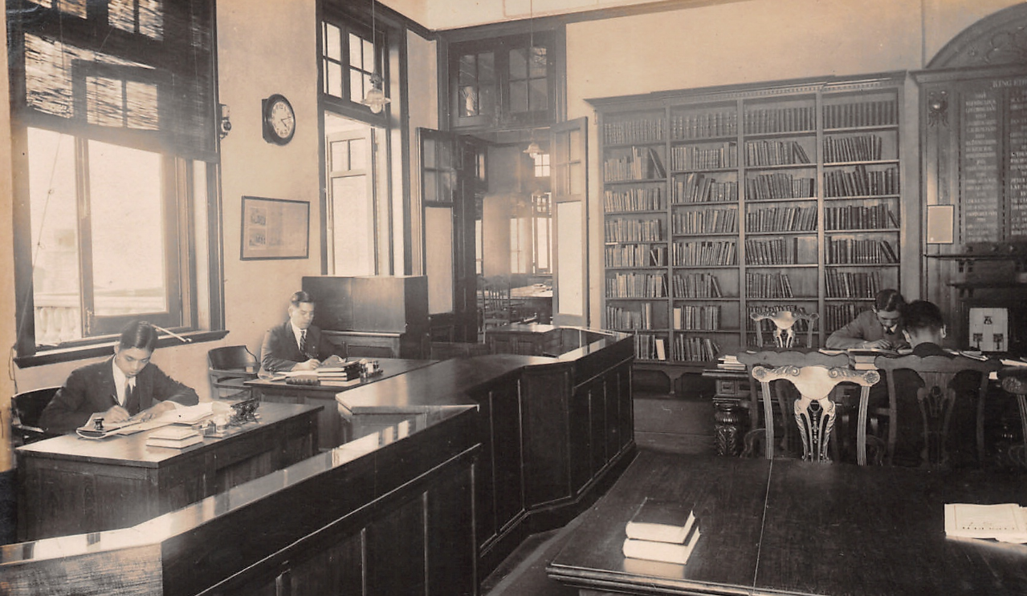
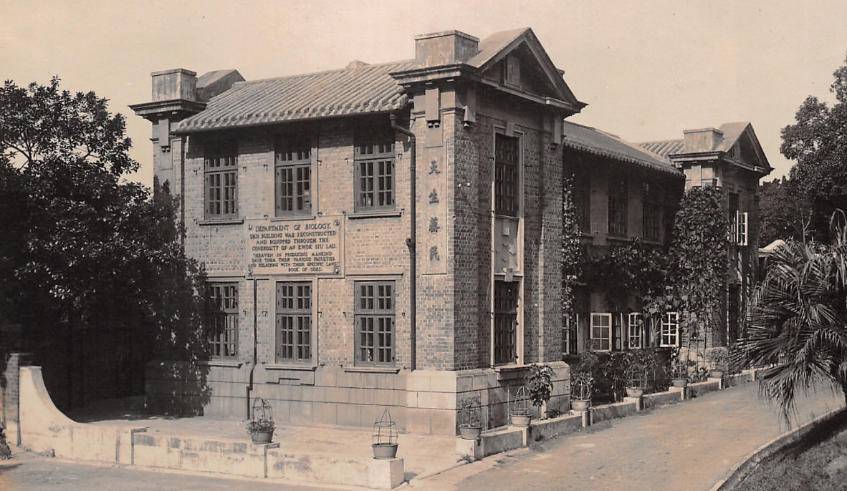
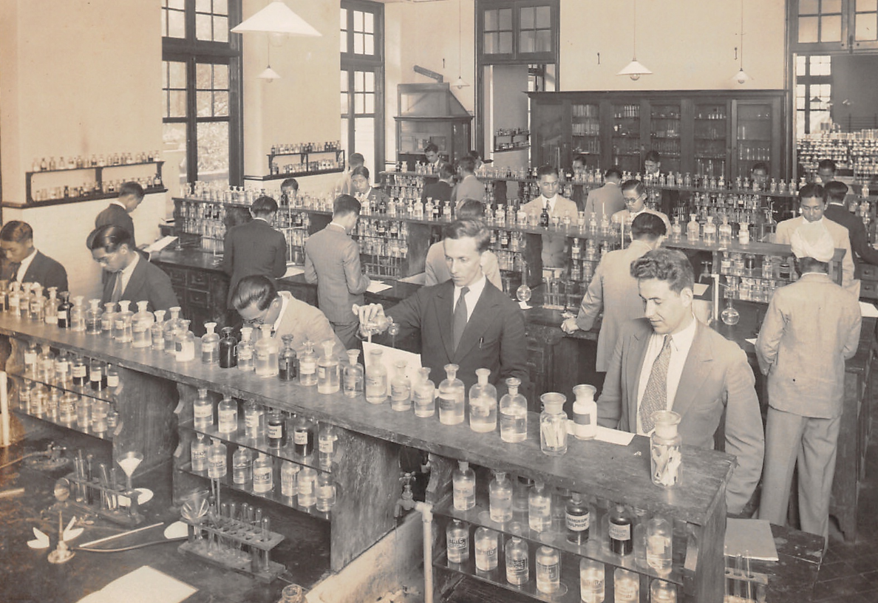
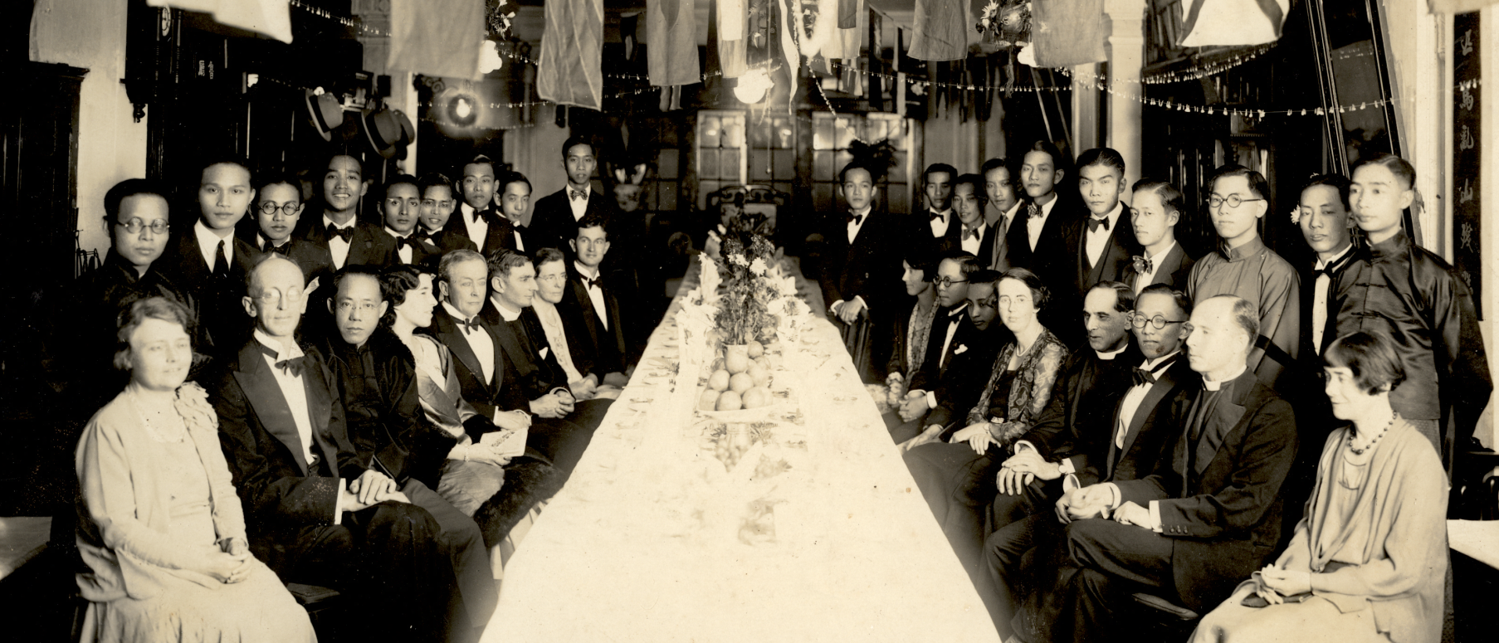
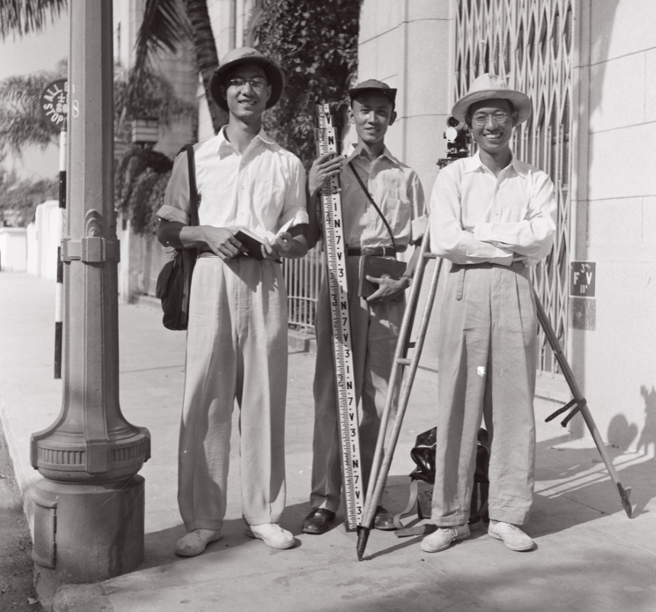
Wong Cho Tong Photo Collection

Slide 17
The rise of analytics platform

Slide 18

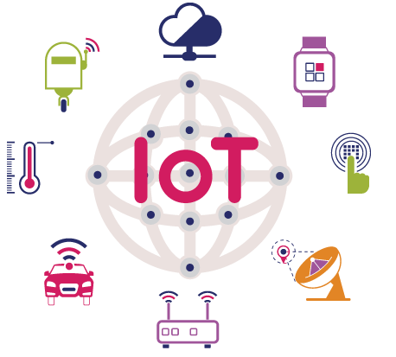
Data around us
Facilities Booking Record
EZProxy
Access Log
COUNTER
Turnstile
Access Log

Slide 19
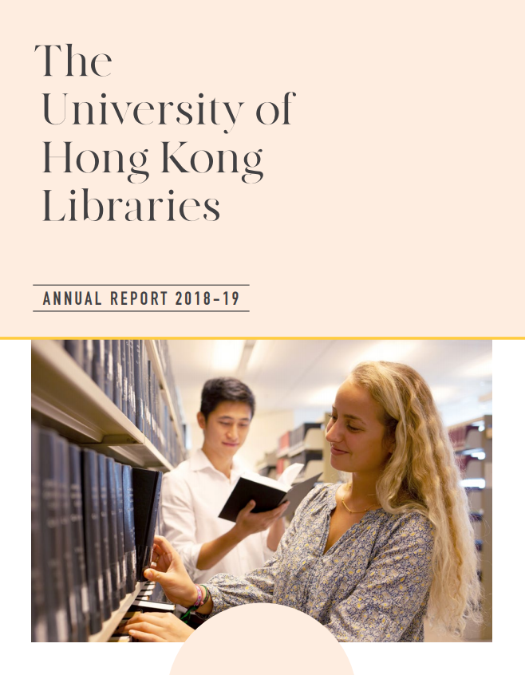

Why we need the analytics?
Improve assessment and evaluation practices

Slide 20

Why we need the analytics?
Increase the use of outcome measurement
Inform changes to library programs and services
Advocate for the value of library programs and services

Slide 21
What is our approach?
Review existing and past statistics collected by library management and divisions for reporting and assessment including key performance indicators and service standards of the Libraries.
Screen and organize analytics for different library functions through a data centric approach.
Suggest strategies for integrating the inventory into our data warehouse/business intelligence system to facilitate data archiving, analysis, visualization and other purposes such as multidimensional report building.

Slide 22
Supporting actions
Strategic planning
Workflow
Application
Organization
Leadership
Competency
Infrastructure
Visuali-zation
Sharing

Slide 23
What is “Big” Data?
“Big data is data that contains greater variety arriving in increasing volumes and with ever-higher velocity.”
— Gartner’s definition, circa 2001
“Without big data analytics, companies are blind and deaf, wandering out onto the web like deer on a freeway.”
— Geoffrey Moore, Author, “Crossing The Chasm”
What is Big Data? https://www.youtube.com/watch?v=mhe5kX10CR4

Slide 24
How to make use of “Big” Data?
Wisdom
Knowledge
Information
Data
Applied
Shows alert in double entry tracking report. Should we check his identity?
Context
A non-academic staff entered to Main Library twice within 5 minutes
Meaning
Record A: A person entered to Main Library at 8:00 a.m.
Record B: A person entered to Main Library at 8:03 a.m.
Raw
Record A: 2020-11-18 08:00, A9123456,1,"",Main Library - 2/F Turnstile 3
Record B: 2020-11-18 08:03, A9123456,1,"",Main Library - 2/F Turnstile 3
Example: Double Entry Tracking
Detect the person who enters the turnstile twice within 5 minutes

Slide 25
Journey from data to knowledge and wisdom
Capture the data in source system
Collect the data and import into datastore
Clean and shape the data
Store/Archive the data
Transform the data into our knowledge and wisdom
  Data aggregation and computation
  Connect with other data

Slide 26





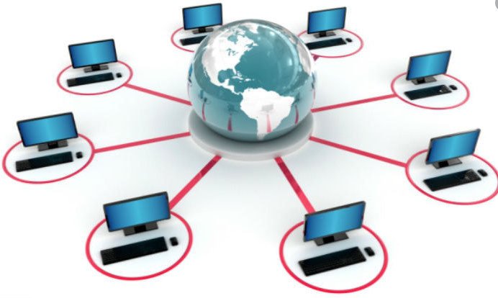

System Architecture
Data in source system
Store the data
Collect the data
Clean and shape the data
Transform the data into our knowledge and wisdom
Coordinator for visualization
Visualize the data
Distributed processing

Slide 27
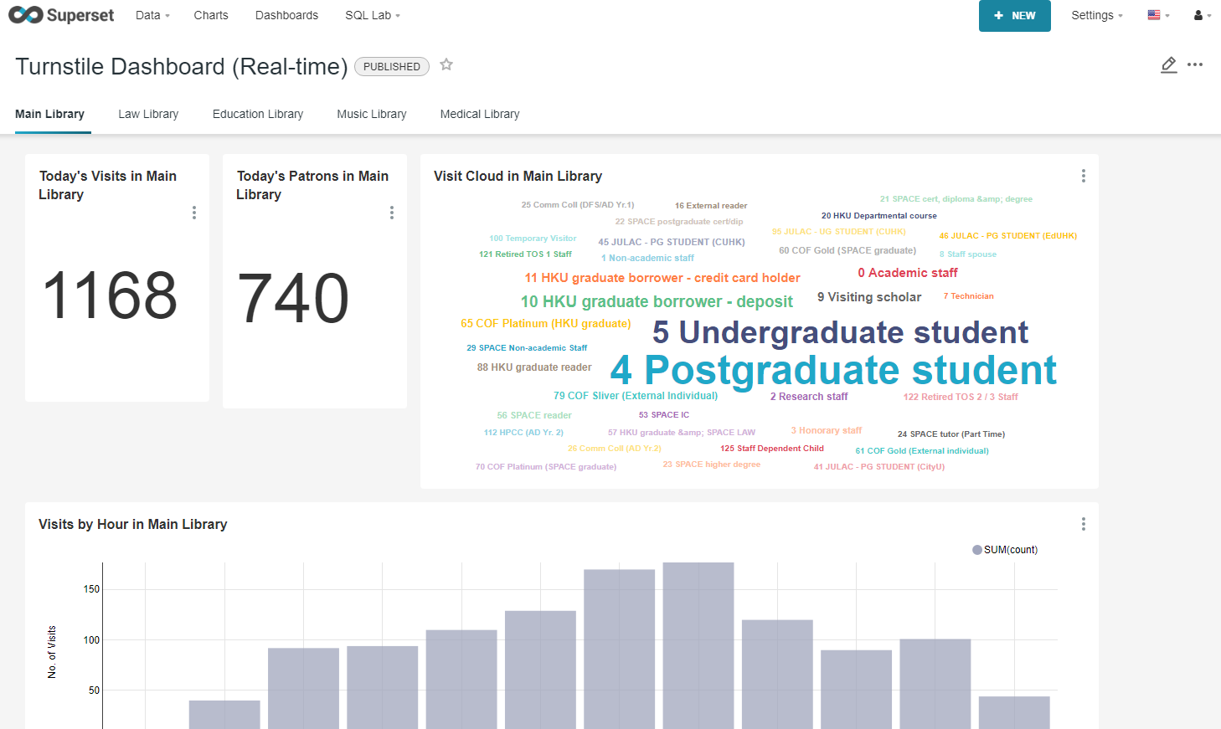
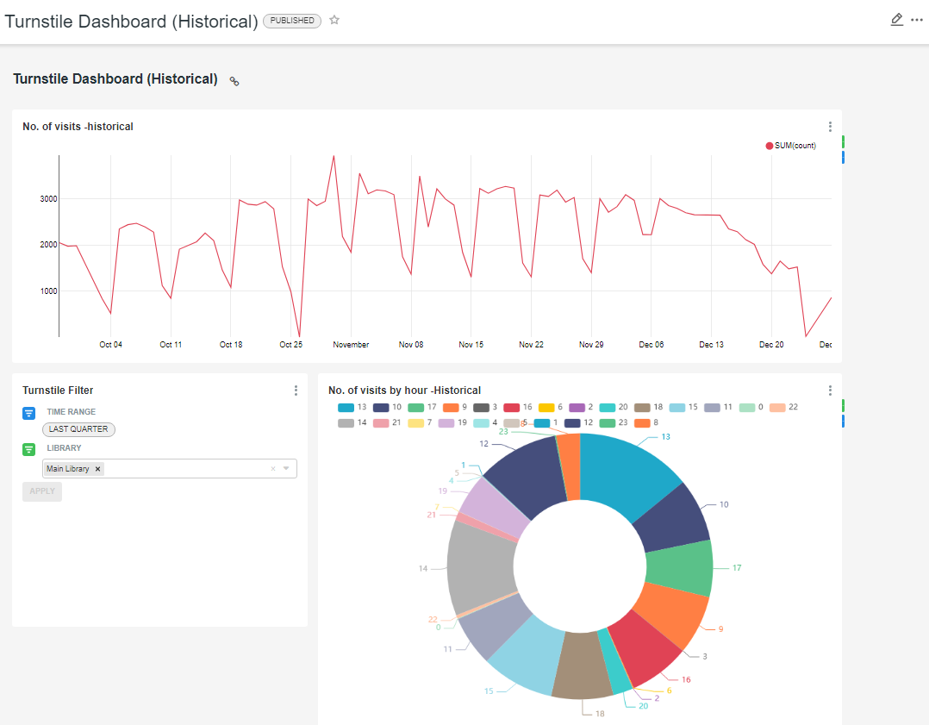
Turnstile application
Turnstile Dashboard
(Real-time/ Historical)

Slide 28
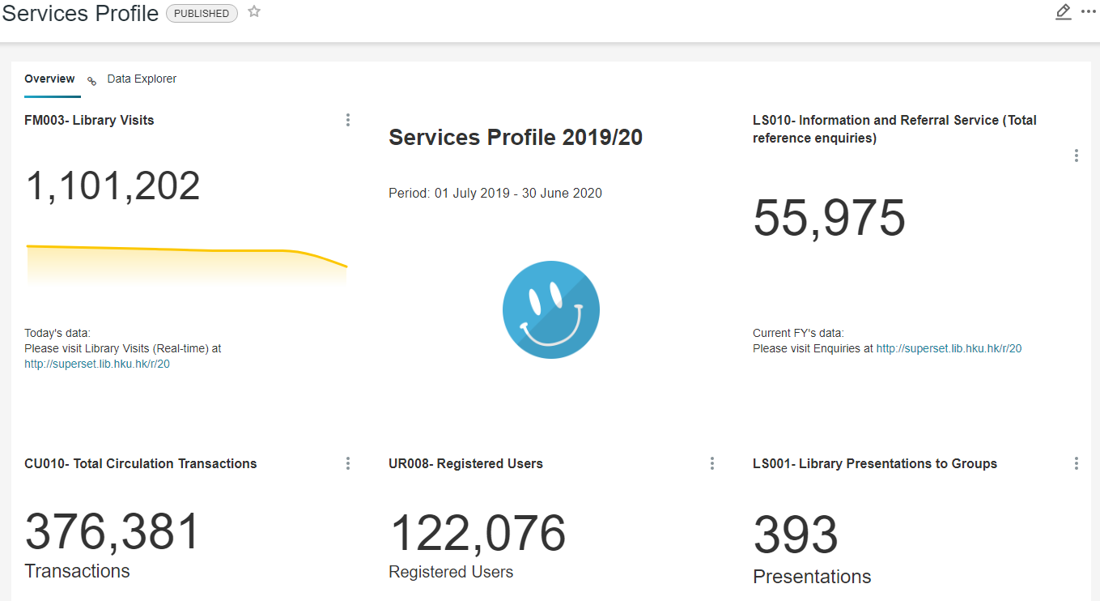
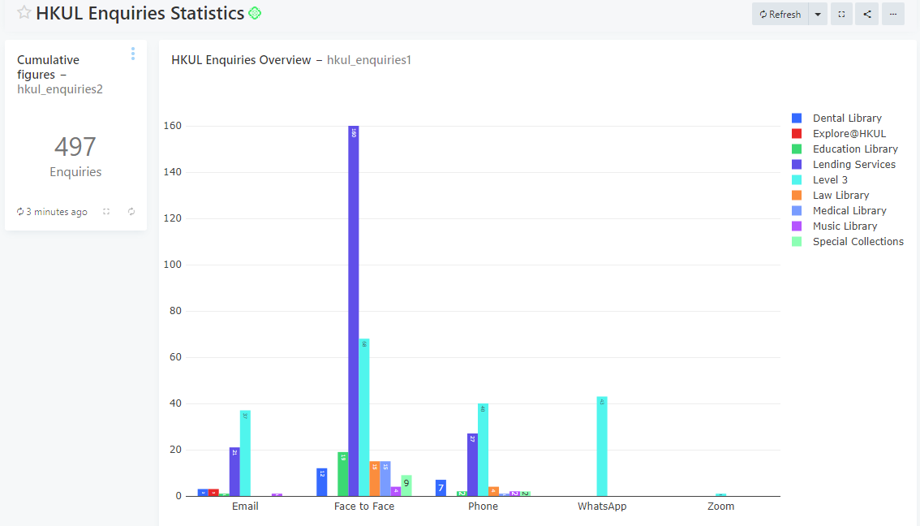
Other applications
HKUL Enquiries Statistics
Services Profile
Resource Profile
Study Place Profile
Non-counter5 Usage Statistics
Inventory Profile

Slide 29
Upcoming Challenging Applications
Full spectrum of users’ access pattern by using COUNTER5 and Ezproxy log access
Collection metrics
E-resources weeding -- decision making

Slide 30
How do we promote it?
Keep updating staff’s data literacy and knowledge about data analytics, e.g. concepts and ideas of Alma analytics.
Gather comments and suggestions from colleagues who are our ”users”
Collect and input data according to the agreed workflow of different units
Ensure accuracy and currency of data acquisition
Apply analytics in decision making and library advocacy

Slide 31
Open Scholarship
Going Open and leading to collaboration
Open scholarship encompasses open access, open data, open educational resources, and all other forms of openness in the scholarly and research environment while also changing how knowledge is created and shared. -Association of Research Libraries

Slide 32
Sharing Information & Experience
Sharing the same algorithm for data analytics on a common platform.
alleviate the effort for compiling (annual) statistics
real-time dashboard could be realized
we can response quicker

Slide 33


Working together
ezPAARSE is a free and open-source software
  Ingest proxy log files and show how users access subscribed electronic resources on publishers' websites
  Now comes with 341 parsers to recognize different platforms
    Parsers are contributed by community
Exploit the usage which does not support COUNTER statistics
  Develop new parser to support over 332 platforms
  Example: Westlaw, Hyread
https://ezpaarse-project.github.io/ezpaarse/

Slide 34
END

