Slide 1
Ingenium: New Interdisciplinary Learning Space for Innovation, Imagination, Invention and more during COVID-19
Michael Cheng
Associate Librarian, Engagement and Learning Environments
22 Jan 2021

Slide 2
New Learning Space - Ingenium
Community building – Engagement Activities
Transformation – new technologies at new learning space
New service mode during COVID-19

Slide 3

Ingenium - Introduction
Located on 2/F of the Main Library
Officially opened in Feb 2019
1,457 sq.m
Access to the Main Library - Total Entrance: 1,381,849 (2018/19)
The Ingenium derives its name from the adjective, ‘ingenious’, which evokes invention, imagination, and innovation. Located on the 2/F of the Main Library, the Ingenium is an interdisciplinary space for the University community to be inspired by and to interact with technology.

Slide 4
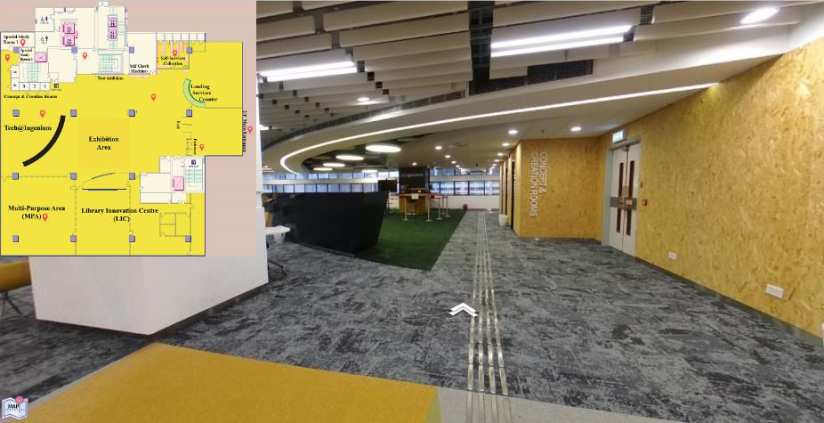
360 Tour of Ingenium
https://lib.hku.hk/360tour/2nd_Floor_A/

Slide 5
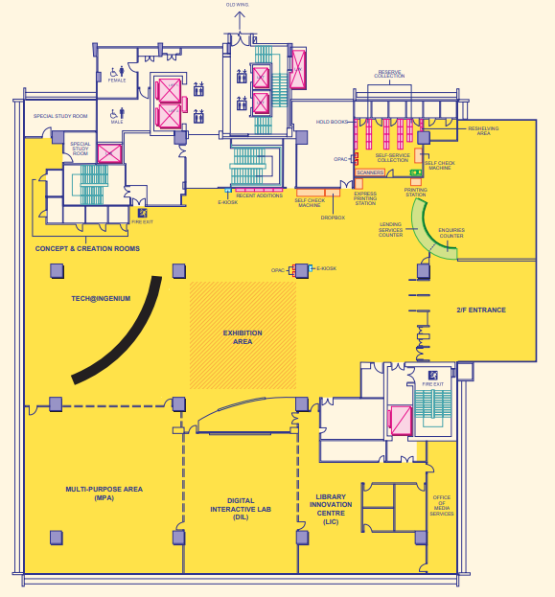
Ingenium, 2/F (New Wing) of Main Library
  Self-service collection room
  Special Study Rooms
  New Addition
  Concept & Creation Rooms
  Counters
  Exhibition and Event Space
  Tech@Ingenium: AI/VR facilities
  Library Innovation Centre (LIC): Digital Interactive Lab (DIL) etc.
  Multi-purpose Area (MPA)

Slide 6
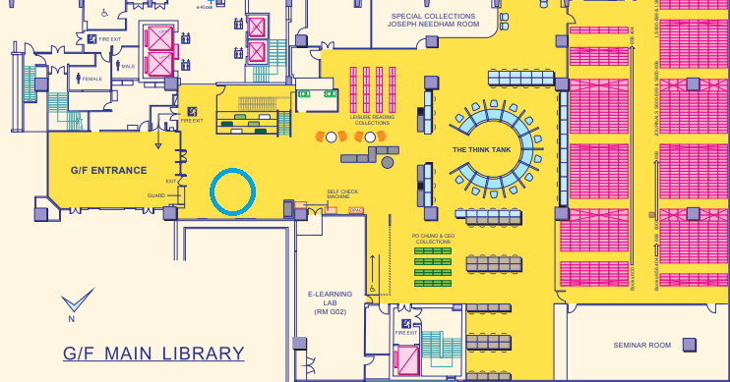
G/F, New Wing
  Joseph Needham Room
  Think Tank
  VR DOME
  Seminar room
  E-learning Lab
  Research Carrels

Slide 7
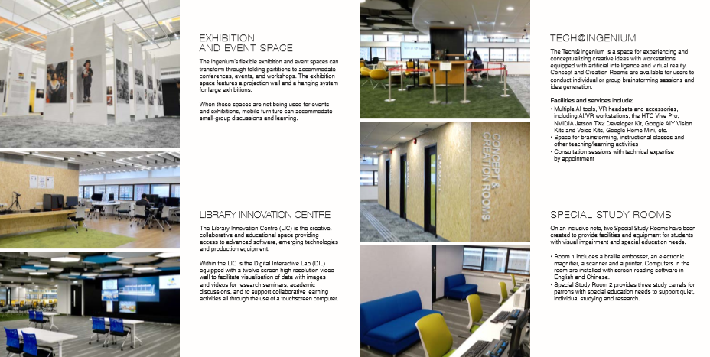
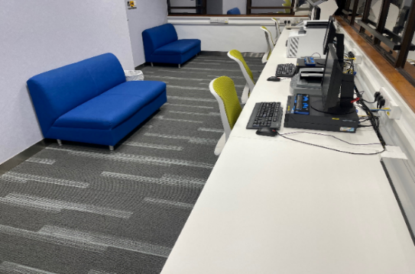
Ingenium

Slide 8
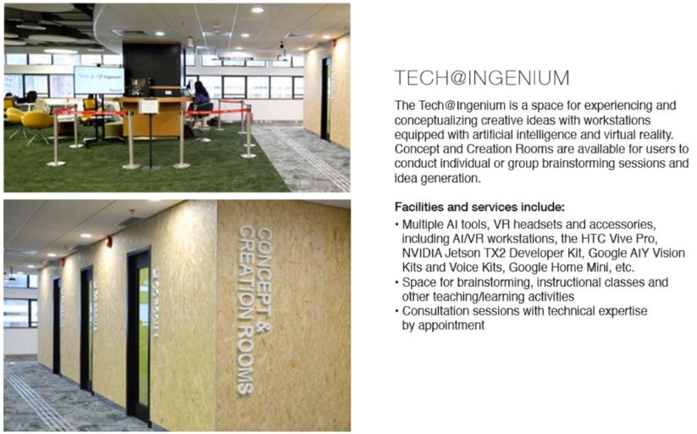
Ingenium – Tech@Ingenium

Slide 9
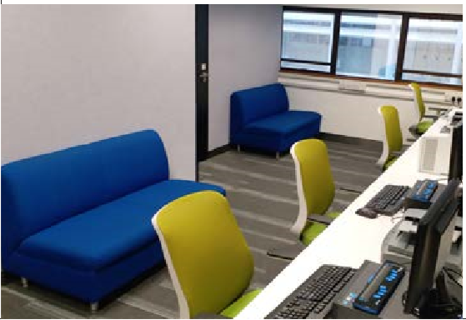
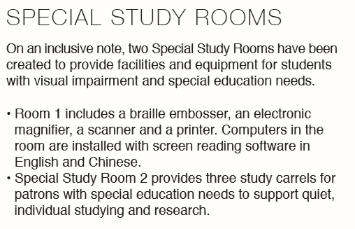
Ingenium – Special Study Rooms

Slide 10
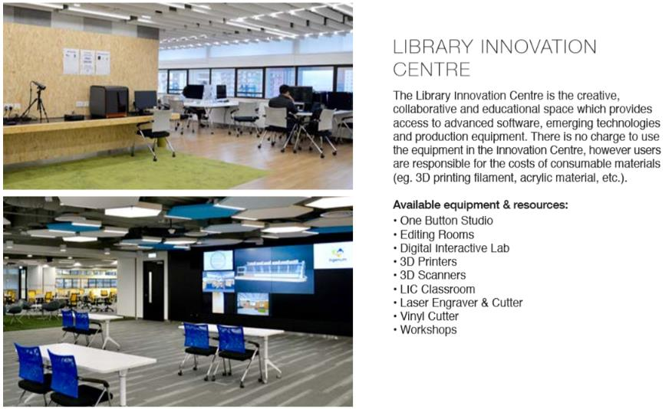
Ingenium – Library Innovation Centre

Slide 11
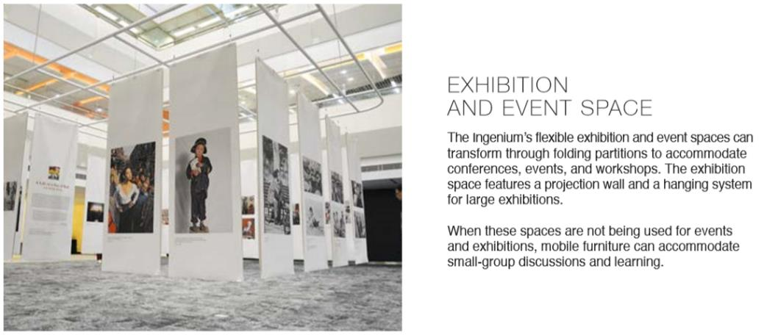
Ingenium – Exhibition and Event Space

Slide 12
New Facilities
  VR – HTC VIVE Pro/Workstations with powerful Nvidia GPU
  AI facilities – AI Lambda workstations with GPU.
  Noise cancelling headphone
  360 camera
  3D printers
  3D scanners
  Laser cutting
  Digital Interactive Lab – Large visualization wall
  Laptop/iPad lending services
  Microsoft HoloLens II
  VR Salon

Slide 13
2. Community building – Engagement Activities
"If you look at history, innovation doesn’t come just from giving people incentives; it comes from creating environments where their ideas can connect!"
by Steven Johnson
The Keynote speaker at 2019 Educause, Chicago

Slide 14
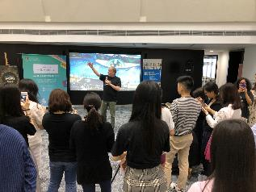
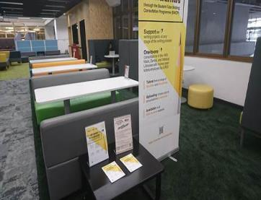
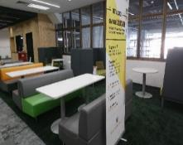
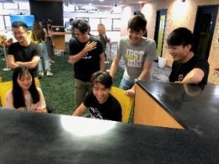
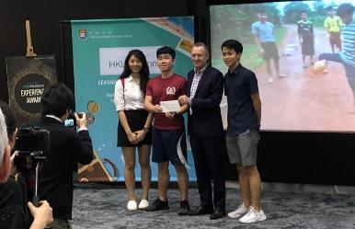
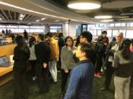
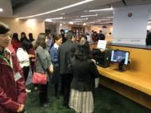
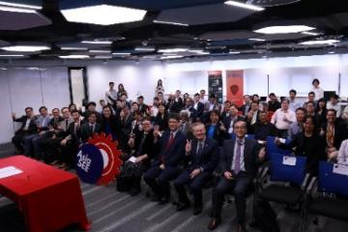
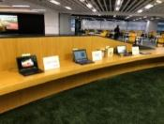
Engagement Activities
Center Applied English Studies (CAES)
Writing Centre Consultation Space
Common Core
Student Learning Festival
Centre for the Enhancement of Teaching and Learning (CETL)
Asia Symposium for Engineering Education
AI/VR Demo@
Ingenium Opening

Slide 15
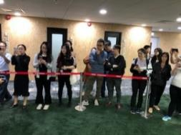
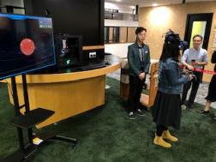
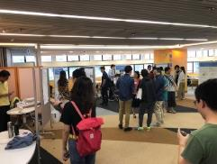
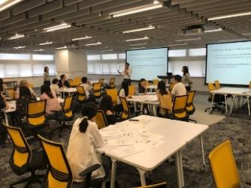
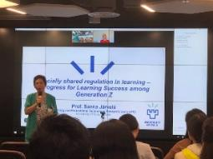
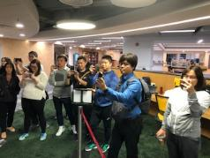
Engagement Activities
Centre for Information Technology in Education
(CITE) Research Symposium
2019
Faculty of Education
Classes
- Faculty of Education

Slide 16
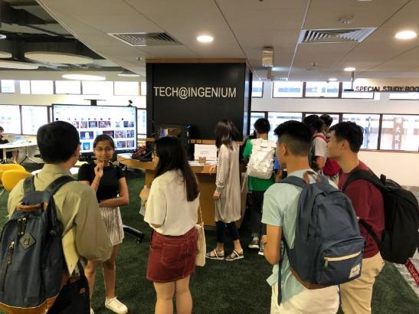
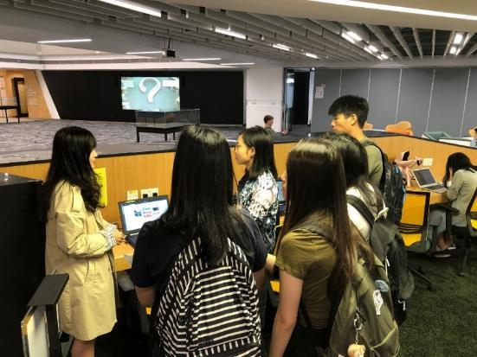
Tutorial on AI at Ingenium
Collaborate with Faculty of Science
Support on an AI Tutorial
(10 sessions – a total
about 130 UG students)
Vision Model:
  Google Smile detector
Voice Model
  Language understanding
Machine Learning on Tensorflow
The Turing Test
The VC office was taking video
for promotion

Slide 17
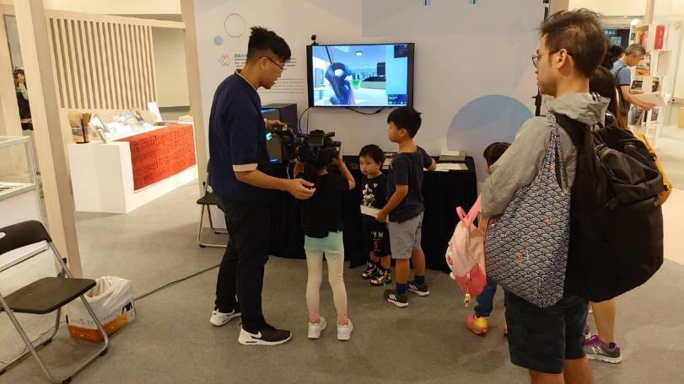
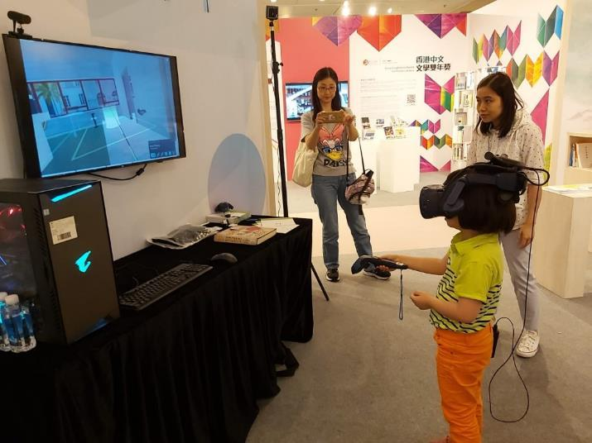
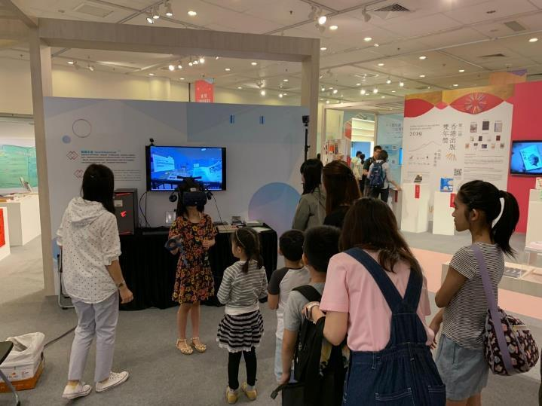
LibFest 2019 at Hong Kong Central Library
- Virtual Ingenium
Virtual VR book of “In Far Eastern Waters” published in 1936
VR Music Score of Beethoven Symphony No. 5 (1830s)
VR Grand Hall

Slide 18
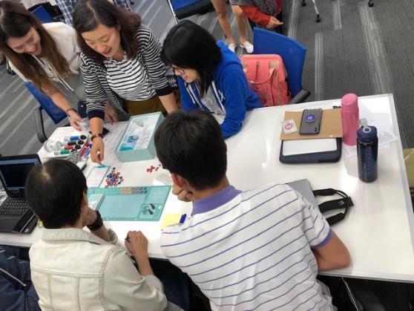
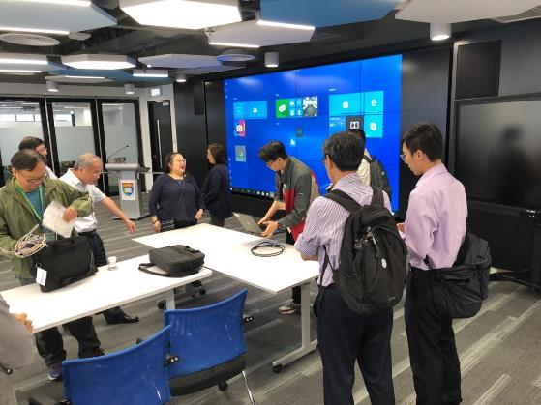
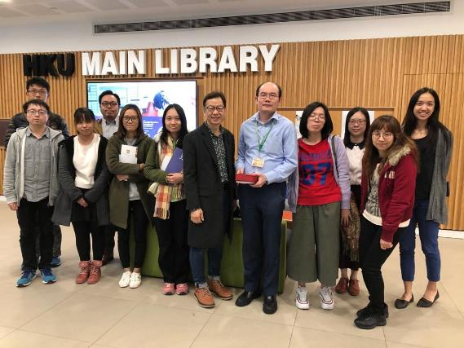
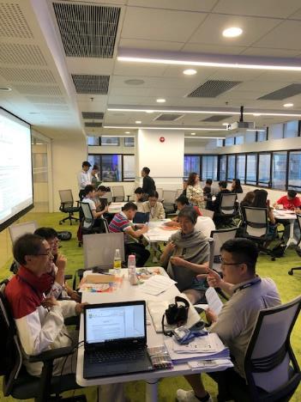
Engagement Activities
Visit of
JULAC
Inter-generational
Participatory Co-design Project
Visit of
THEi

Slide 19
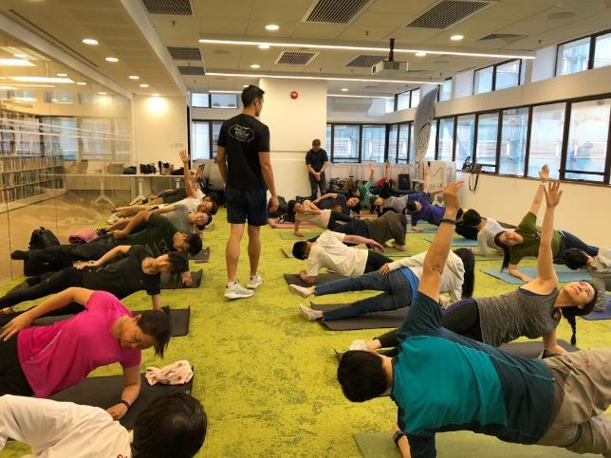
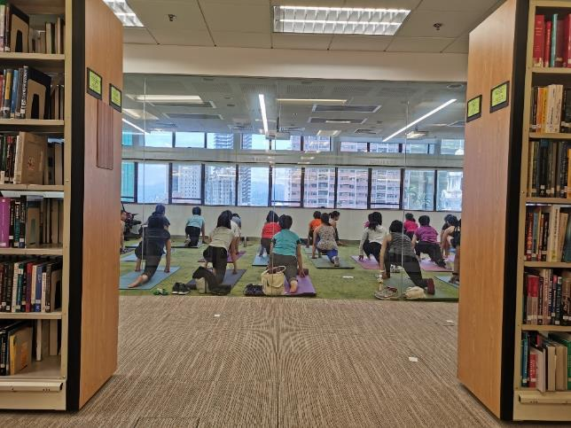
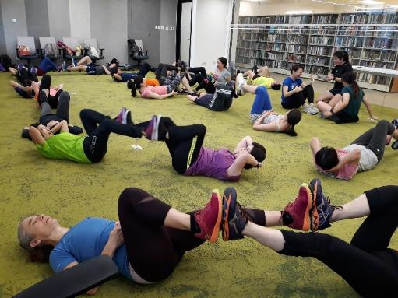
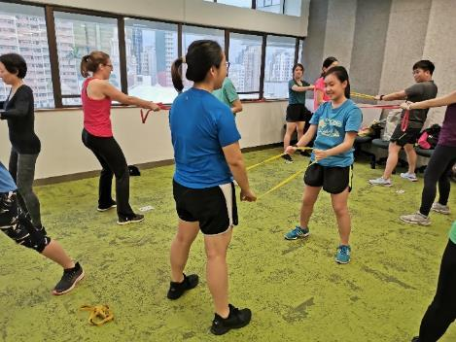
Sports activities in the Library
Collaborate with the Centre for Sports and Exercise (CSE)
109 participants (Staff/students) across 4 classes in May 2019

Slide 20
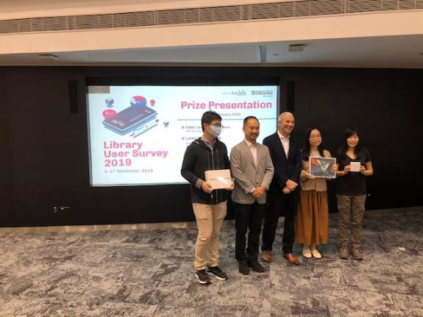
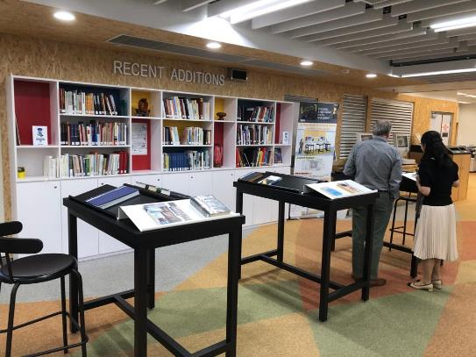
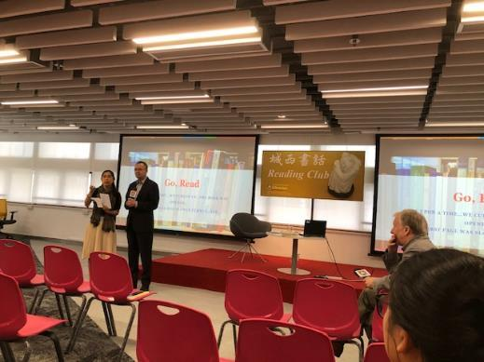
Book Talk and Prize Presentation
Recent Addition - New Book Display, Thematic Book Display, Library Survey Prize Presentation, Book Talk
Book talk “Curling Up with the Infinite” by Professor Gray Lindgren at Ingenium in October 2019

Slide 21
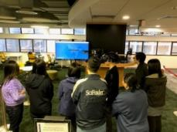
3. Transformation – new technologies at new learning space
Some colleagues (Lending services) were trained to provide technological support on events, Teaching/Learning and Research activities at new learning space
Gallery, Library, Archive and Museum (GLAM) Lab at Level 3
Training of HKU students as part-time helper/internship to support services (Computer Science, Electrical & Electronic Engineering, Mechanical Engineering)
  2 – local students, 3 – Mainland, 3 – Oversea
Internal Training

Slide 22
New Skillset/Mindset/Organisation
AI/VR instructional technological support
Zoom studio/conference support e.g. breakout sessions/registration
Engagement/collaborative attitude
Embrace emerging technologies
Assistant Librarian (Lending services & Learning Environments) is recruited
Assistant Librarian (Engagement & SEN Support) is assigned.

Slide 23
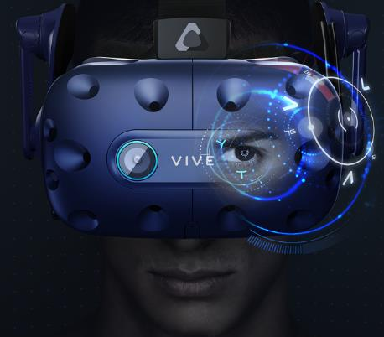
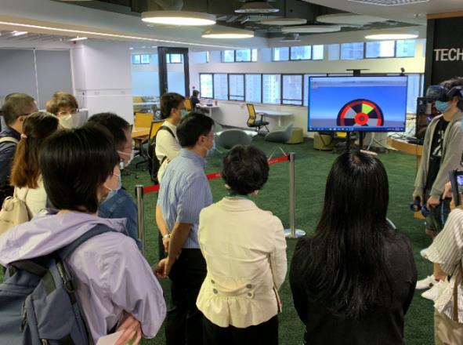
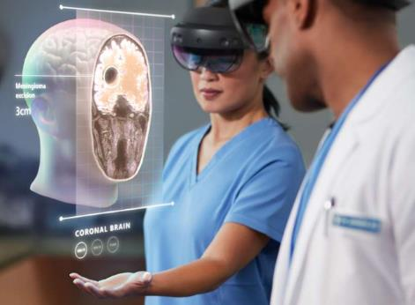
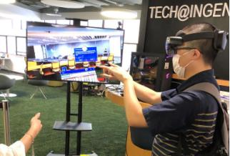
New Services…
Microsoft Hololens II (Mixed Reality)– visited by EEE eLearning Dev Lab
VR Eye tracking – visited by academic members of Department of CS, Faculty of Education
Notes:
Submitted the statistics of handled proofread requests and PIN members’ performance to CEDARS for reference and record (December 2019). No PIN members were assigned to the Libraries in the 2nd semester, due to the outbreak of COVID-19.

Slide 24
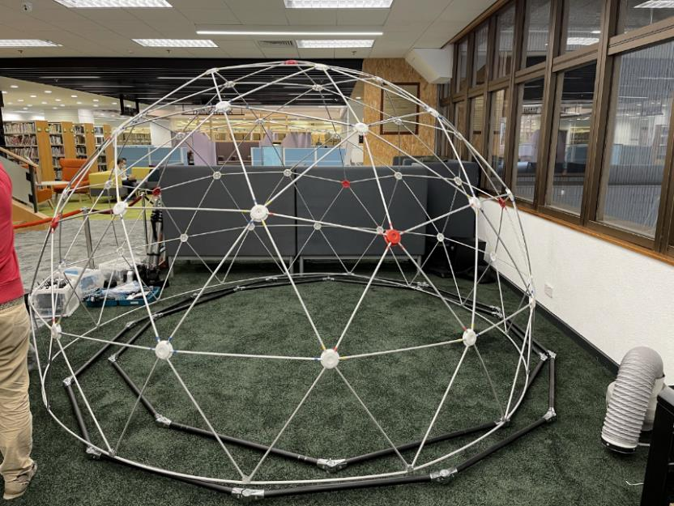
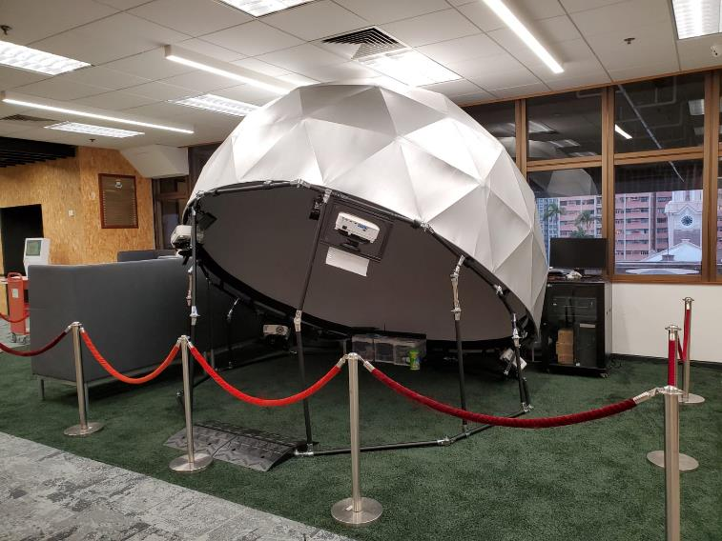
DOME - Virtual Reality
DOME placed on G/F of Main library (from the VR salon at Global Lounge by CommonCore)
To support Teaching and Learning with immersive experience without HMD

Slide 25
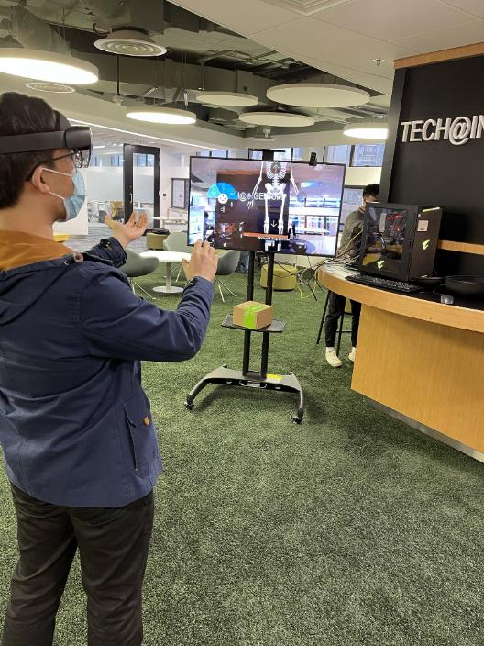
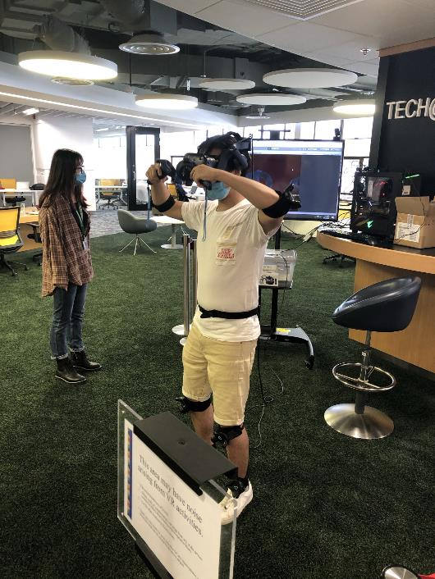
Technological support
New Project Associate learned how to operate MS HoloLens II
AI tutorials of coming CommonCore course to be delivered by Library staff in Feb 2021

Slide 26
4. New service mode during COVID-19

Slide 27


Social Distancing - Partitioning

Slide 28

Lending Services under COVID-19
Thermal Camera
IoT to count the current user at the Library
Bulk Due Dates Extension
Change of Opening hours/Services according to the HKU Task Force on infectious diseases
Access to different types of users
Registration for access
Fine Waiver
Application for special access

Slide 29



VR - Teaching and Learning
Instructional Technology
The first VR item “Inanimate Alice. Perpetual Nomads” was acquired and installed at Ingenium.
An e-learning class (MSc) about Young Literature was conducted via Zoom on 14 March 2020.

Slide 30
Research – Interdisciplinary Participatory Co-design Project (IPCP)
Teaching Development Grant (TDG) : Collaboration with Common Core, Faculty of Education, Sau Po Centre on Ageing. (Last for 18 months)
VR support on Tech@Ingenium
Facilities and space at Libraries, MPA, Tech@Ingenium, LIC, Seminar room (G/F of Main Library)
360 camera
Wristband support on the biological data of participants such as heartbeat
Planning of hardware of the motion capture and software and the trackers – Tai Chi
Sharing about some AI solution of pose estimation
Video recording of the events and Tai Chi practice
https://www.campus.ageing.hku.hk/commoncore

Slide 31



Research – Interdisciplinary Participatory Co-design Project (IPCP)
Motion capture of Tai Chi movement
by using motion trackers in Apr-Jun 2020

Slide 32
Impact of IPCP
Webinar and workshop to share with University academic staff about the future teaching and learning practices and support by Libraries on 18 Jan. A seminar on the theme of Curriculum Innovation through Intergenerational Participatory Co-Design will be conducted, jointly with Common Core.
The team plans to submit papers and presentation proposals to regional and international conferences to further disseminate findings of this project.
Potential CommonCore courses adopting the topic
Many collaborations with Faculty of Education, CETL, CommonCore e.g. SDG workshop, CITERS
Another potential TDG project on eXtended Reality (XR)
Research data on DataHub: Promote DataHub of the Libraries

Slide 33

Dream Chamber@Tam Wing Fun Engineering Innovation Wing
A collaboration with Engineering Faculty
Provide selected Library items to the Chamber
Provide support to the kiosk display of Library resources
“…I like particularly the Dream Chamber in the Innovation Wing, as daring to dream and having the courage to face failure is key in research breakthrough and innovation.” HKU President Professor Xiang Zhang said at the Ceremony.

Slide 34

Zoom Media Conference – an exhibition of Hong Kong Historical Photos from the Frank Fischbeck Collection
On 10 Dec 2020, a zoom conference was held at LIC of the Ingenium of the Main Library

Slide 35

Zoom Workshop: Teaching by Design for the
U.N. Sustainable Development Goals (SDGs)
On 7 Nov 2020, the zoom conference was organized and the studio was held at the Multi-purpose Area (MPA)
Co-organized by HKU Libraries, HKU Common Core, HKU Sustainability Office, HKUST The Division of Integrative Systems and Design (ISD), HKU Business School, Encompass HK, Knowledge Dialogues etc.
About 50 participants joined the workshops.
Breakout sessions were used.
https://lib.hku.hk/teachbydesign/sdg2020.html

Slide 36

Mixed Reality (MR) – Teaching & Learning
A Library staff was demonstrating MR during a class at Library
She was playing the virtual piano
Peer technical support by HKU students

Slide 37

Student Internship of HKU
Usability tests on web, services and facilities by undergraduate/postgraduate students of Faculty of Education
Data science/Visualization project using Tensor-flow and KNIME by undergraduate students of Data Science.

Slide 38


Annual Planning Day 2020 - Zoom
In March 2020, over 100 library staff joined zoom meeting and we had the control at the DIL.
Over 100 staff participated in the
annual planning day.

Slide 39
References/Acknowledgements
HTC VIVE website
Microsoft HoloLens
HKU Libraries websites
360 Tour by Media Services of HKU Libraries
https://www.librarianshipstudies.com/2018/05/quotes-libraries-librarians-library-information-science.html
https://lib.hku.hk/360tour/Second_Floor/

Slide 40
Thank you!

