Slide 1
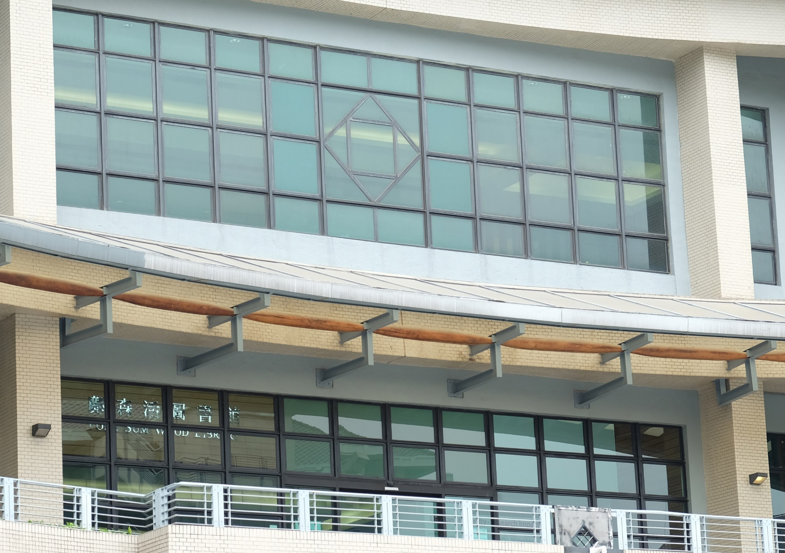


2021 JULAC Libraries Forum
Working towards a
FAIR-Research Information Management System (RIMS) at Lingnan University
Sheila CHEUNG
Lingnan University Library
21 January 2021

Slide 2









RIMS@Lingnan
Lingnan University's scholarly portal to capture all research-related information including research outputs, grants, projects, awards, and the impact of these scholarly activities produced by our renowned scholars. It serves as the gateway to support the University's mission to promote excellent research, to explore Lingnan's cutting-edge scholarly works via open access to the research outputs, and to foster collaboration with the wider community across all disciplines.
https://scholars.ln.edu.hk/
Implemented in 2018
Launched since Jan 2019
Externally
- RAE 2020 Submission
- CDCF Reporting
- UGC OA Policy Consultation
- Professional Accreditation
Data Scope
Stakeholders
Researcher Profile
Prizes / Awards
CIO Office
IT (Technical Setup & Support)
LIB (Research Outputs & Metadata for all)
Research Office (Projects & Grants / Prizes)
Finance Office (Grants-related)
Human Resources Office (Researchers Profiles)
Public Affairs (Press Media + Impacts)
Internally
- Performance Review
- Research Impact Services
Research Outputs
Press / Media
Now
Projects / Grants
Impacts
Research Activities

Slide 3
RIMS
FAIR-
RIMS
Research Information Management
[an adapted version]
“The aggregation, curation, and utilization of metadata about research activities and outputs”
Metadata in RIM context is only useful when being integrated and contextualized to become valuable information to provide insights and support informed-decisions for research development.
1
Metadata is the Key
a complex ecosystem with heterogeneous mixture of stakeholders
F
Findable
Rich metadata descriptions
Unique headings for name entries with identifiers
Common searchable interface
FAIR
Data Principles
A
Accessible
“a set of guidelines to improve the Findability, Accessibility, Interoperability, & Reusability of digital assets”
Data retrievable with identifiers or other common access points
Researchers / Stakeholders to access / retrieve data by roles through authentication
2
Good data management & stewardship is NOT a Goal…, but a Pre-Condition supporting knowledge discovery and innovation.
I
Interoperable
Use formal, accessible, shared and broadly applicable language for knowledge representation
Data of related research activities can be cross-referenced
1
Bryant, Rebecca, Anna Clements, Carol Feltes, David Groenewegen, Simon Huggard, Holly Mercer, Roxanne Missingham, Maliaca Oxnam, Anne Rauh and John Wright. 2017. Research Information Management: Defining RIM and the Library’s Role. Dublin, OH: OCLC Research. https://doi.org/10.25333/C3NK88
R
Reusable
Described with plurality of accurate and relevant attributes / entities
Data can be selected and actionable by human / machines based upon prescribed criteria
2
Wilkinson, M., Dumontier, M., Aalbersberg, I. et al. The FAIR Guiding Principles for scientific data management and stewardship. Sci Data 3, 160018 (2016). https://doi.org/10.1038/sdata.2016.18
3

Slide 4
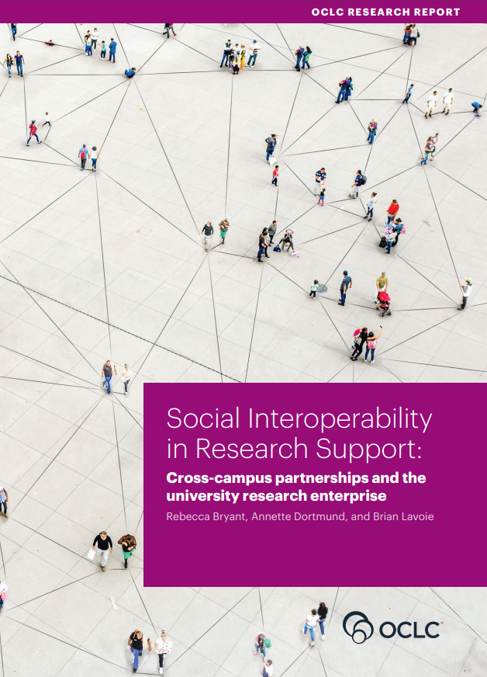
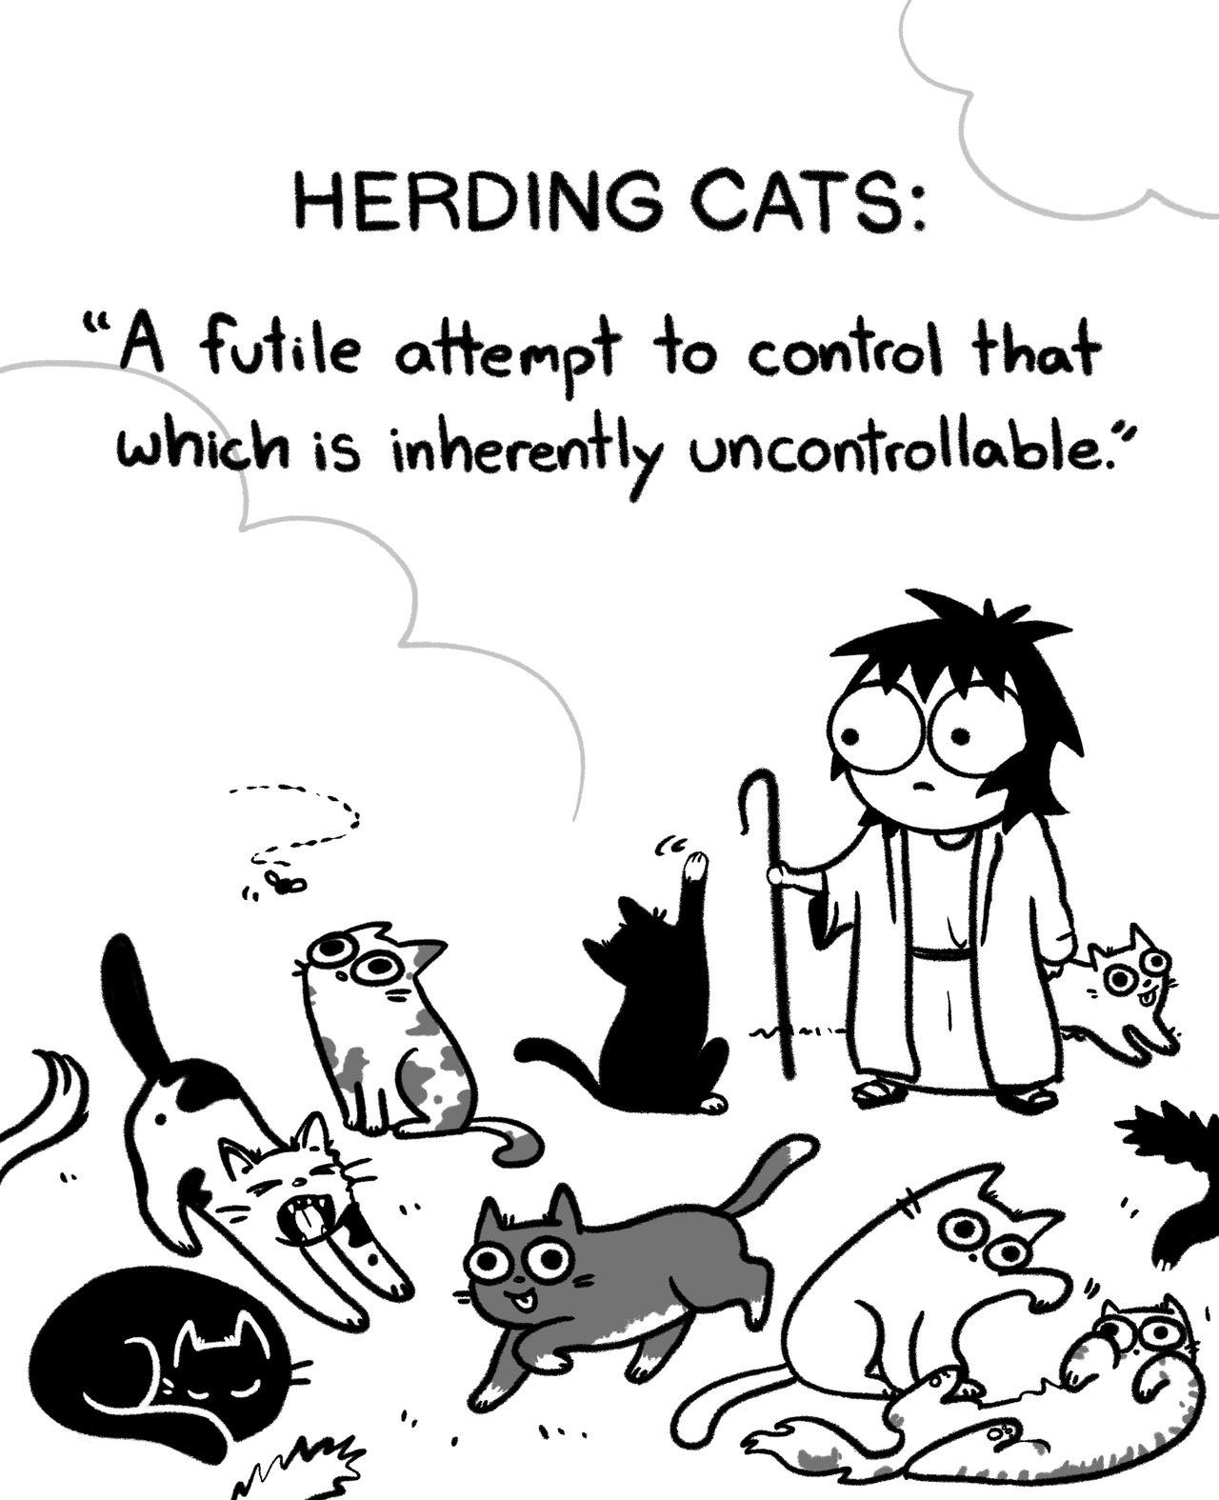
Quoted from Librarians:
“implementing a campus-wide research information system feels like Herding Flaming Cats…”
Bryant Rebecca. Research Support is an Enterprise Activity. The Scholarly Kitchen 7 Oct 2020.
https://scholarlykitchen.sspnet.org/2020/10/07/guest-post-research-support-is-an-enterprise-activity/
Bryant, Rebecca, Annette Dortmund, and Brian Lavoie. 2020. Social Interoperability in Research Support: Cross-Campus Partnerships and the University Research Enterprise. Dublin, OH: OCLC Research. https://doi.org/10.25333/wyrd-n586
RIMS
FAIR-
Metadata Handling
- One-off integration of heterogeneous sources of data
- Forward planning – good practices of RIM-metadata management
Paradigm Shift among RIM-Stakeholders
RIM :
Incremental
shared responsibilities
cooperation among stakeholders
Image courtesy of [Herding Cats Facebook]

Slide 5




Pre-RIM Data @ Lingnan
eCV
Project Management System (PMS)
Press Media Record
(List)
Digital Commons
System Nature | In-house built | In-house built | NA [Microsoft Word Doc / Excel] | Open Repository (bePress)
System Owner | [No one claimed this] | Research Office | Public Affairs | Library
Data Scope | Publications Projects / Grants Press / Media Other Activities [Basically Everything] | Projects / Grants data (Only those with Lingnan researchers as Principal Investigator) | News coverage relevant to Lingnan University | Scholarly Publications
Data Source | Researchers – Self-Entry | Research Office + Finance Office (Funding details) | Public Affairs | Library
Accessibility | Researchers (individual profile) HR (performance review) IT (system admin / data extraction) | Research Office IT (system admin / data extraction) | Public Affairs | Library User-Depts (Admin rights assigned per series)
Searchable Public Interface | ✗ | ✗ | ✗ | ✓
Data Validation | ✗ | ✓ | ✓ | ✓
Data Elements | Except Lingnan Researchers (Persons) – data synchronized from University’s Central Admin Databases, other were mostly free-text entries. |  | Free-text entries | Fields mapped to Dublin Core elements Controlled List for Persons (Literally)

Slide 6


Common European Research Information Format (CERIF)
Conceptual data model describing Research domain
Linkage
Link Entities
c
Library
Result + 2nd Level Entities
Publications
(LIB)
Projects & Grants
(Research Office)
Press & Media
(Public Affairs)
Activities
Stakeholders + Researchers
Core Entities
Persons
LU Researchers
External Collaborators
Organizations
LU Organizational Structure
External Organizations
Journals
IT + Library

Slide 7

Name Entries – with Authority Control concepts
Core Entities (Master Files) –
established & controlled by IT + LIB
Other Stakeholders
Name Entries from their Legacy are accurate and comprehensive, though with these common VARIANCES
Persons
Organizations
Chan Tai Man David
Chan T. M.
David Chan
Dept. of Economics, Lingnan University
Lingnan University, Department of Economics, 8 Castle Peak Road, N.T., Hong Kong
UGC
University Grant Committee
LU Researchers
LU Organizations
Embedded with Attributes to facilitate reporting or other routine operation
Sync (LU-Central)
Stanford University
Standford University
External Collaborators
External Institutes
Create
Sync (SciVal)
Non-Lib Stakeholders : Create Entries ONLY
Library : monitor and maintain uniqueness
Entries not originated from their legacy - all SKEPTICAL
Comprehensiveness
Reliability
QUERIES e.g. Can Lingnan Scholars tell how many external collaborators are from California, US
Research Activities and Collaborative Networks of individual researcher to be Findable under his/her unique profile
Claimed the Legacy could tell
Expect answer express only with Yes / No
RIM-Stakeholders can be COMPETING with diverse perspectives against research process and custodial priorities
“
JISC, Imperial College and Elsevier (Aug 2010). Research Information Management: Developing tools to inform the management of research and translating existing good practice
https://spiral.imperial.ac.uk/bitstream/10044/1/9024/1/Imperial%20College%20Research%20Information%20Management.pdf

Slide 8
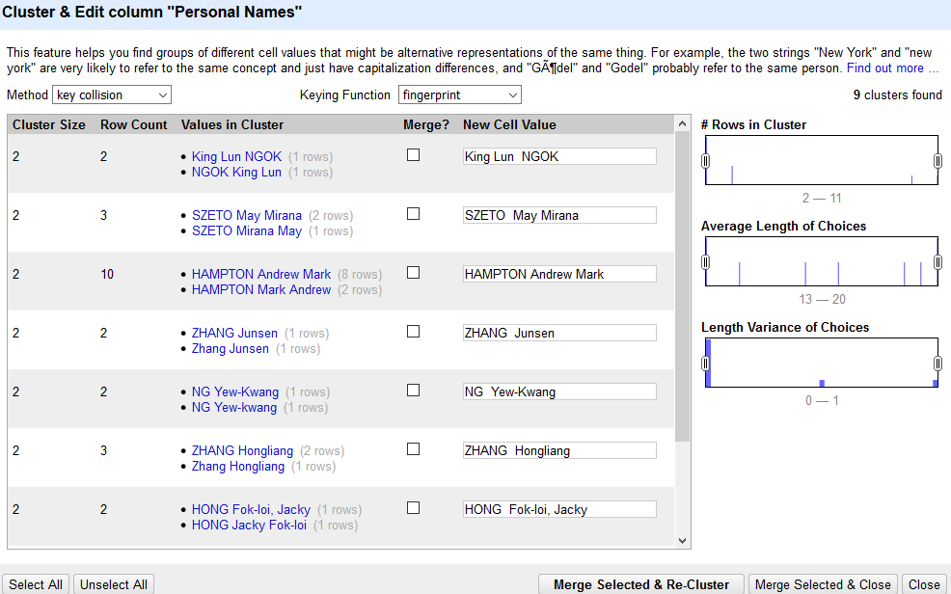
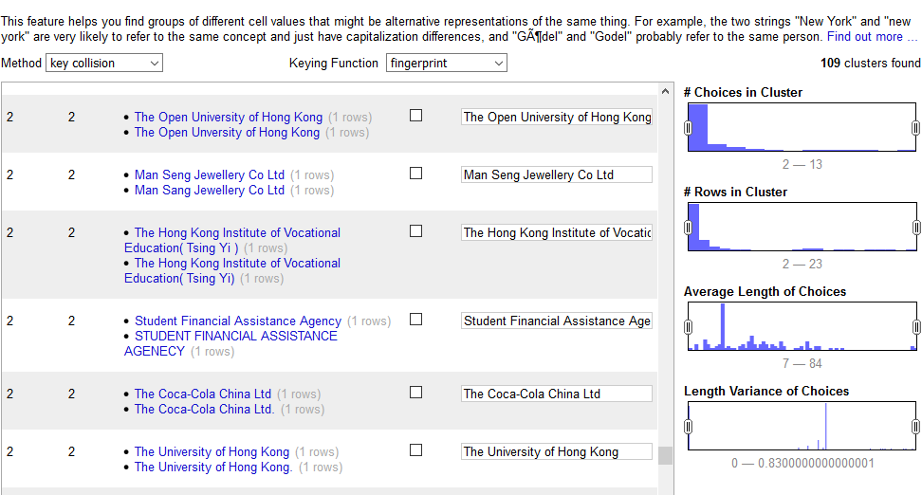
Name Entries – with Authority Control concepts
Result Entities –
Normalization with OpenRefine
Core Entities –
Map with Core Entities
Chan Tai Man David
LU-Researchers
Persons
CORE
Chan T. M.
Chan Tai Man David
David Chan
Dept. of Economics, Lingnan University
LU-Organizations
CORE
Lingnan University, Department of Economics, 8 Castle Tuen Mun
Department of Economics
Organizations
External-Organizations
UGC
CORE
University Grant Committee (HKSAR)
University Grant Committee
External-Organizations
Standford University
CORE
Stanford University
Stanford University

Slide 9

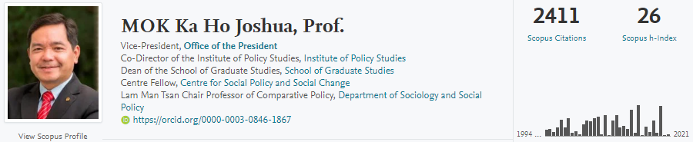
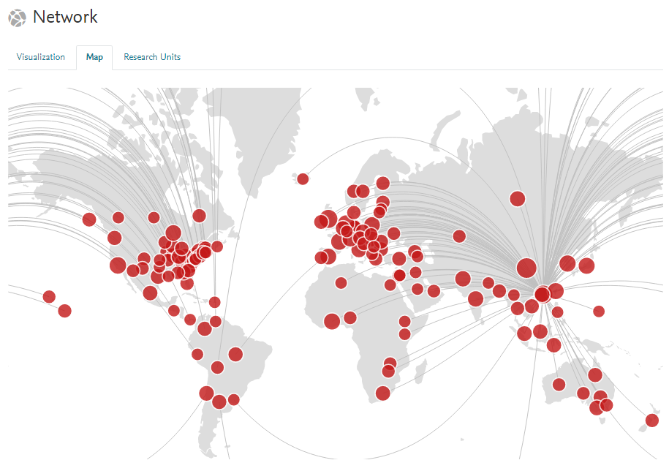
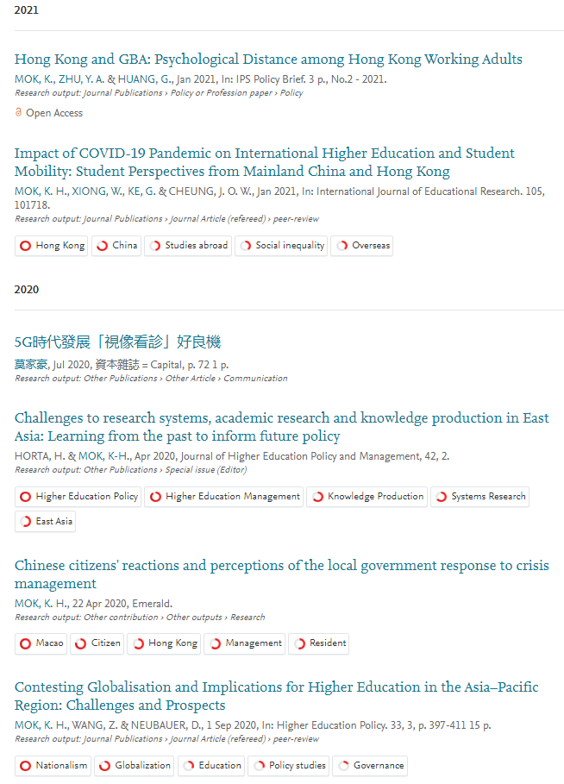
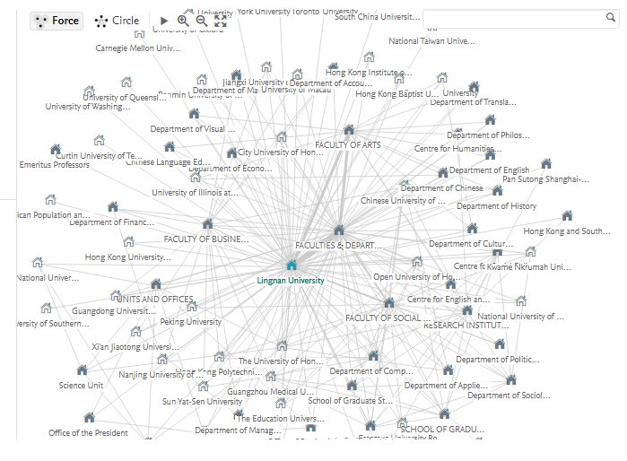
F
indable
Research Activities all held under his designated profile
Common searchable interface
A
ccessible
Researcher / His Trusted Staff / Authorized Stakeholders can access or extract data from Admin interface

Slide 10
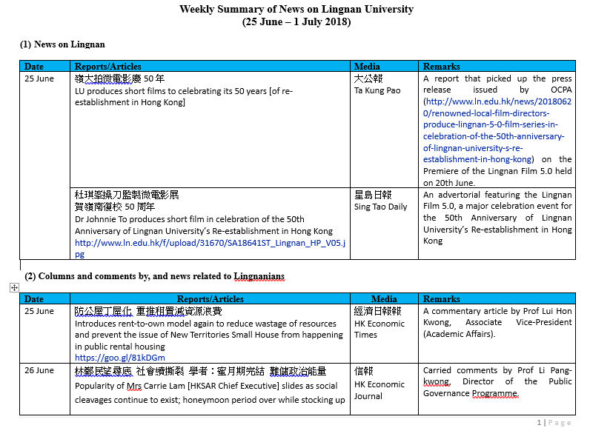
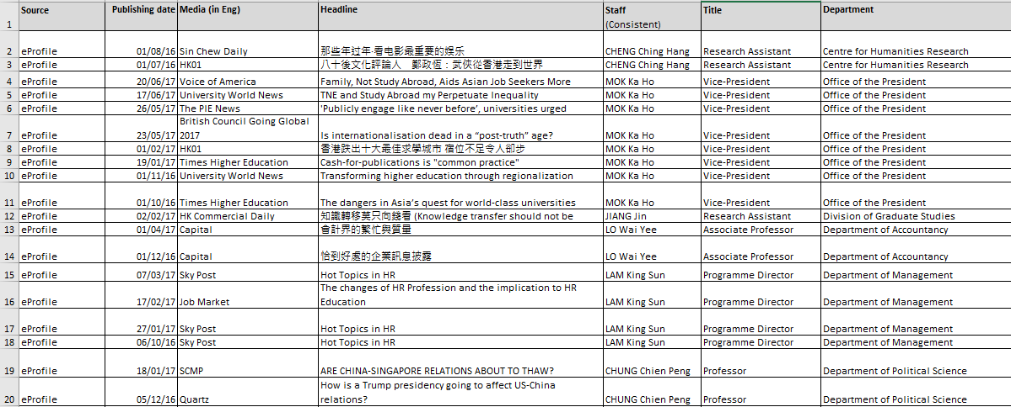



Schematic Mapping – Press & Media data
Data Conditions –
Doc – Weekly Digest to be sent for all members within LU
Excel – Statistical purpose (sort & count)
Came with limited data fields
Stakeholder – Public Affairs
Data = Collect & Count
Like Consumables, not intended for reuse / repurpose

Slide 11
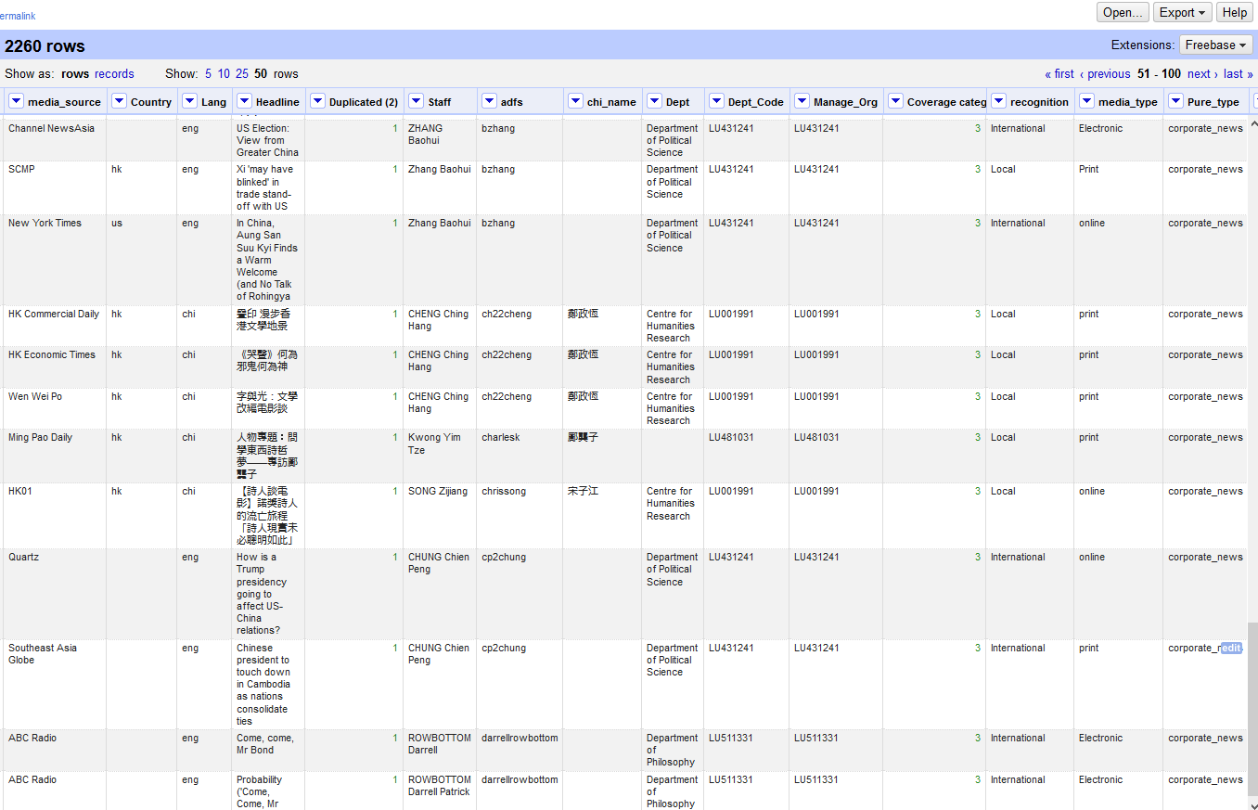
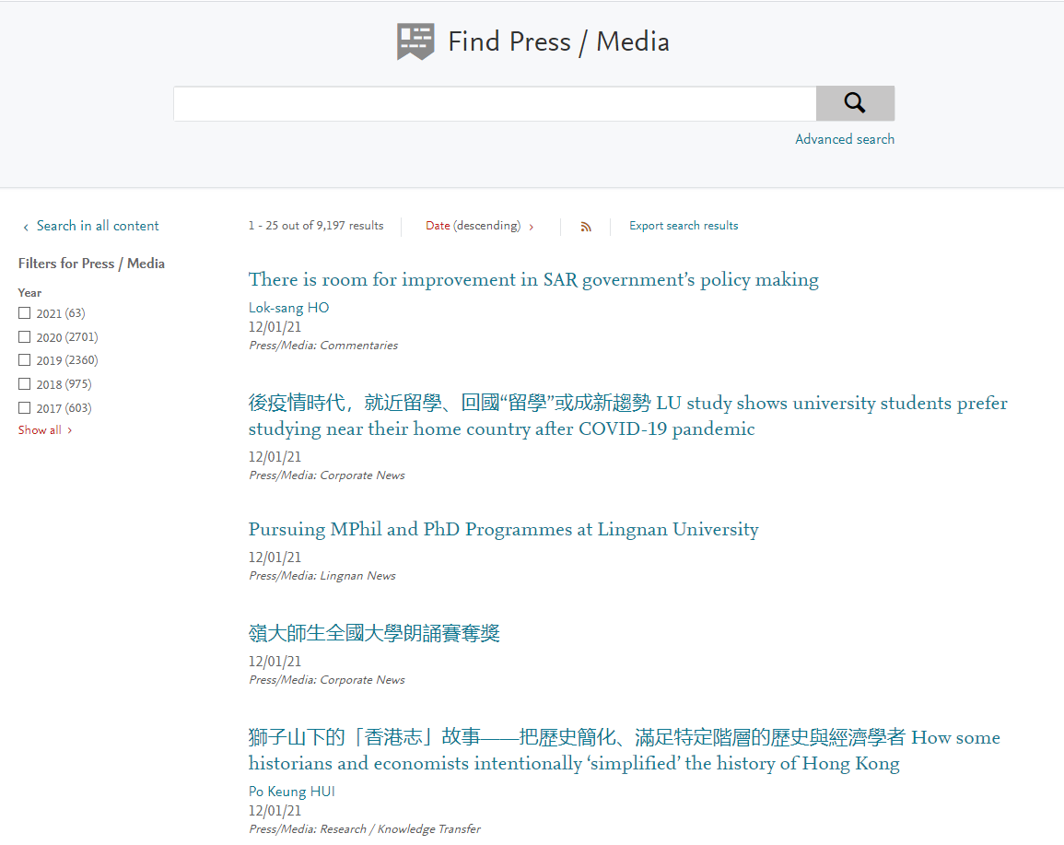
Schematic Mapping – Press & Media data
Working Together with Stakeholder
Study previous statistical reports
Derive new and more detailed Press & Media category skeleton in Lingnan Scholars
Map existing data against new skeleton upon migration
Remediated data with OpenRefine
Derive new fields based on specific data pattern / criteria, e.g. Lang. source of origins
Transit Workflow
No More Doc | Excel | Weekly Digest
Data collation, reporting, other routines, all performed in Lingnan Scholars
Rights grant for staff with need to derive statistics for Press / Media data via Admin Interface
F
indable
All Press / Media data became Findable, Browsable via Public Portal

Slide 12

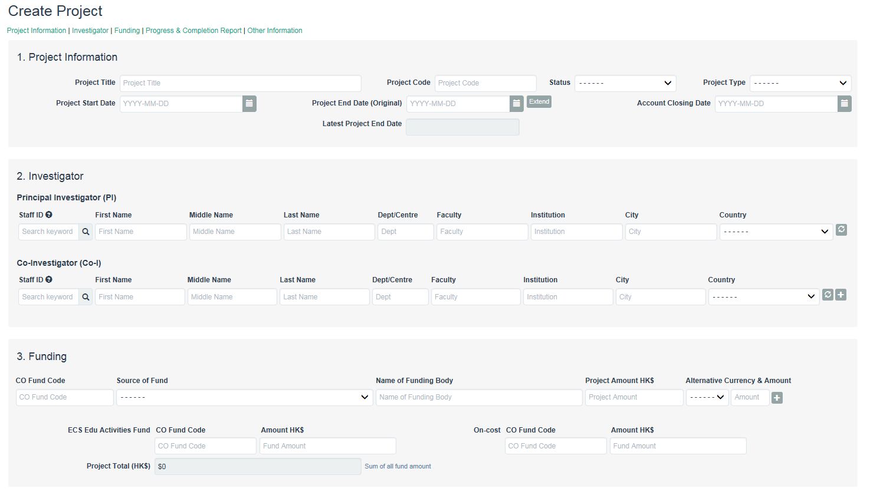

Schematic Mapping – Projects & Grants
$$\$$$
Project Management System (PMS)
Based upon requirements raised by Research Office (RO)
Each Function & Feature tied up with a specific routine performed by RO / as reporting fields (CDCF / UAA)
Highly Manual System, with fields were manually controlled by RO staff, not dependent on / related to other embedded features
Both system & data were restricted within RO

Slide 13


Schematic Mapping – Projects & Grants
$$\$$$
Metadata | Operation
Fall outside Library’s Remit
Data Fields in Project Management Context
Not field-to-field mapping
LIB to mediate the migration plan with RO
IT was involved to handle data migration across PMS and Lingnan Scholars
Funding
Funding Bodies
Funding Sources
Funding Scheme
> Confidentiality
> Public Display
Project Lifecycle
Awarded Date
Expected Start / End Date
Actual Start / End Date
Delay
Migration and Integration Mysteries
> Project Status
Stakeholders Reaction (RO)
Project Milestones
Progress Report
Completion Report
Delay / Curtailed
When having PMS (Legacy)
> Action Taken / Follow Up
> Alert
With RIMS
Not-so-satisfied with PMS
(Continual Criticisms over IT services)
Praised PMS
How RO Colleagues Interact with Data
Expected to have “Identical” functions in Lingnan Scholars
Daily Operation
Facet/Groups
Grievance against PMS’s Deficiencies
Reporting / Statistics
Types / Format
Criteria
Frequency
One-Click Syndrome
Tasks involve 2 or more clicks – mean too much
un-FAIR
FAIR (all within RO ONLY) > Misconceptions

Slide 14




F
A
I
R
Fixing Misconceptions
within Own Remit
Sense of Openness
Data Scope
Data ≠ Magic
Keep the data within their office
Resist to accept data need to go public via Portal ; what they entered reflected what users would see
Intended to control the pubic display every single fields
Handled mainly data / records fall within their administrative remit
CERIF Multiple Language Entities – abstracts, non-English titles, other descriptive details basically NOT existed (not needed in reporting)
Non-LU Projects – NOT existed [RO manages only projects with LU researchers = Principal Investigators (PI)]
Obtain Data / Reports simply by raising requests to IT (+ Lib)
Expect IT can interpret and handle all data requirements
Expect CDCF reports to be generated in 1-Click with all data and formatting requirements fulfilled
Users need to find and view the data
Researchers need them as their FULL profile
Data handling is Incremental
No Pain No Gain!

Slide 15


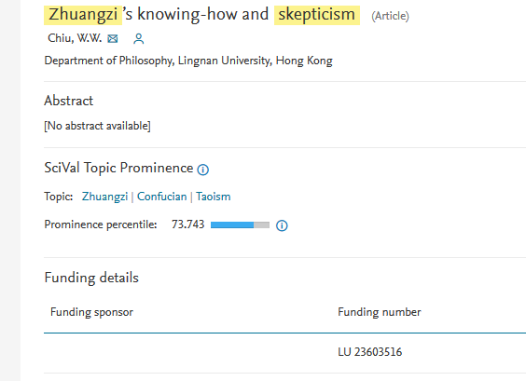
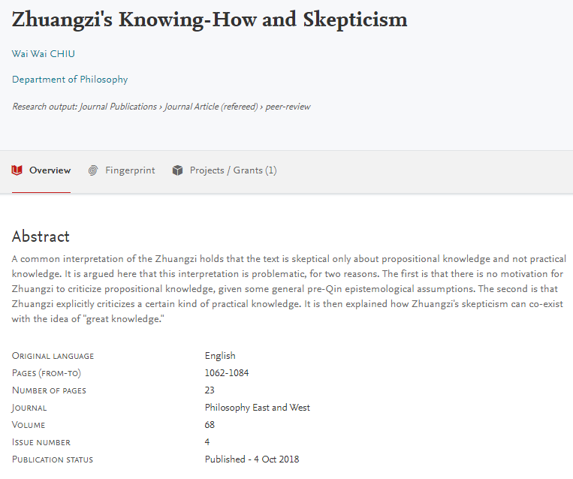
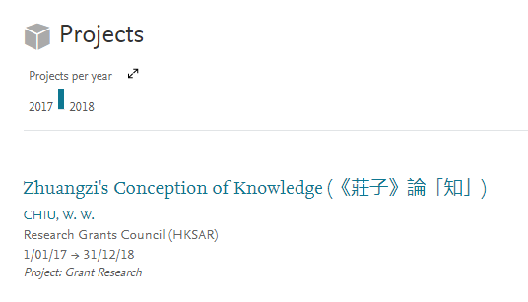

I
nteroperable
Cross-referencing Projects with Publications
$$\$$$
Taking Funding number from Scopus, mapped against Publications
Link up Funding Project with Funded Publications (though not with big success)
Until UGC Open Access Policy Consultation – requesting statistics of UGC-Project Funded Publications with OA …..
RO utilized that linkage to help compiling part of their responses
Get involved to validate linkage
Share Updates / Reports with details related to Publications with Library

Slide 16
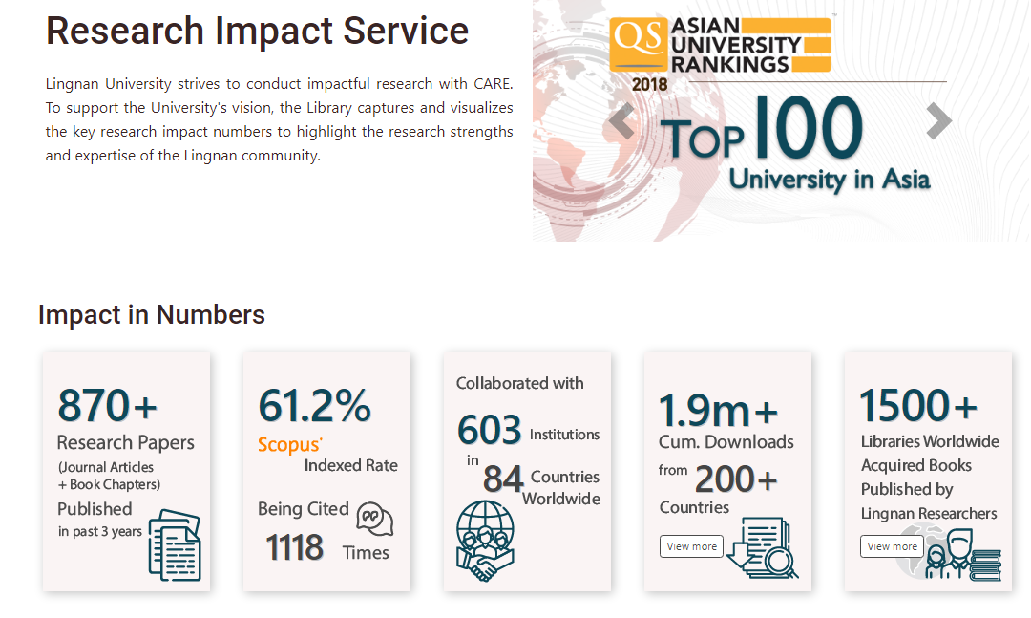
R
eusable
RAE2020
Reporting / Statistics
Selection Workflow Embedded with Lingnan Scholars (Publications + Impact)
Data Synchronized to Submission system via API
UGC Reports / Statistics
- Common Data Collection Format (CDCF)
- University Accountability Agreement
Association to Advance Collegiate Schools of Business (AACSB) Accreditation
Library’s Experimental Attempts
Make use of Lingnan Scholars data
Research Impact Showcase
https://www.library.ln.edu.hk/en/research/measure/impact

Slide 17

FAIR-
RIMS
…a long way to go
What We need?
Strong Force to control the uncontrollable
- a person (with authority)
- Mandates / Policy
- Top-down support
Stakeholders’ Trust & Cooperation
Sense of Openness across the University
Right Timing
Thank You!
Sheila Cheung
sheila@LN.edu.hk
Librarian (my reflection) in RIM …
~ is not the one to herd cats, but one of those cats to be herded…
~ go beyond my own remit…

